Slide 1
Quantum Hall Effect
Final Presentation • Physics 108
Gene Liu
David Saykin
Cameron Wagner
Gayathri Ganesan

Slide 2
Contents
Motivating our Work (1 minute)
Quick Summary of what we wanted to see and why
Sample Preparation (4 minutes)
Stacking
E-beam lithography
Sample Mount (2 minutes)
PCB
Mounting Piece
Wire Bonding
Electronic Setup and Testing (3)
Wiring + Conductivity
Lockin/Magnet stuff + Equipment checking
Code writing + DAQ tests
Electrostatic Discharge (1)
A cautionary tale…
Cooling Down (2)
Nitrogen
Helium
Sadness
Thanks (1 minute)

Slide 3
Contents
Setting up the Experiment
Motivating our Work
Sample preparation
Sample Mount
Running the Experiment
Electronics Setup + Testing
Electrostatic discharge
Cooling Down

Slide 4
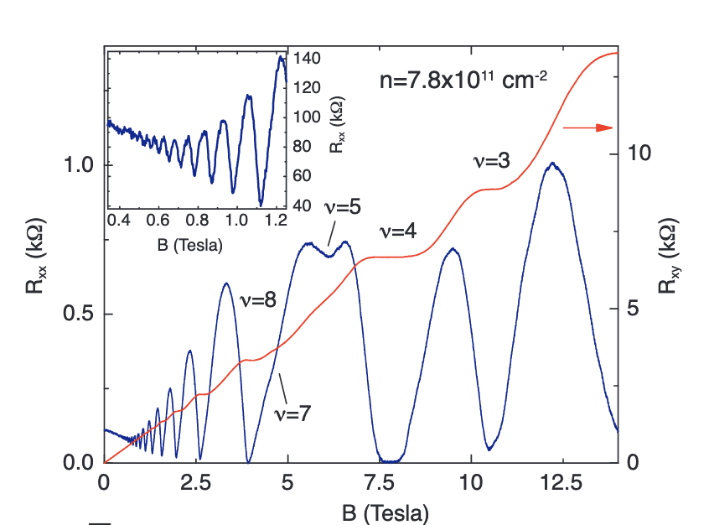
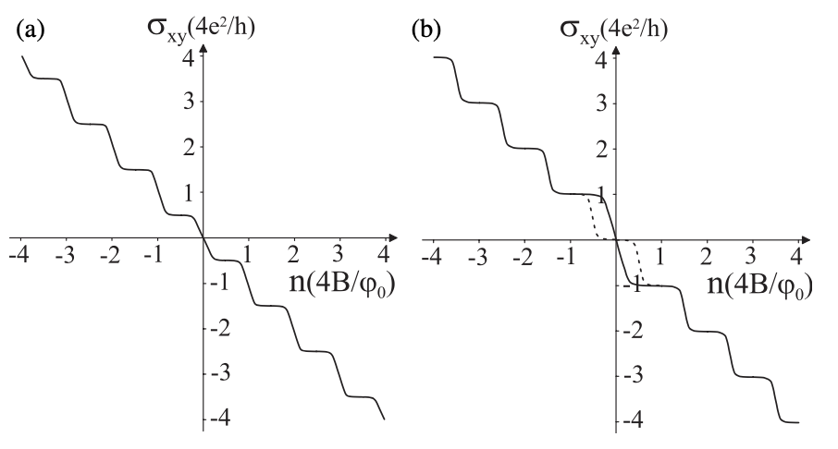
When we last talked…
Notes:
David

Slide 5
Sample Preparation
Notes:
David

Slide 6
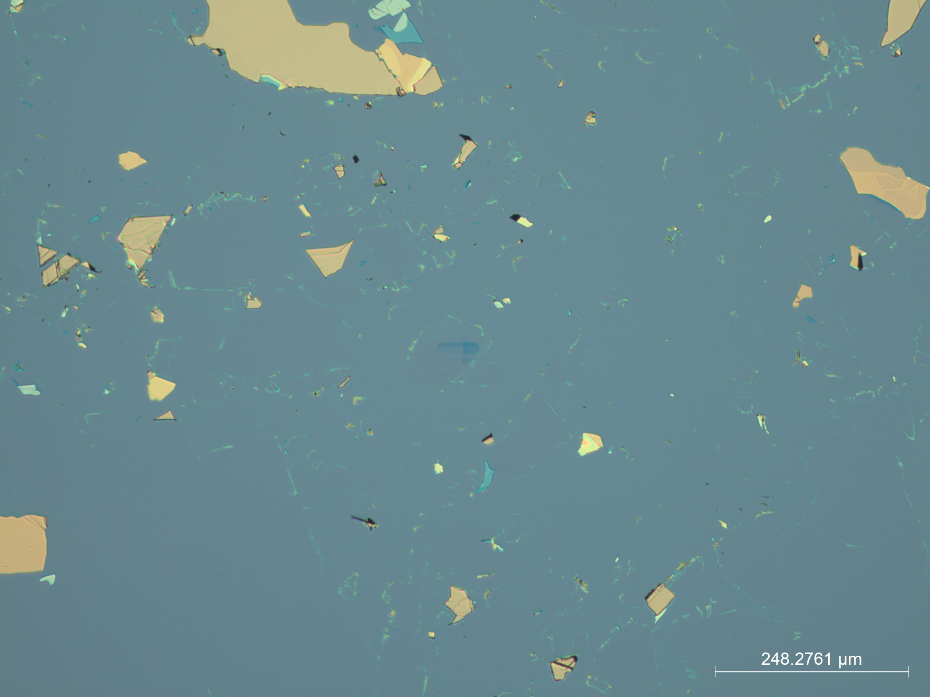
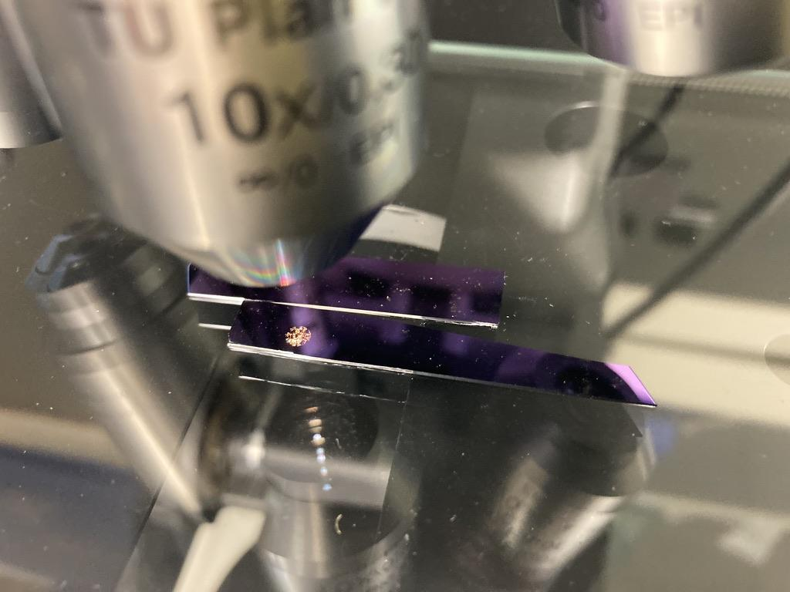
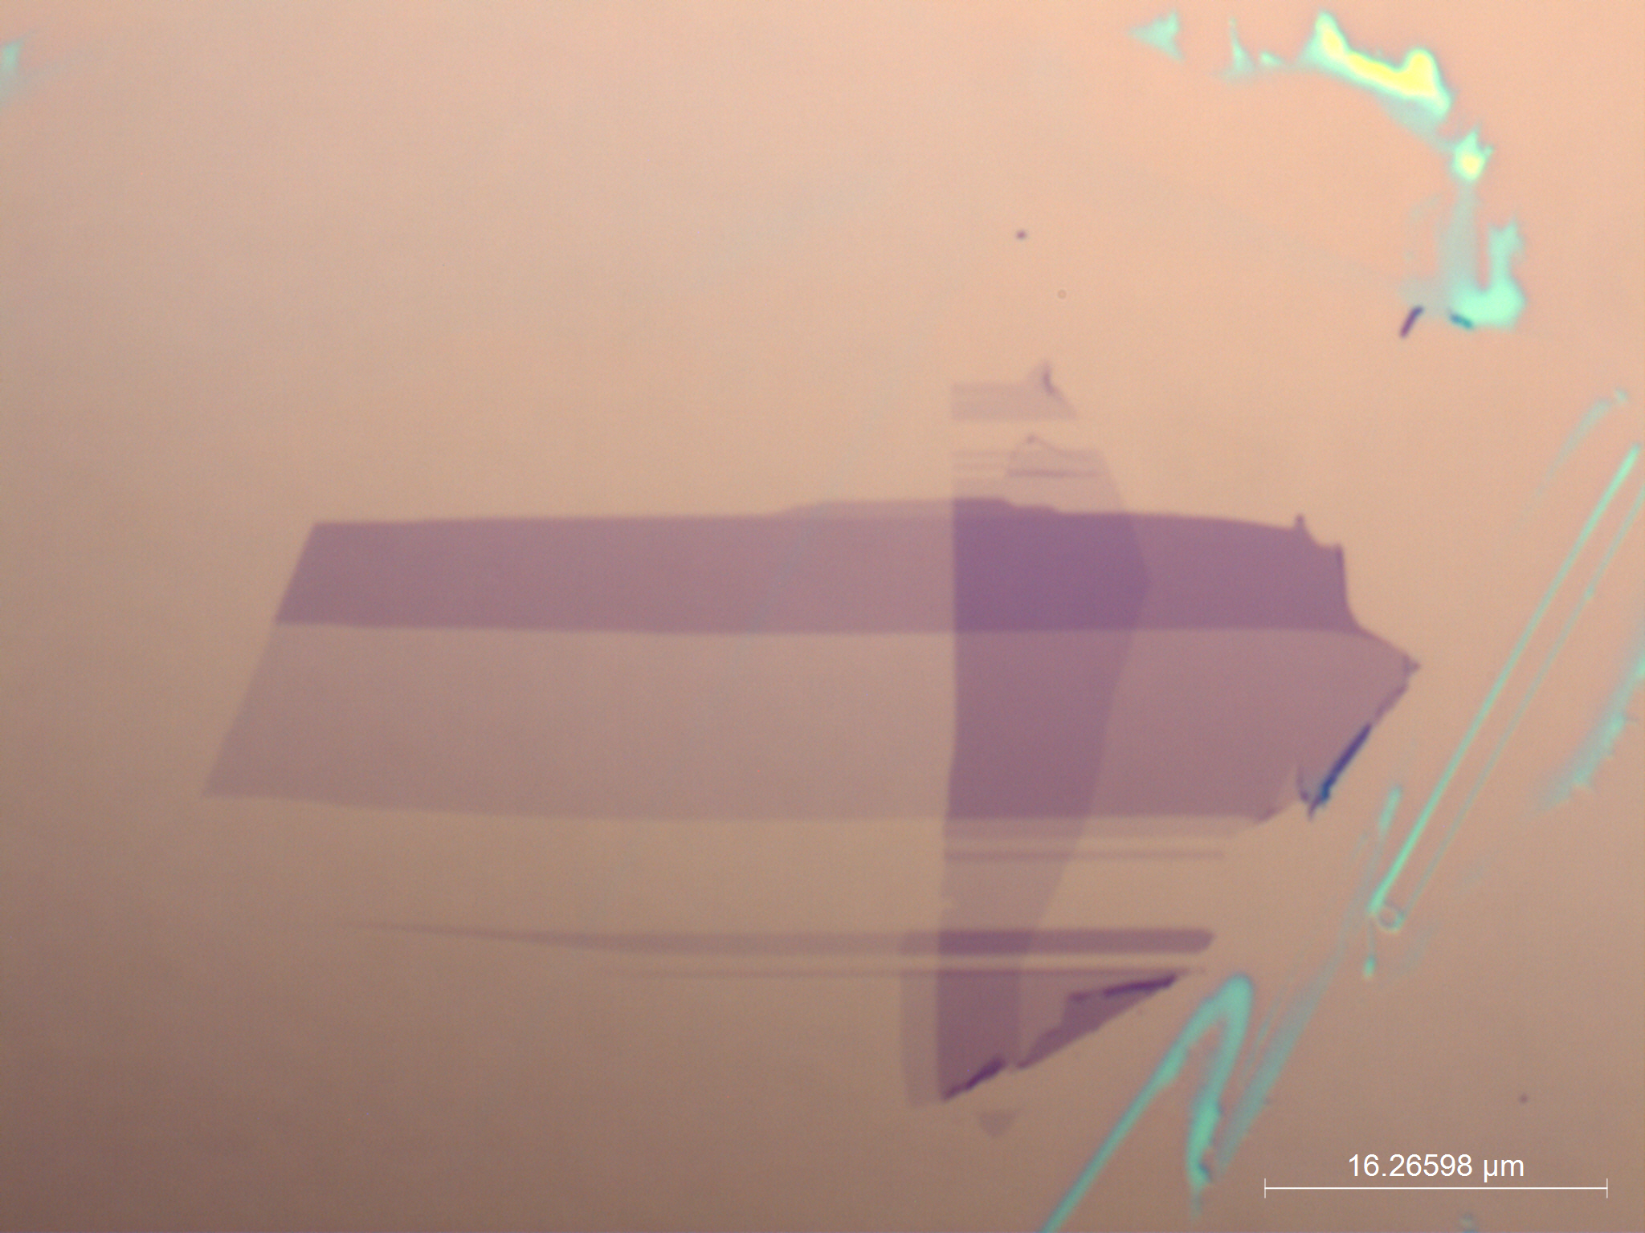
Graphene collection
Notes:
David

Slide 7
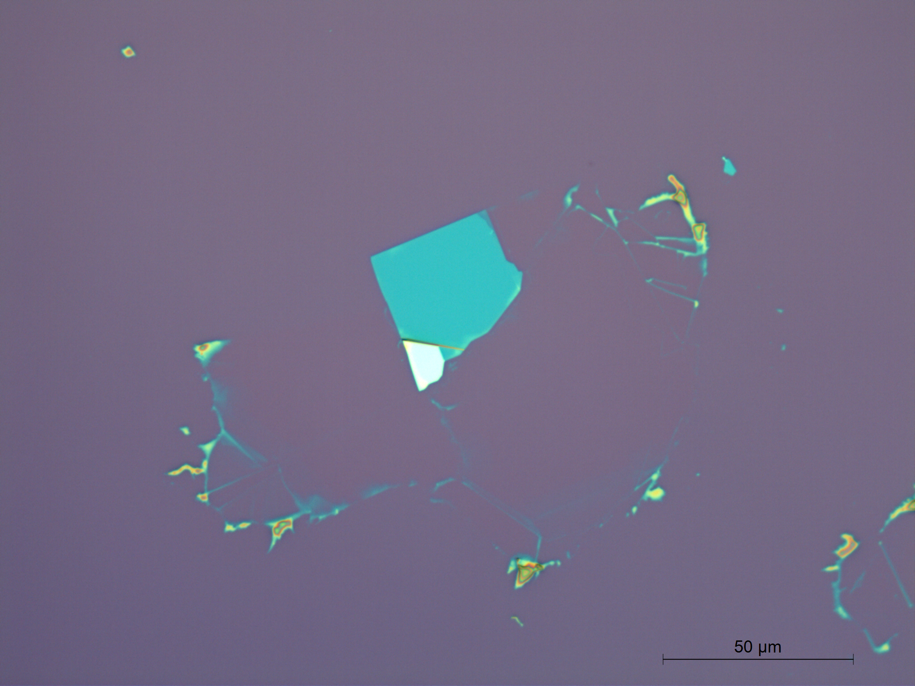
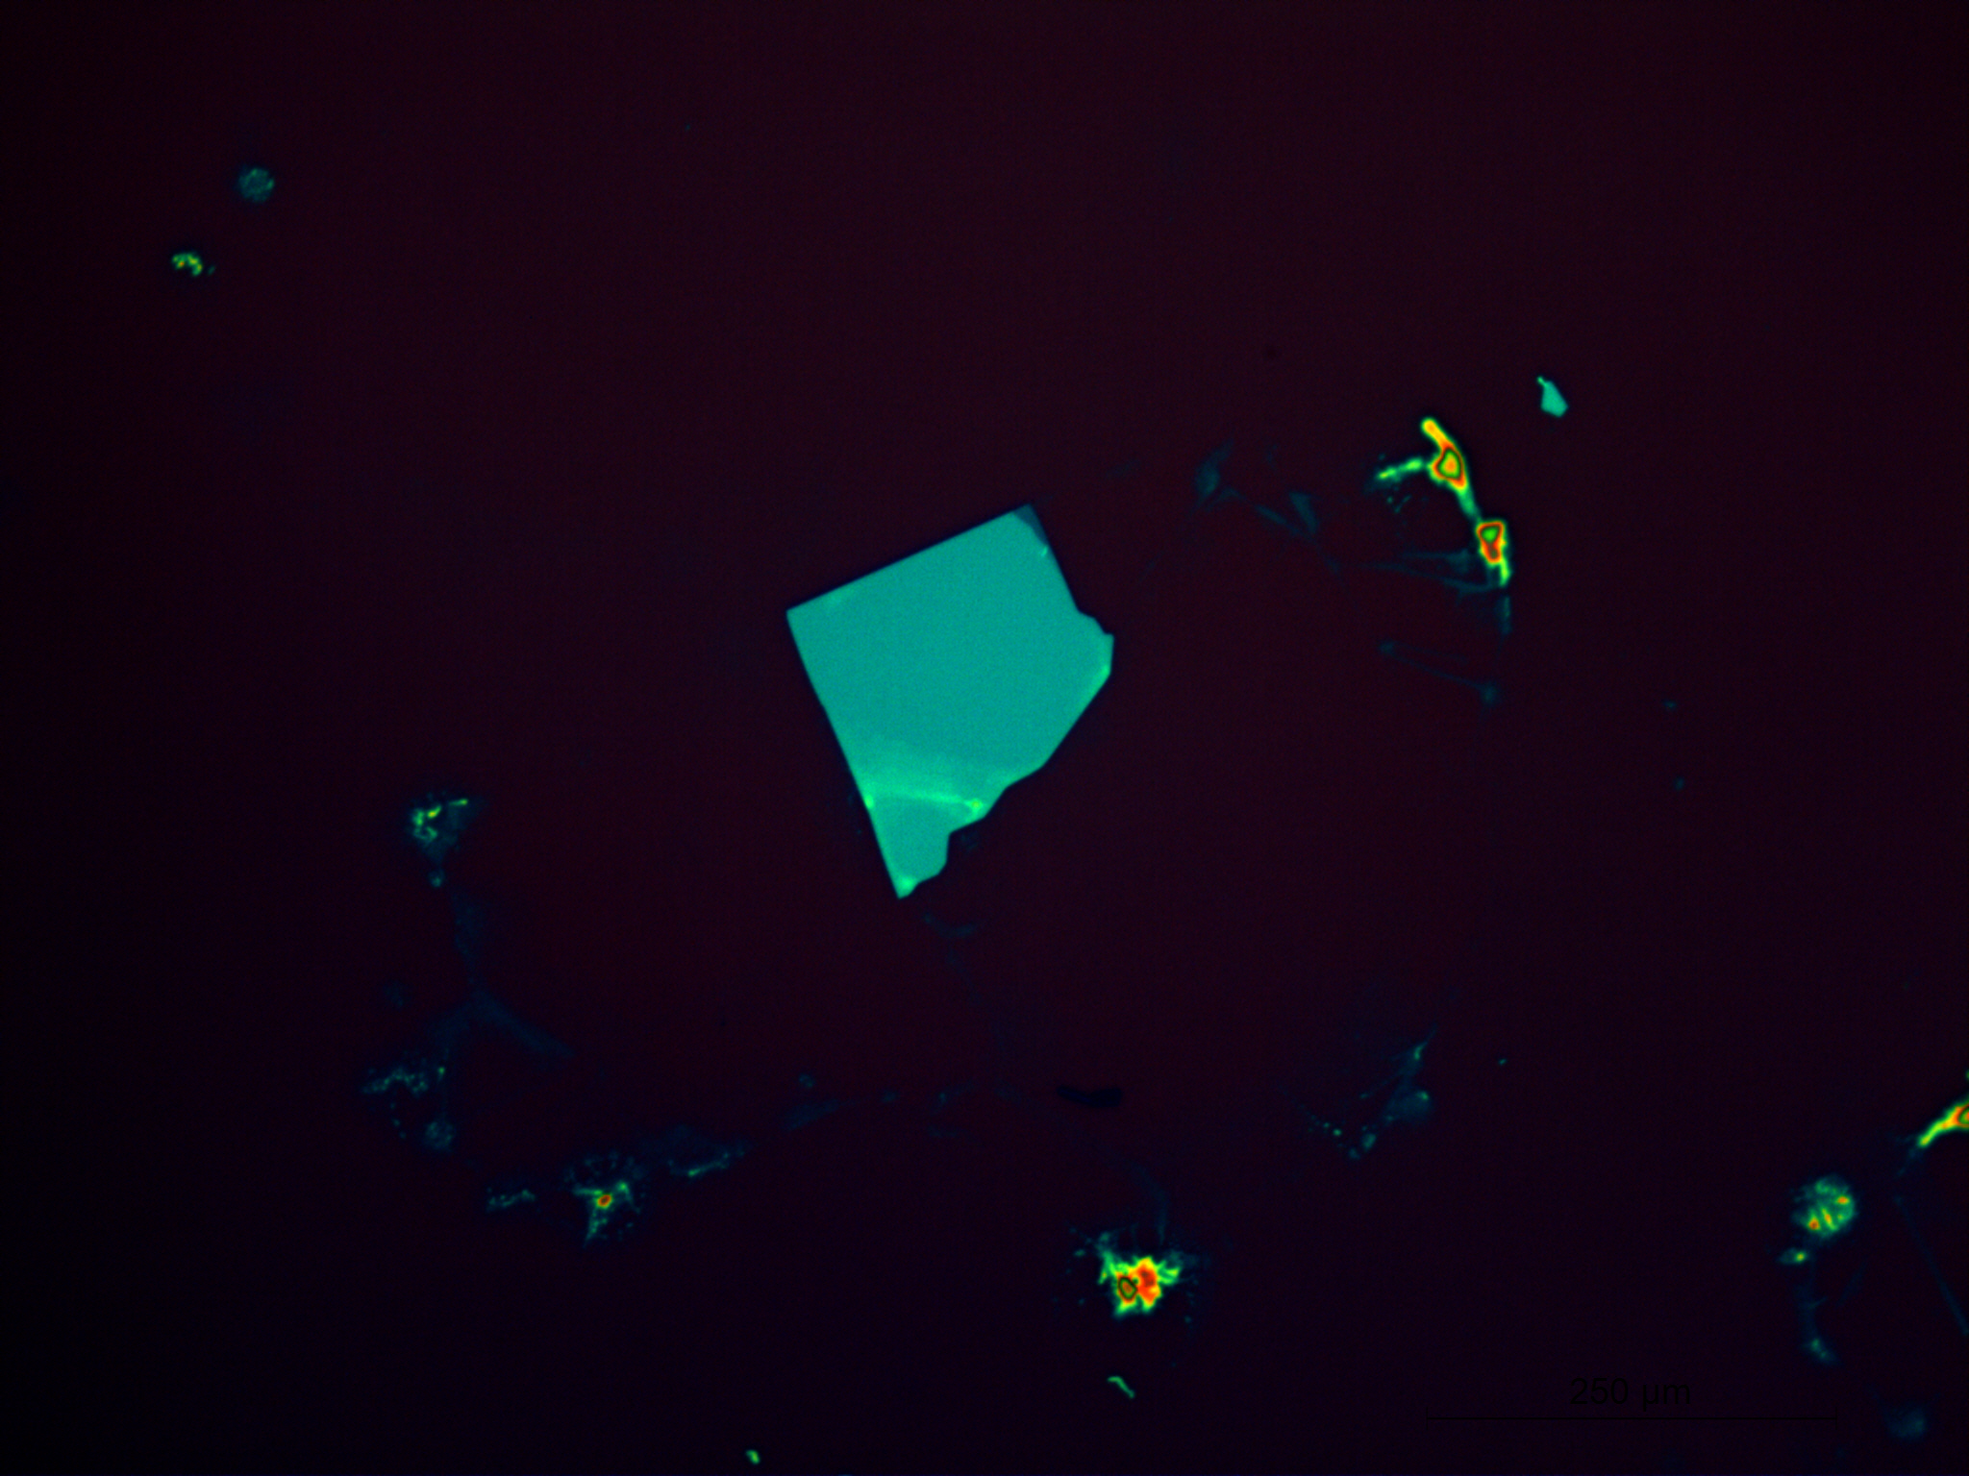
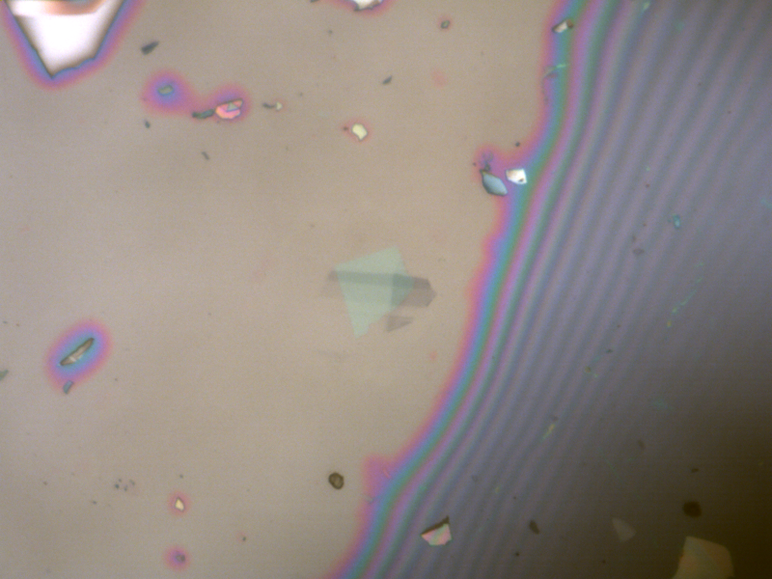
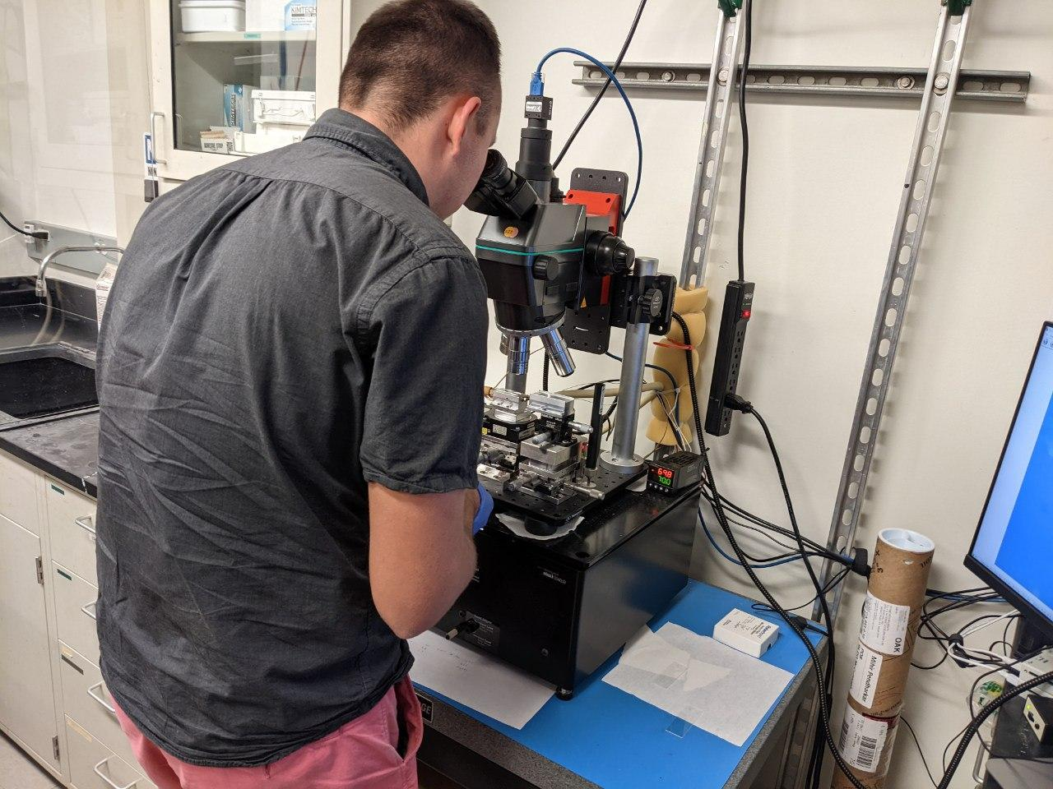
Graphene Stacking
Notes:
David

Slide 8
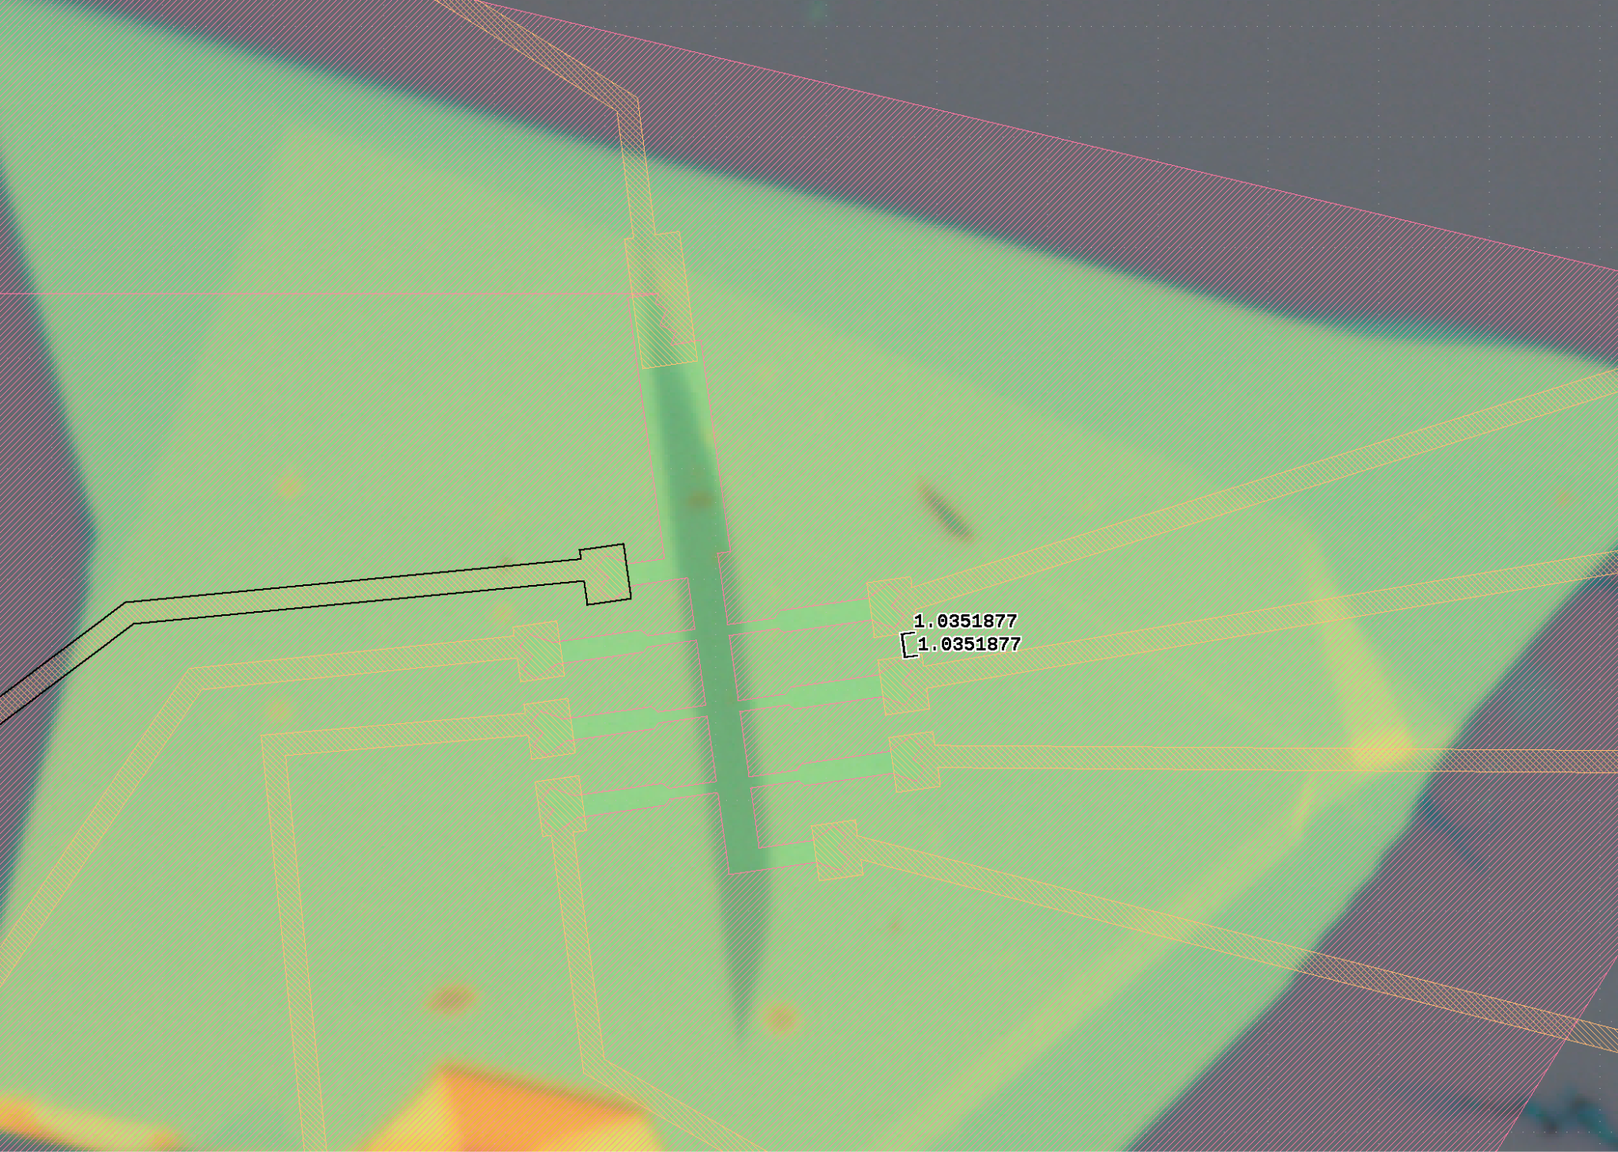
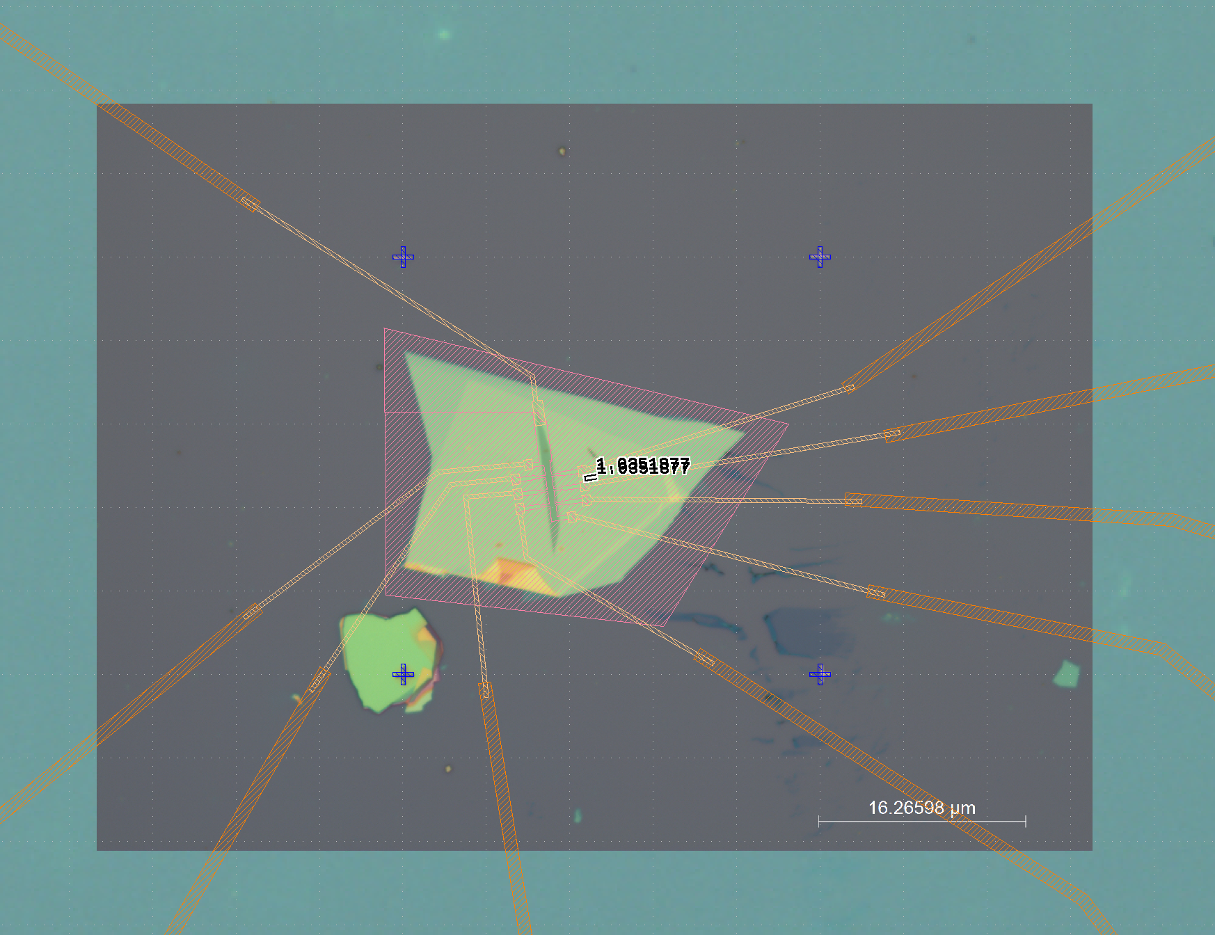
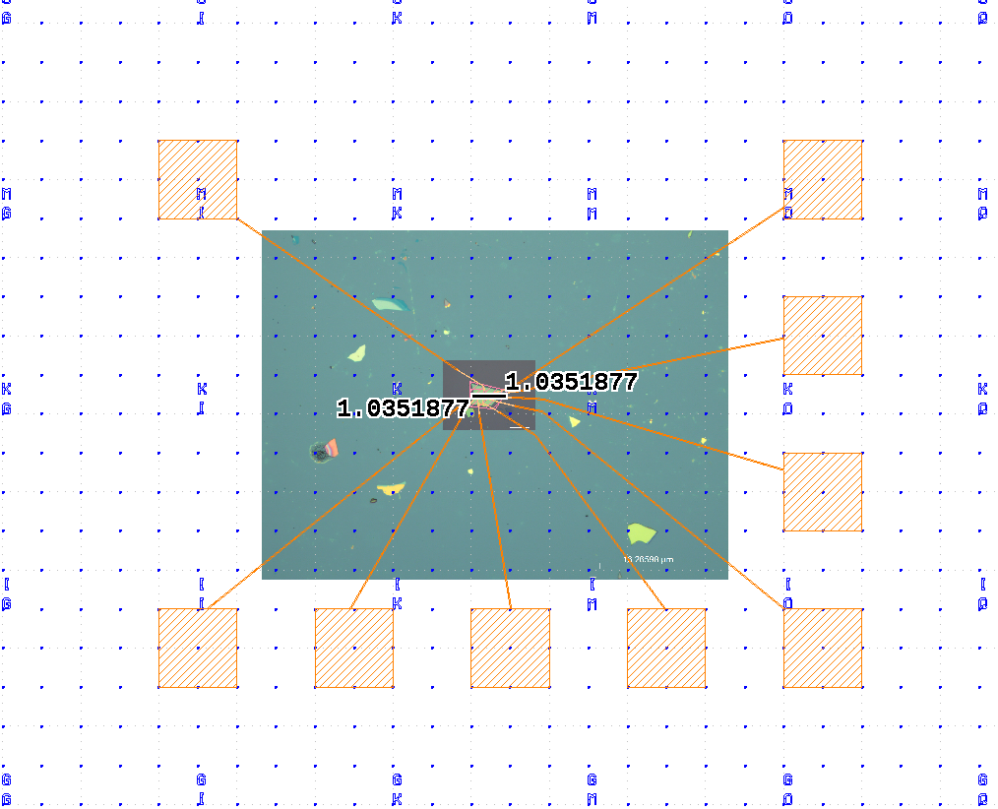
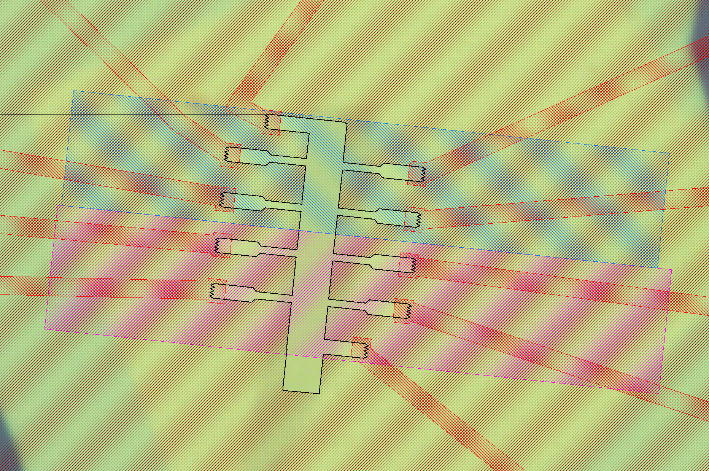
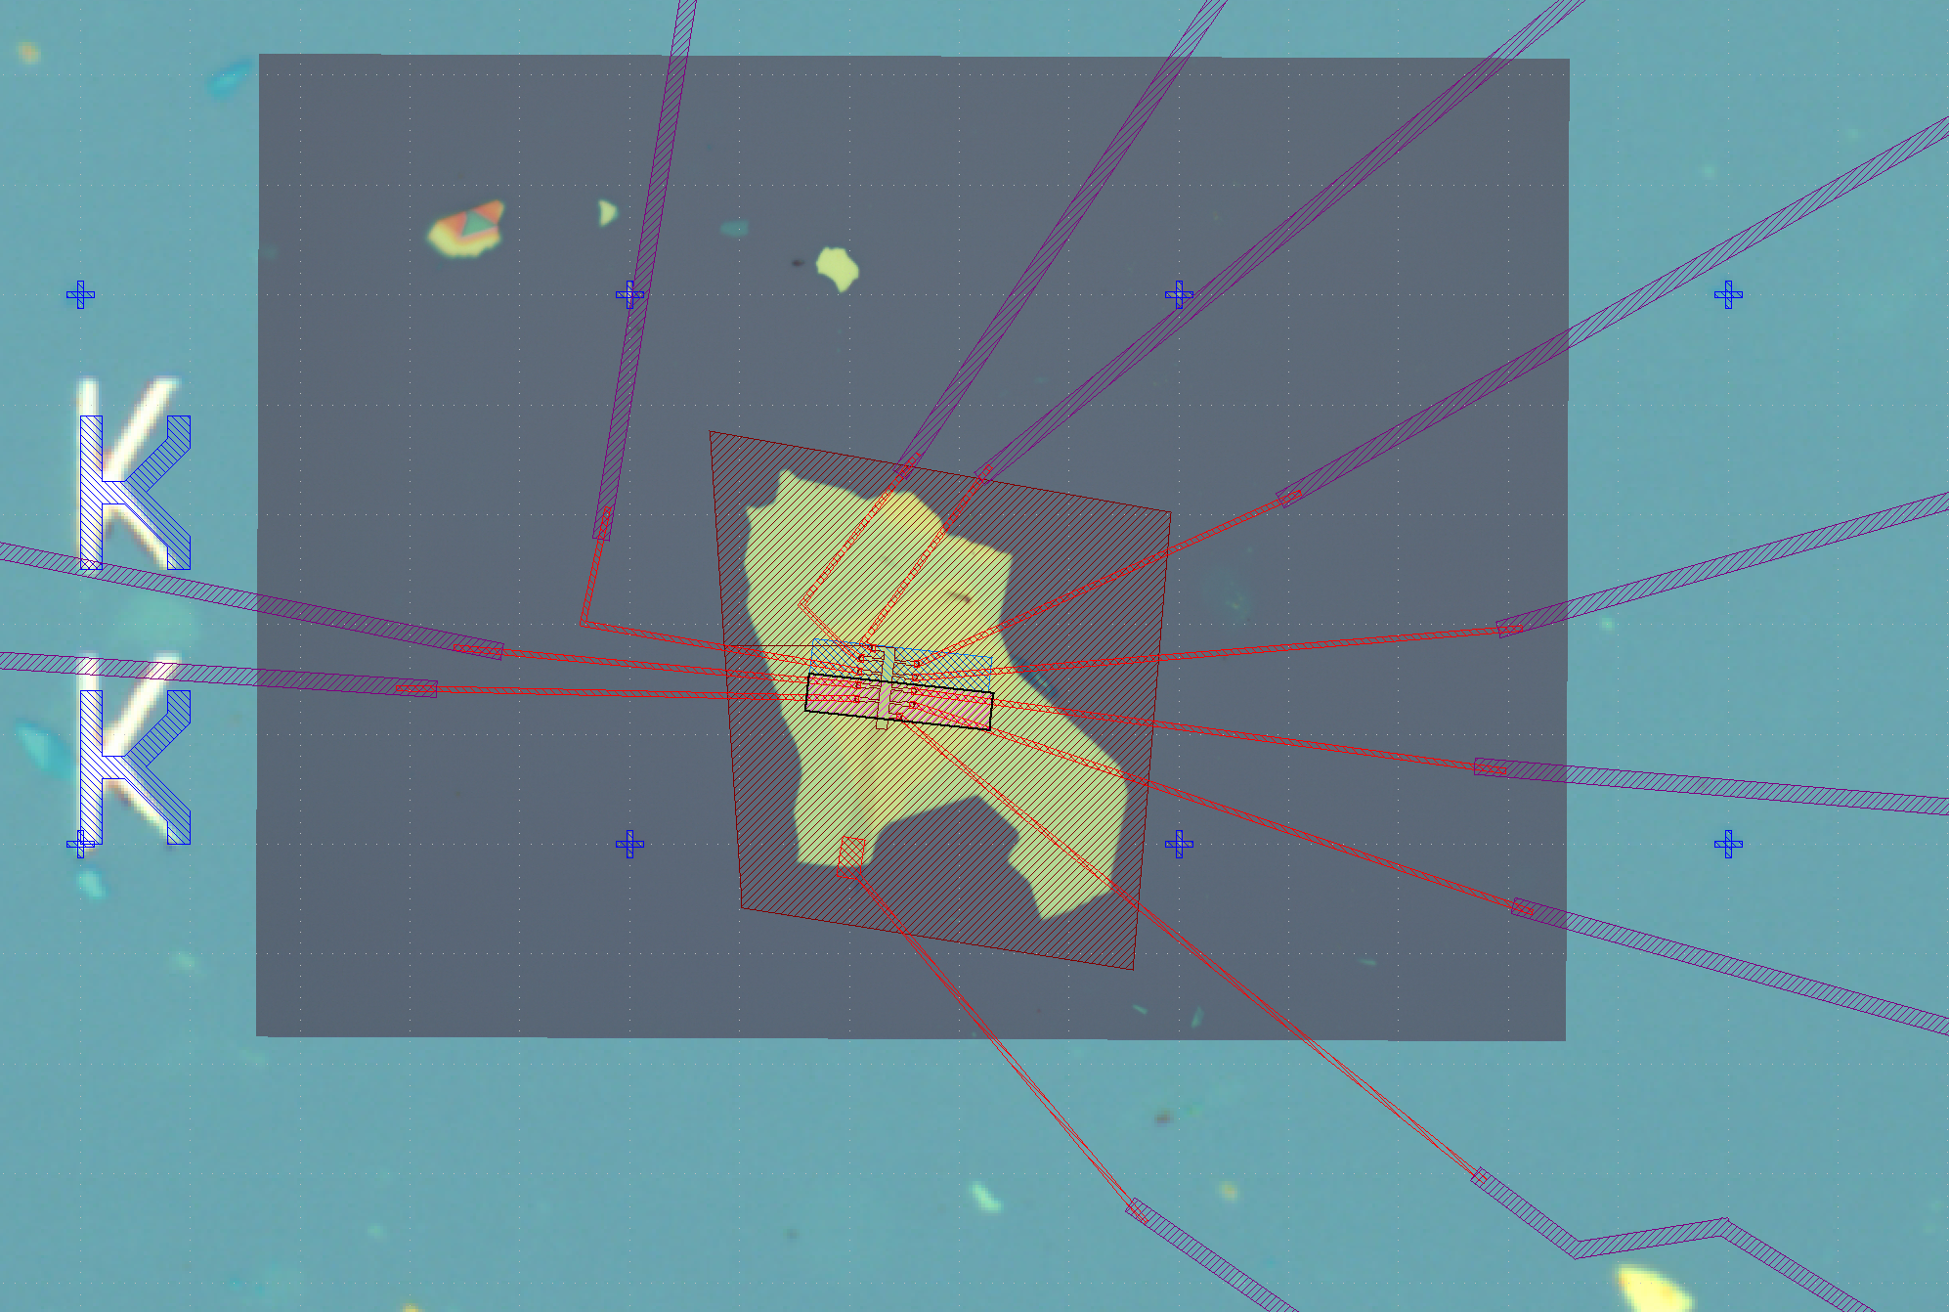
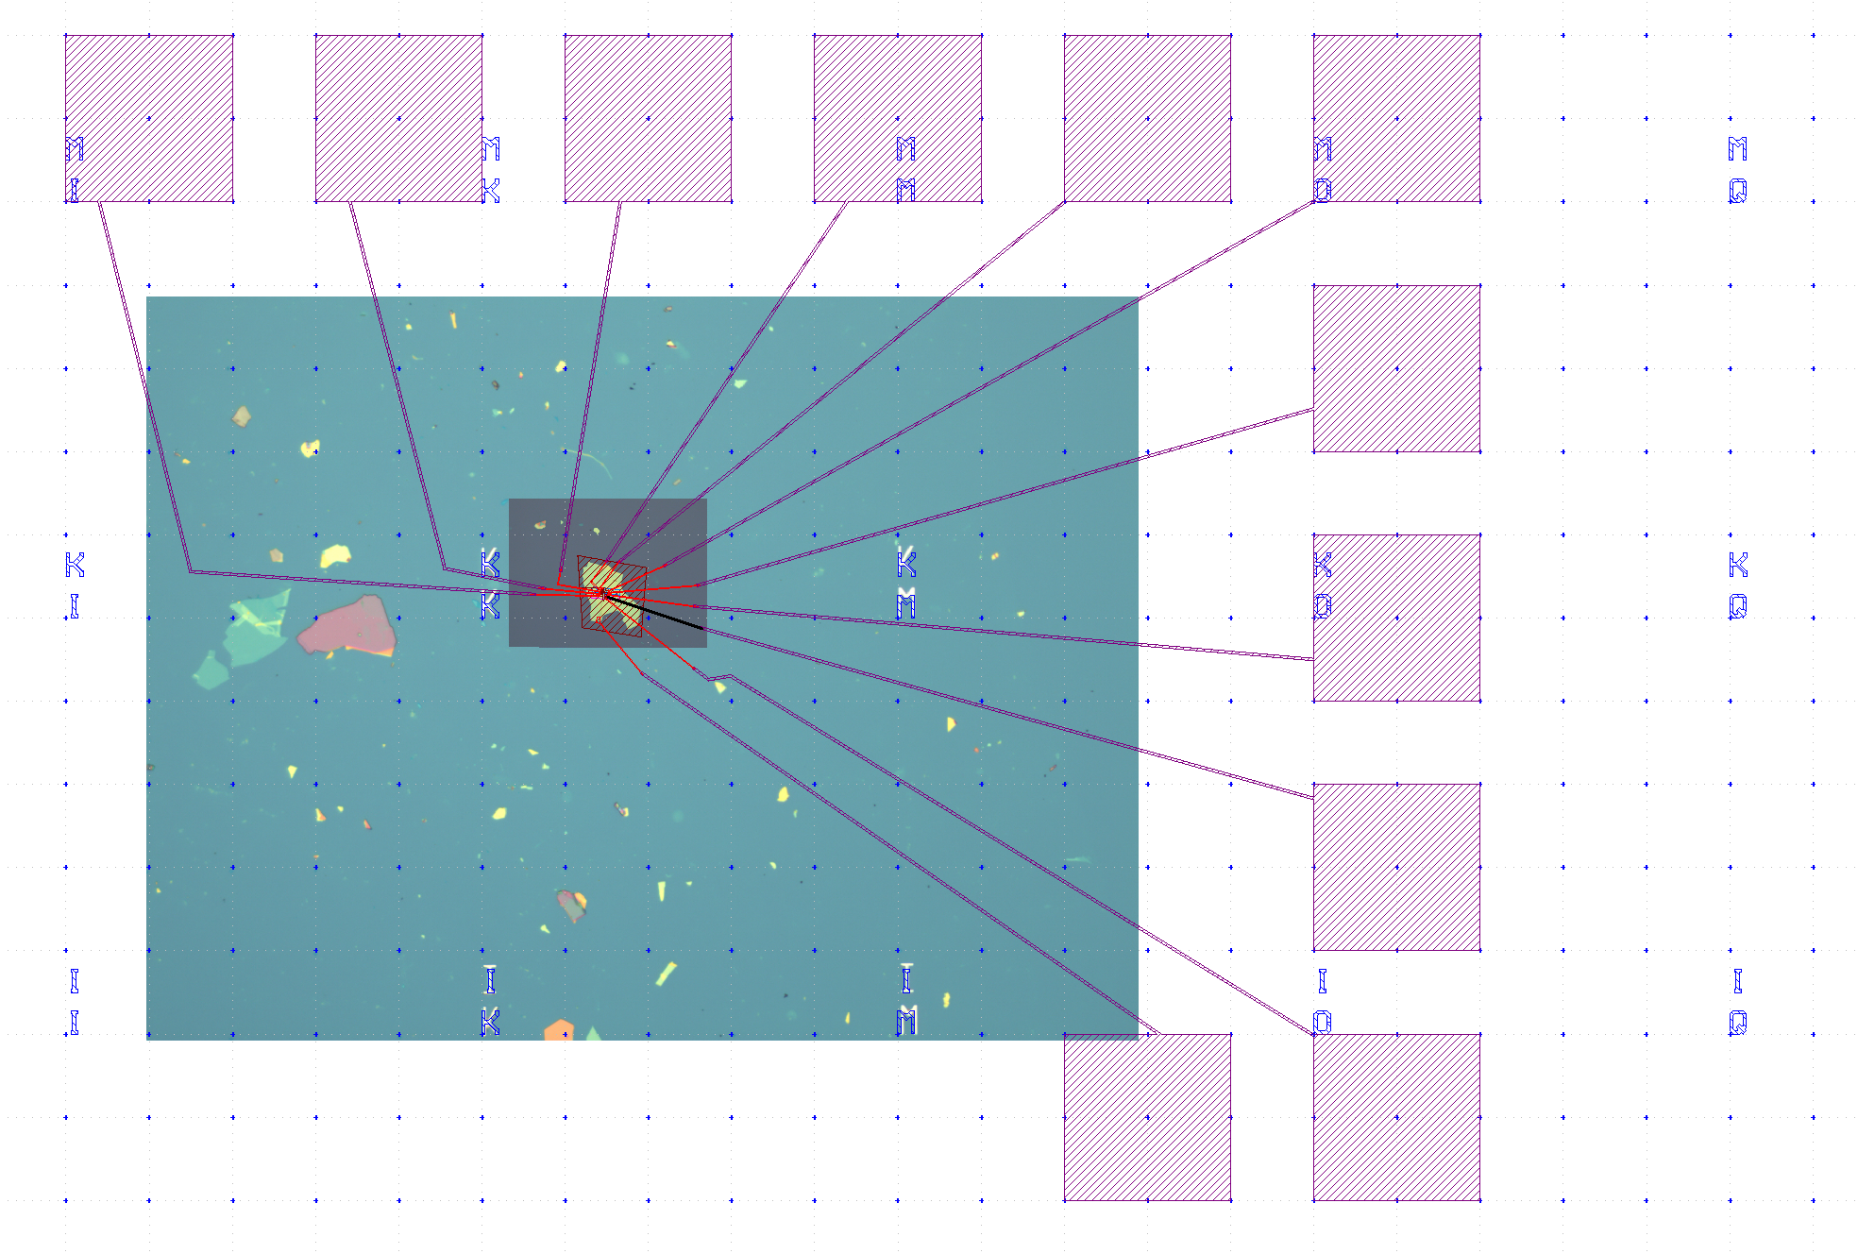
Pattern design
Notes:
Gene

Slide 9
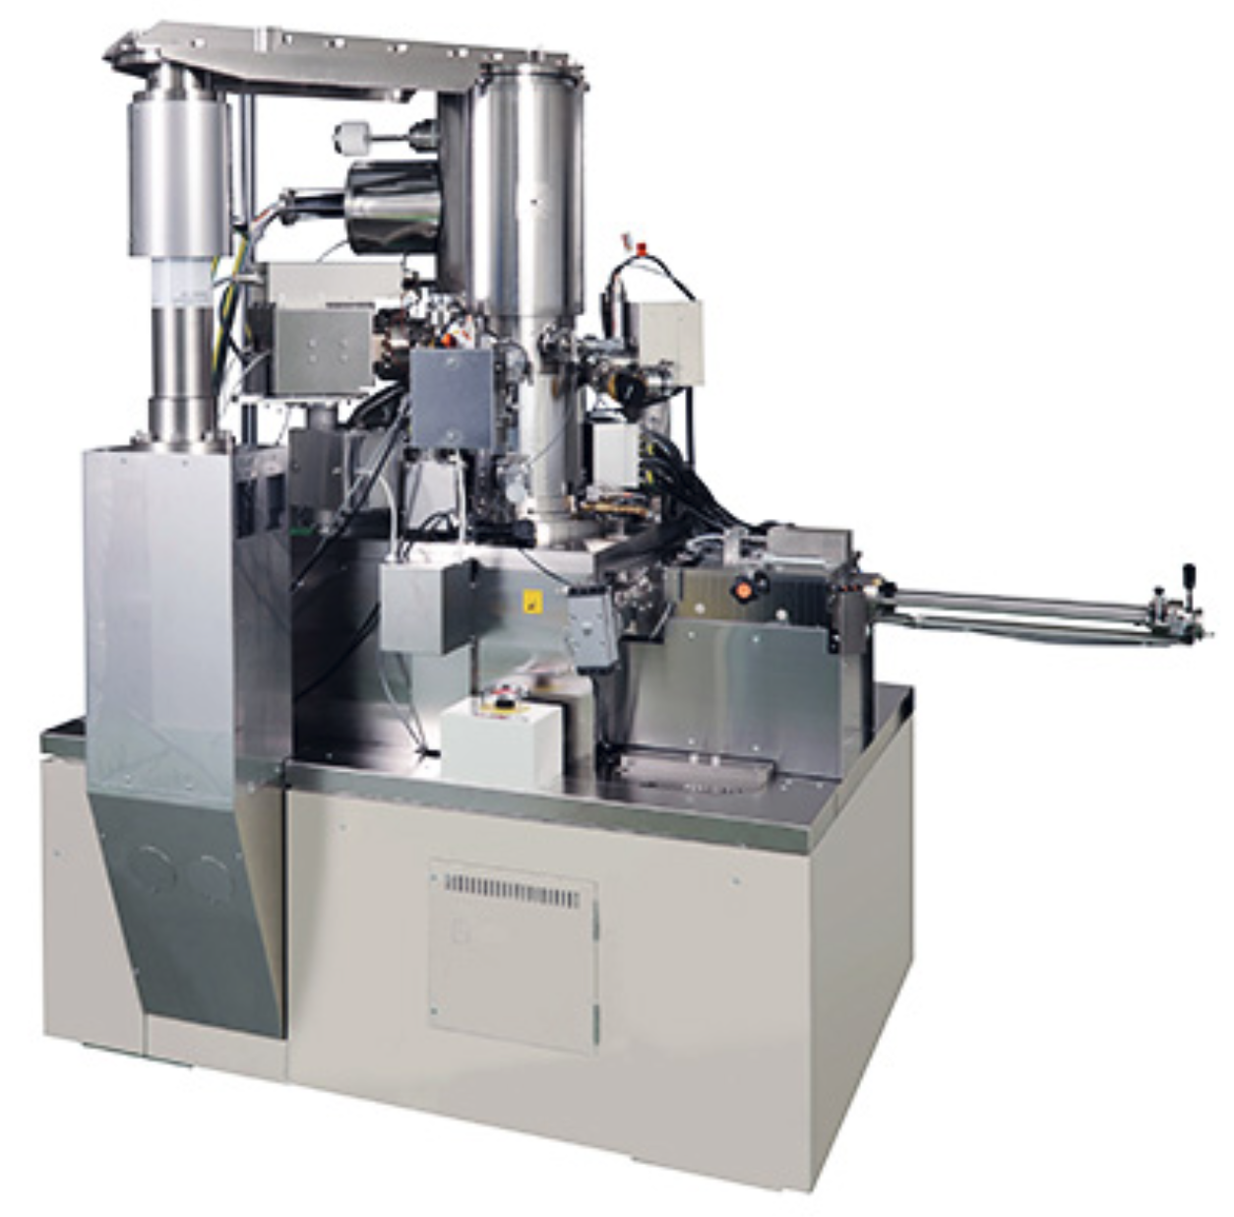
Device Fabrication
Step 1: Defining the hall bar (etching process)
PMMA
Spin coating
E-beam writing
Development
Plasma etching
JEOL JBX-6300FS Electron Beam Lithography System
Notes:
Gene

Slide 10
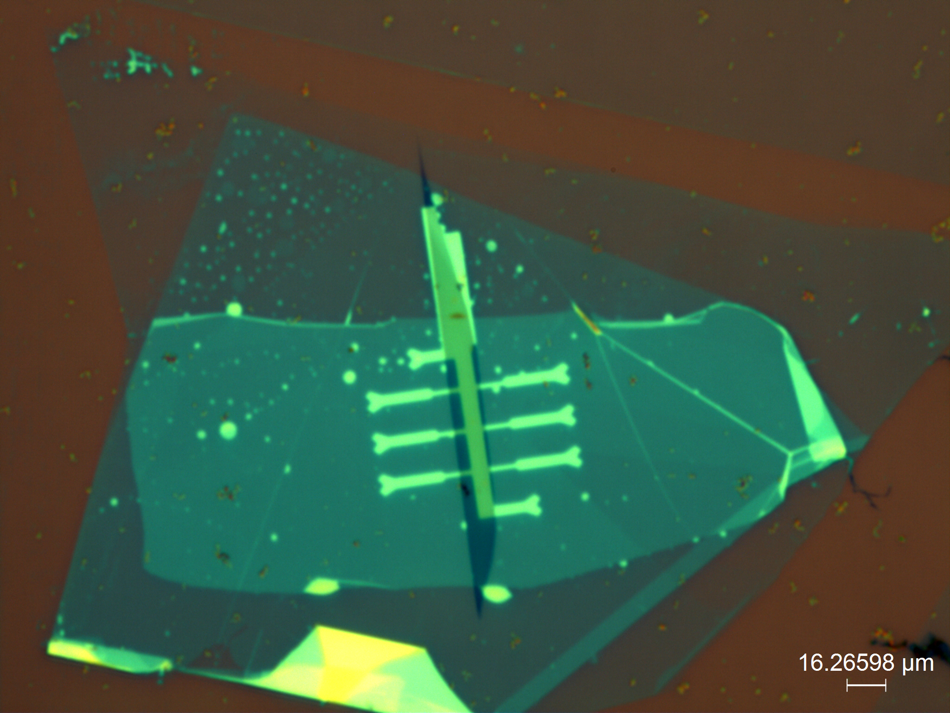
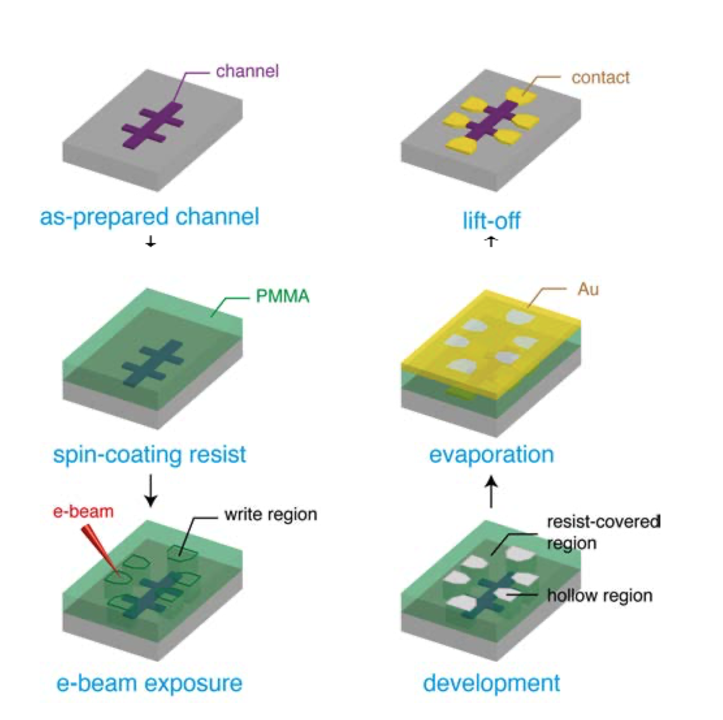
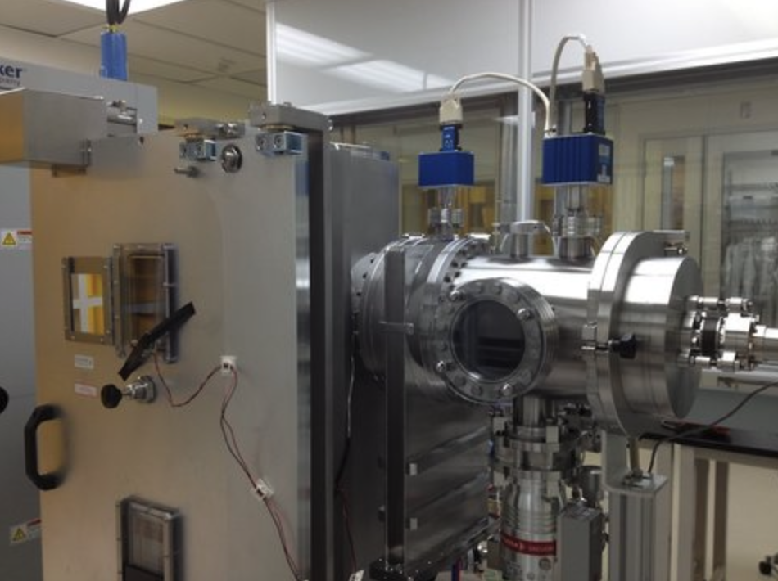
Device Fabrication
Step 2,3: Metal Deposition
Liang, L. (2017). Field effect controlled magnetism and magnetotransport in low dimensions. Rijksuniversiteit Groningen
Kurt J. Lesker E-Beam Evaporator
Notes:
Gene

Slide 11
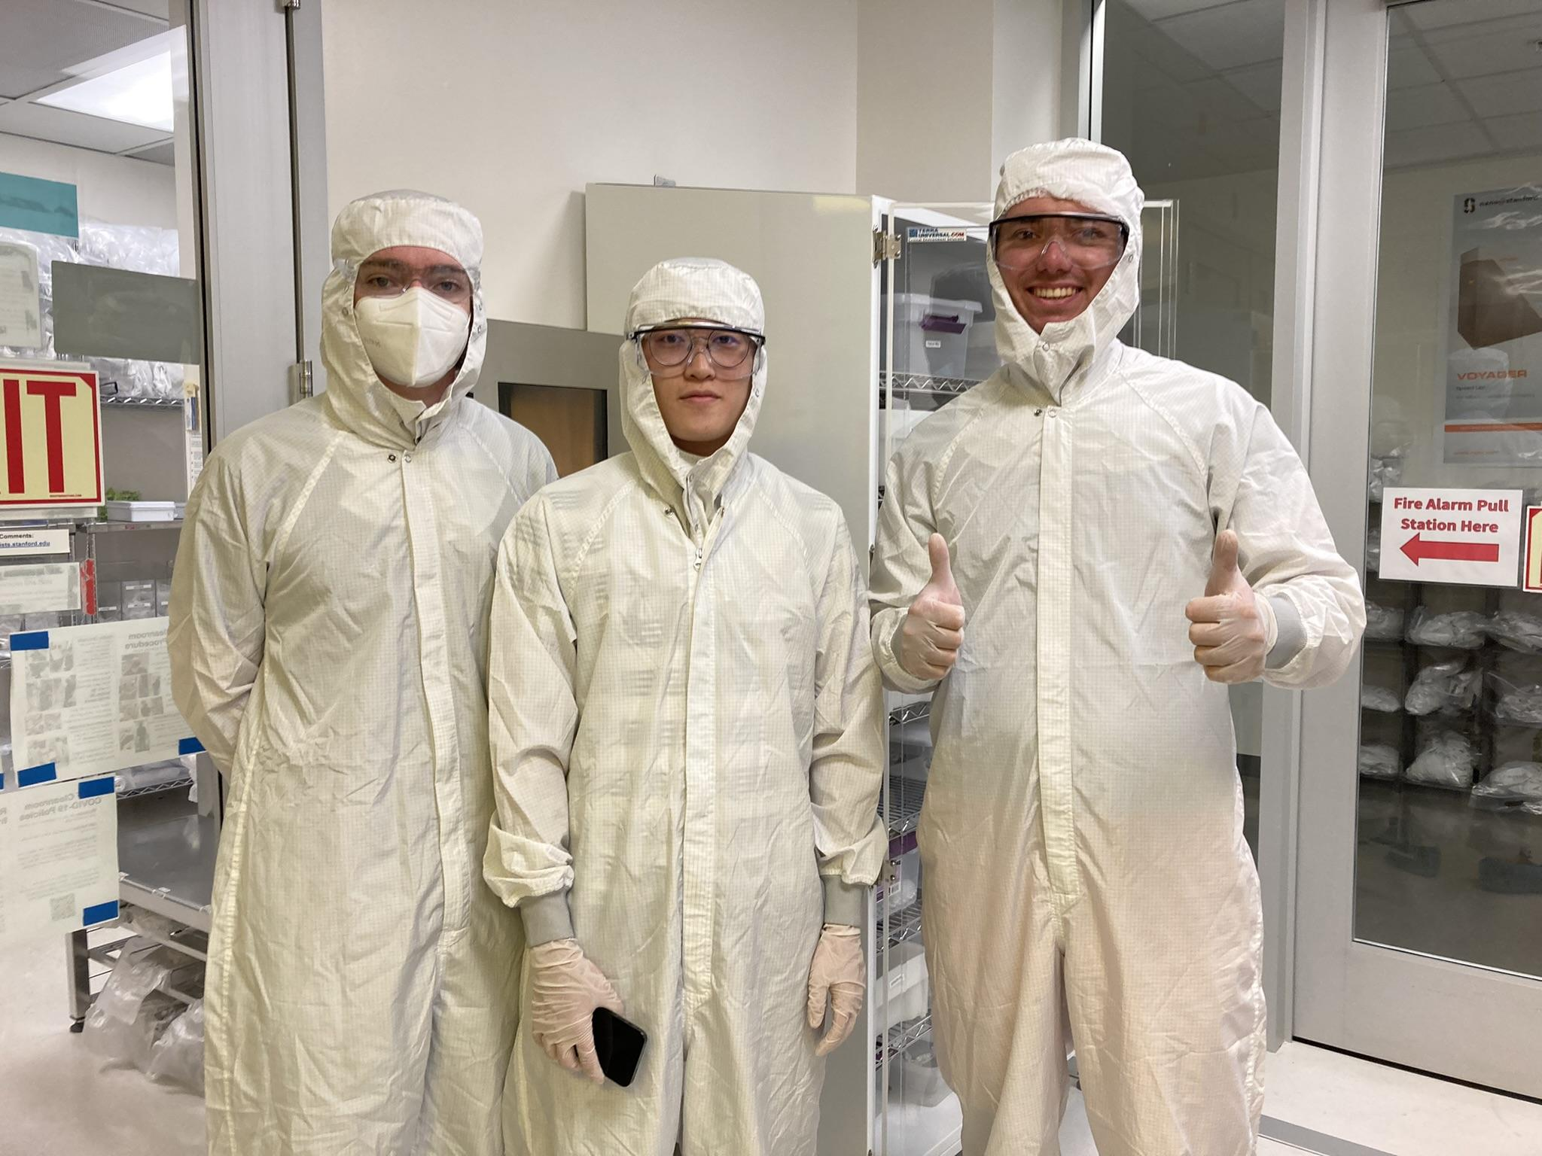
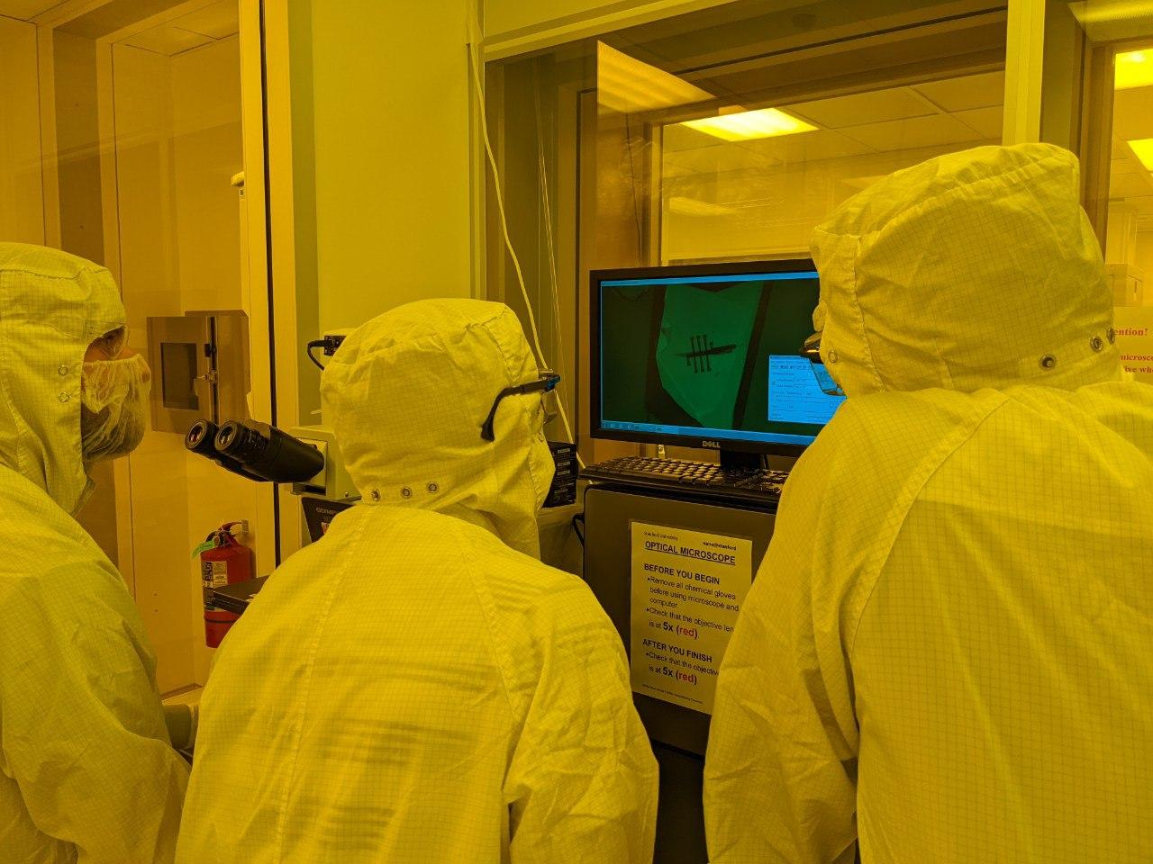
E-Beam Lithography to Cut Hall Bars

Slide 12
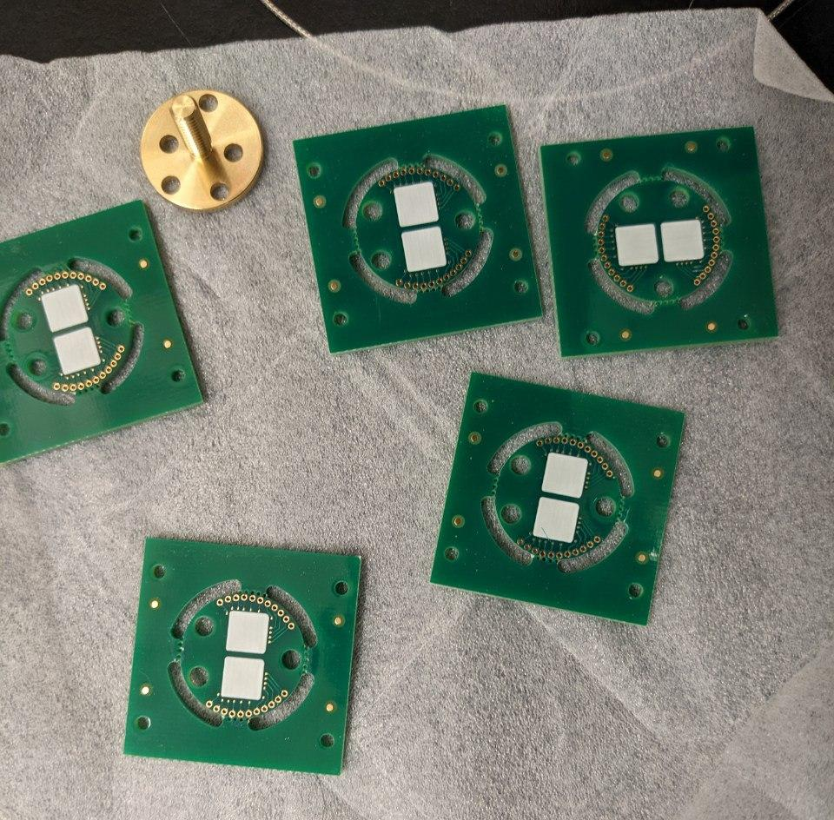
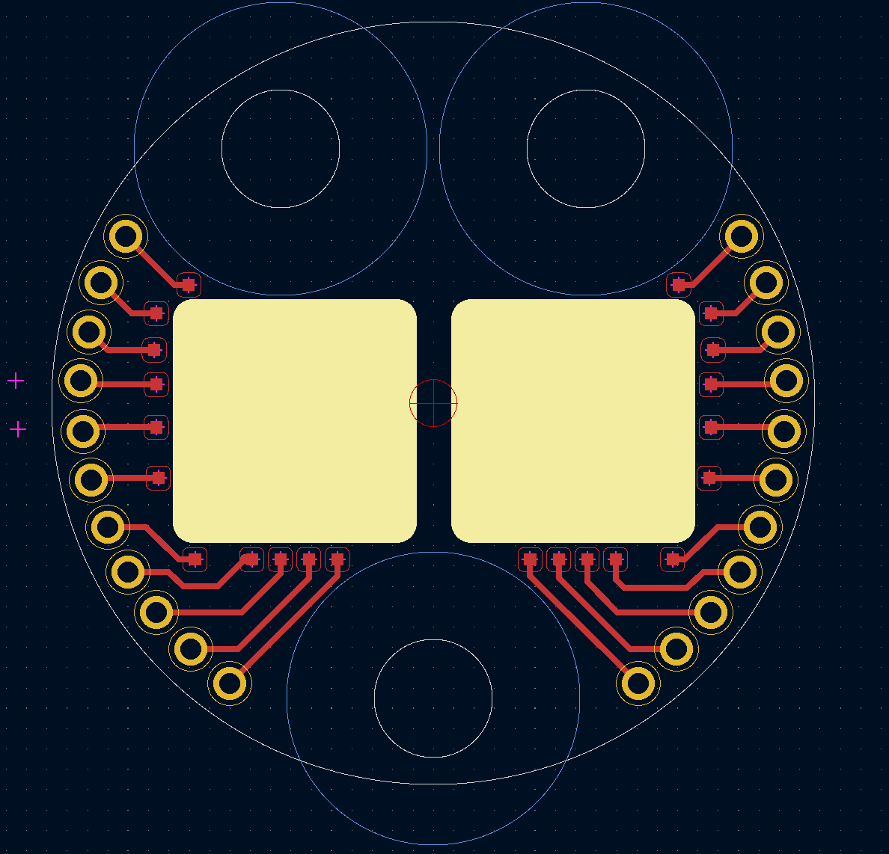
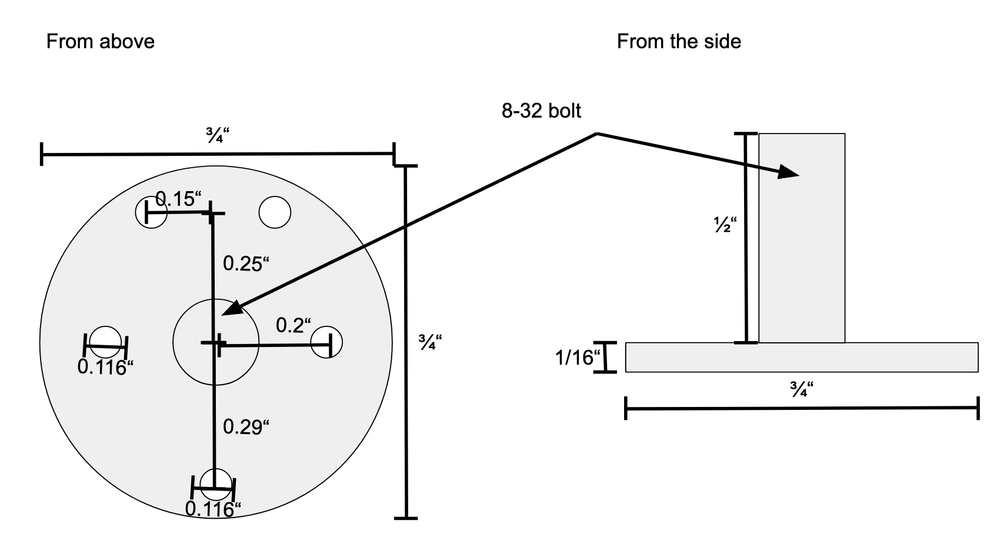
Sample Mount
Notes:
Cameron

Slide 13
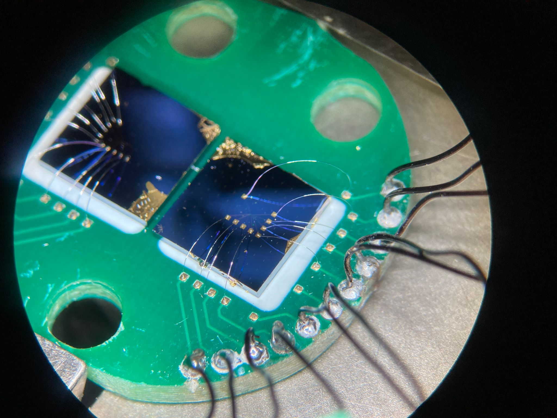
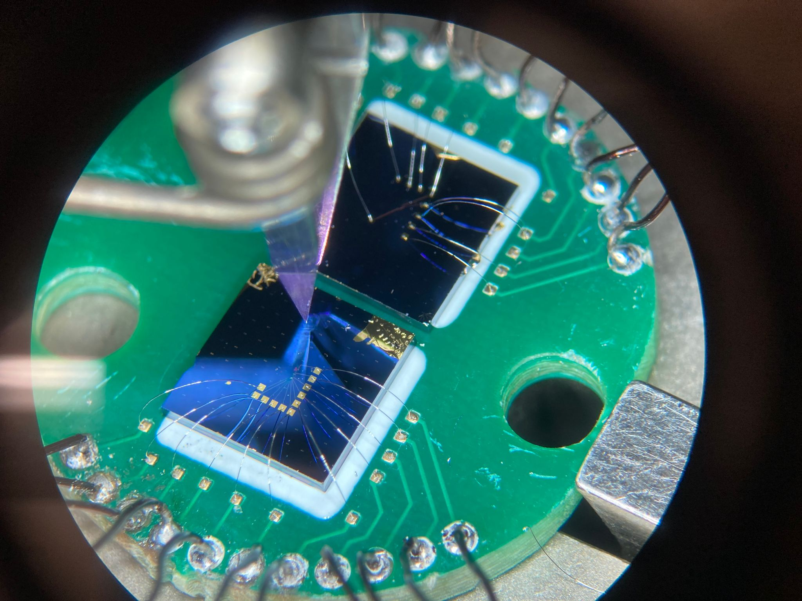
Wire Bonding
Notes:
David

Slide 14
Testing the Experiment

Slide 15
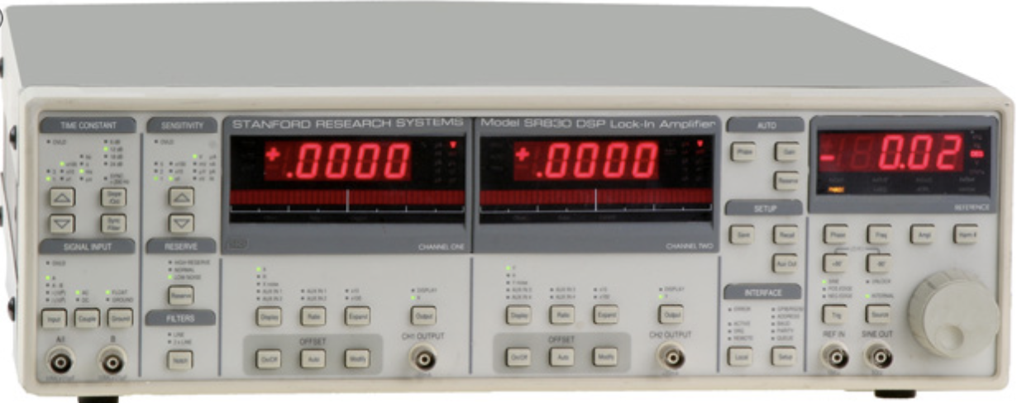
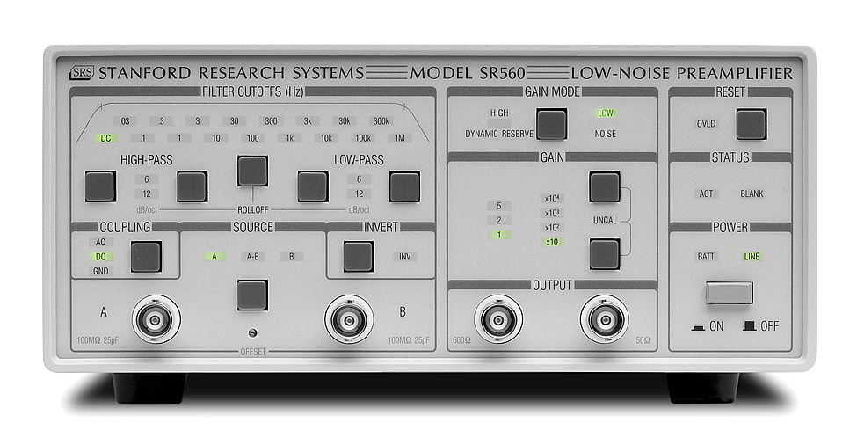
Lock-in Testing
10nA
1V
100 uV
100MOhm resistor
100 Ohm resistor
Notes:
Cameron

Slide 16
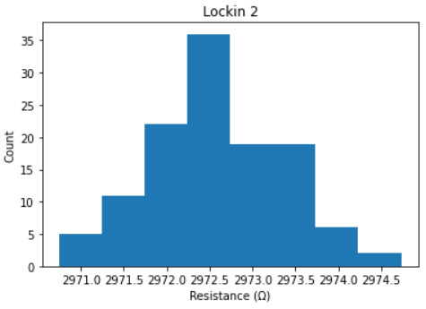
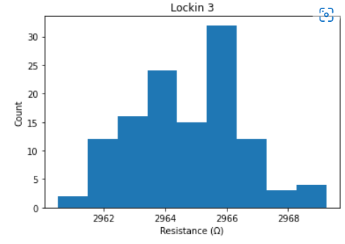
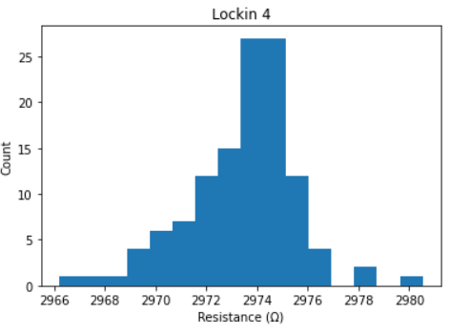
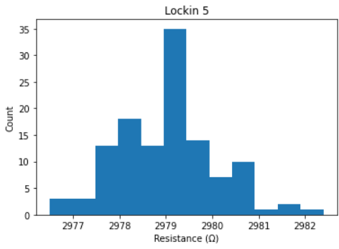
.02%
.05%
.07%
.03%
Notes:
Means: rxx mean
Gene
2972.6
2964.75
2973.46
2979.03

Slide 17
Code Writing
Initialize instruments
Ramp magnetic field from 0T to 5T at max magnet ramp rate
Measure Rxx (2), Rxy (2), and temperature every 1s
Ramp gate voltage from 0V to 2V at 0.02 V/s
Ramp voltage to -1V and ramp magnetic field to 0T

Slide 18
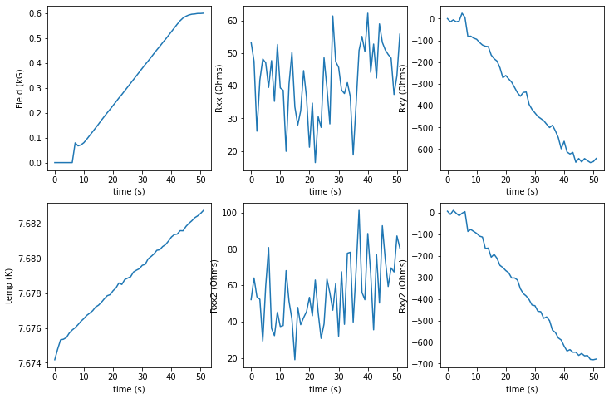
Notes:
RH = 1 Ohm/1 Gauss = 10^4 m^2/C (does not make sense)

Slide 19
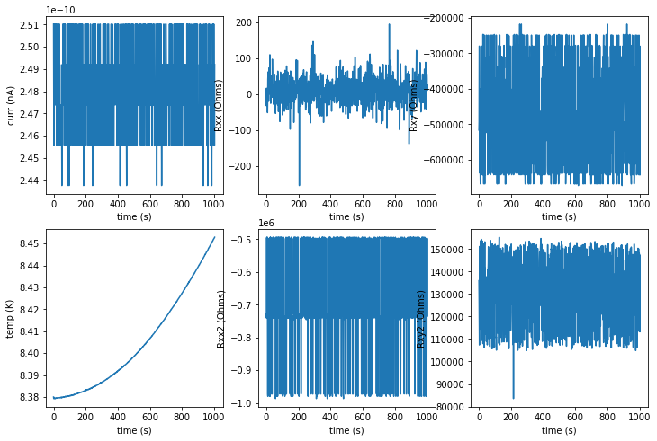

Slide 20
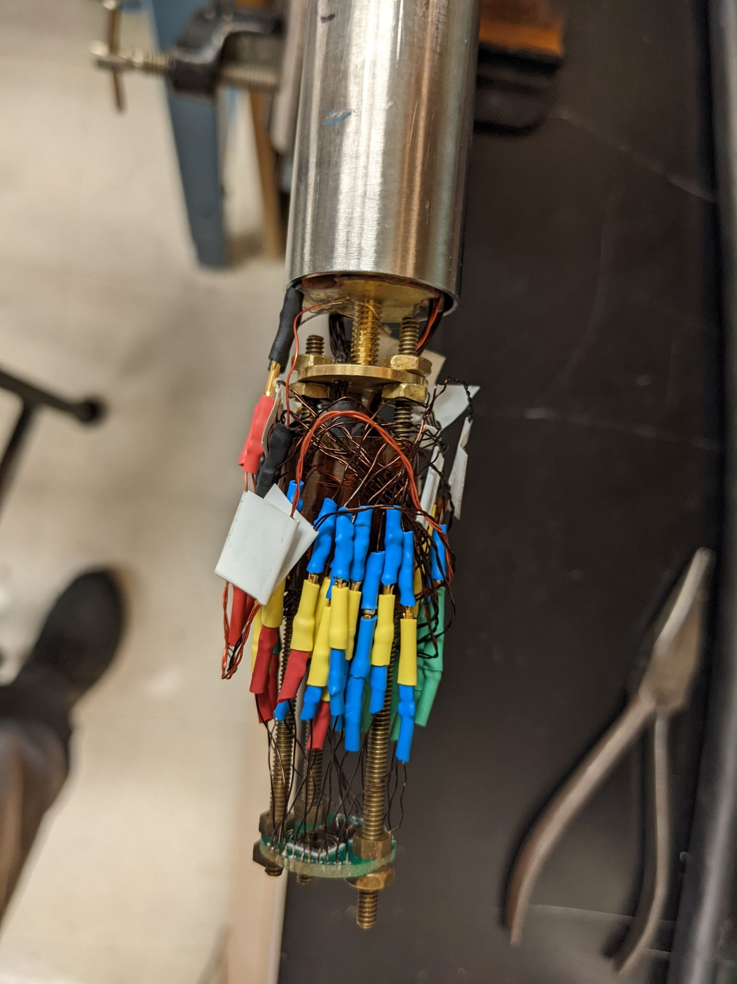
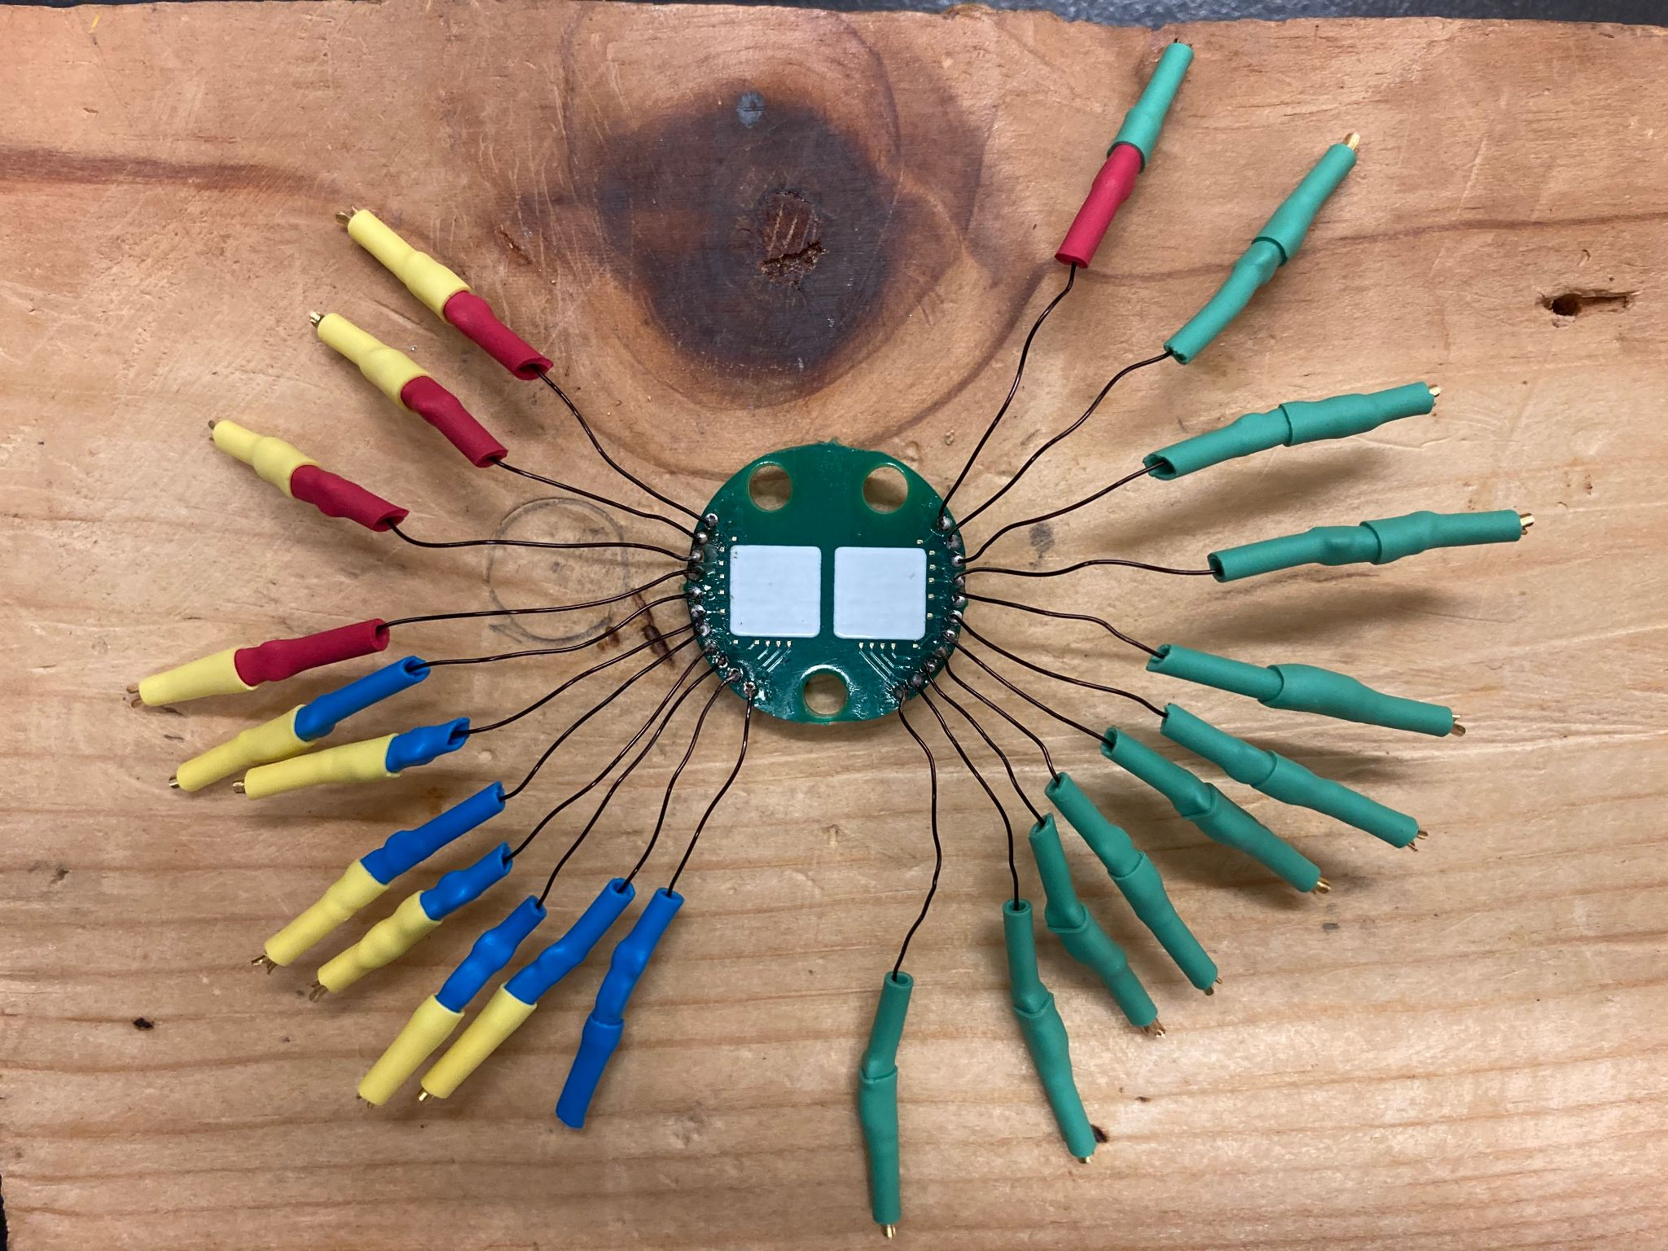
Wiring
Notes:
Cameron

Slide 21
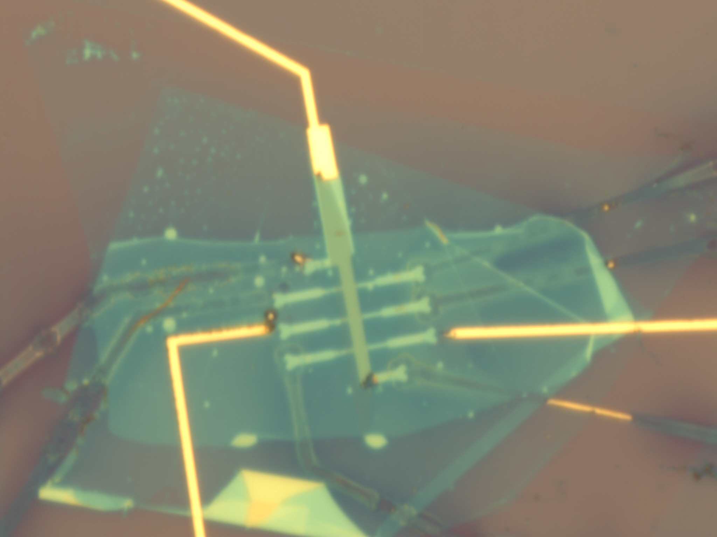
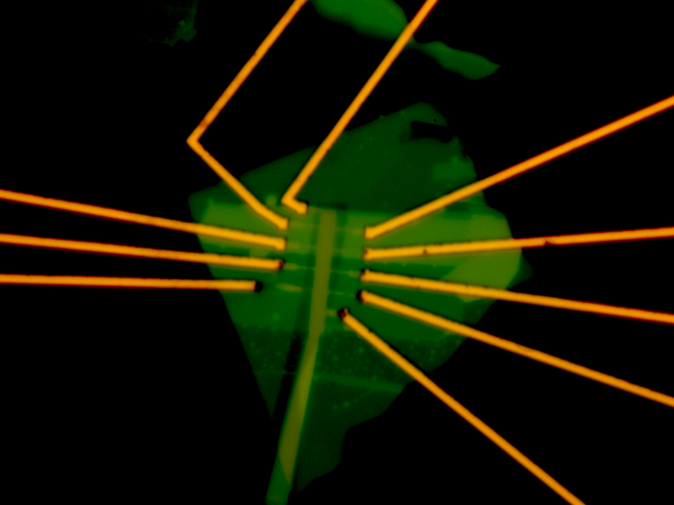
Sadness, part 1.
Notes:
Cameron

Slide 22
Final Setup
10nA
1V
100M resistor
InAs Hall Bar
Notes:
Gayathri

Slide 23
Contact Resistances
Single-Pin Resistances (Ω)
Two-Pin Resistances at Room Temp (Ω)
Pin # | Room-temp R (Ω) | R at 8K (Ω)
9 | 1075 | 1M
10 | 1045 | 1M
17 | 909 | .5M
18 | 948 | .5M
19 | 1125 | 0.7M
20 | 6055 | .5M
11/12. | inf | 21
Pins | 9 | 10 | 17 | 18 | 19 | 20
9 |  | 1650 | 1430 | 2230 | 2520 | 7620
10 |  |  | 1355 | 2200 | 2450 | 7350
17 |  |  |  | 2150 | 2400 | 7350
18 |  |  |  |  | 1290 | 6300
19 |  |  |  |  |  | 6750
20
Notes:
Gayathri

Slide 24
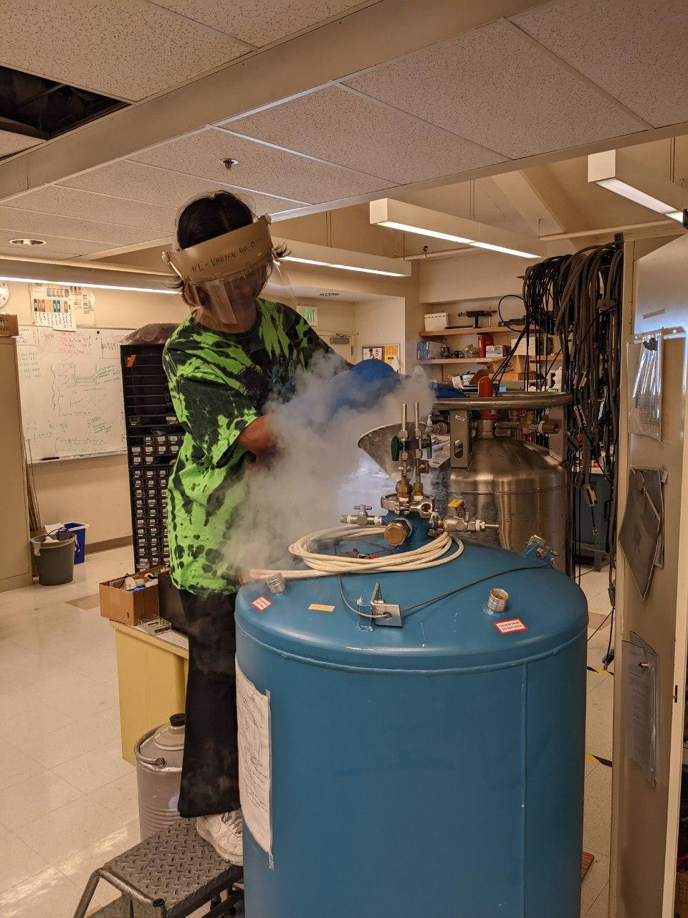
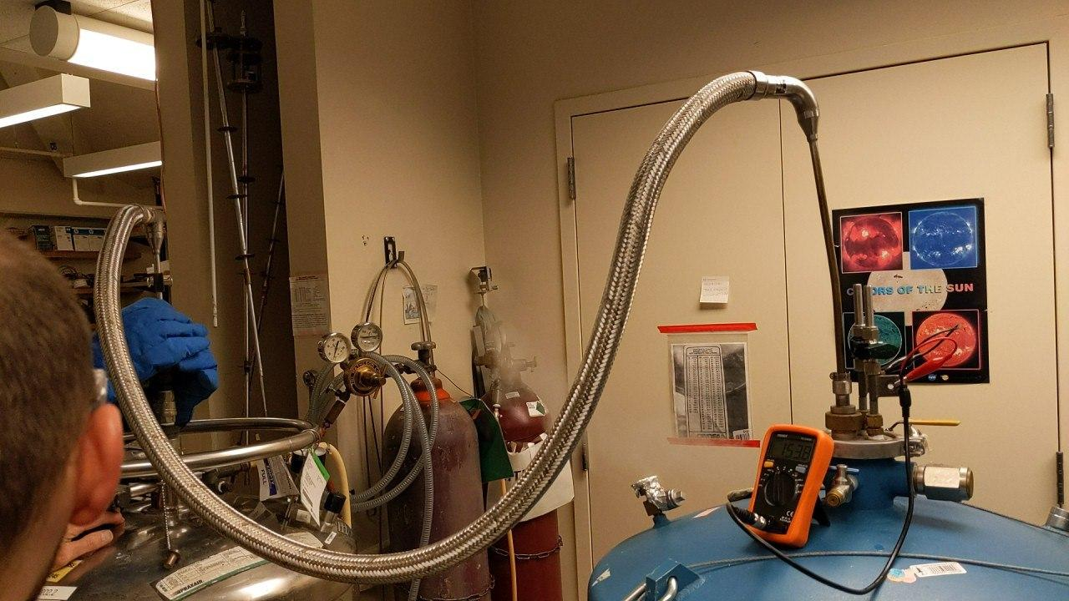
Cooling Down
Notes:
Cameron

Slide 25
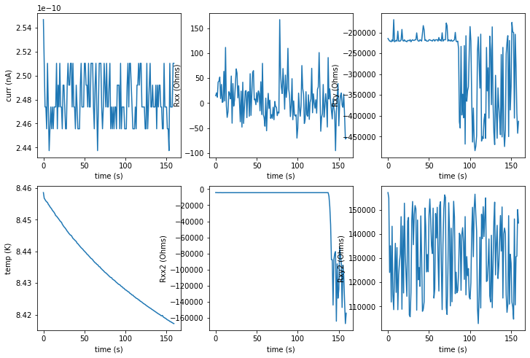

Slide 26
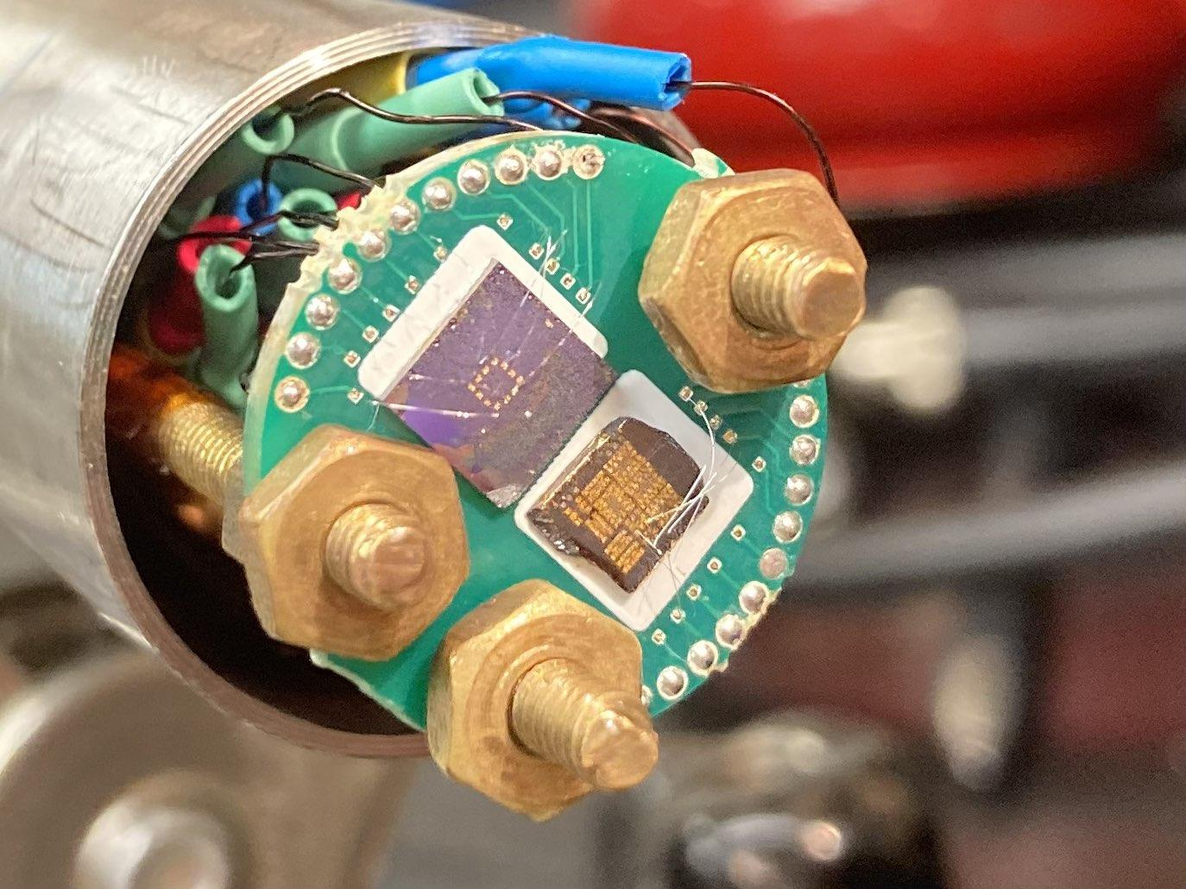
Sadness, part 2.

Slide 27
Thanks to…
Joe
Caleb
David Goldhaber-Gordon
Rick Pam
Mehmet and the Machine Shop

Slide 28
Questions

