Slide 1









High Resolution Polar Kerr Effect Studies of CsV₃Sb₅
David Saykin
APS March Meeting 2023
M58:11. GMAG: Light Matter Interaction
Mar, 8, 2023
Saykin et al., arXiv: 2209.10570

Slide 2


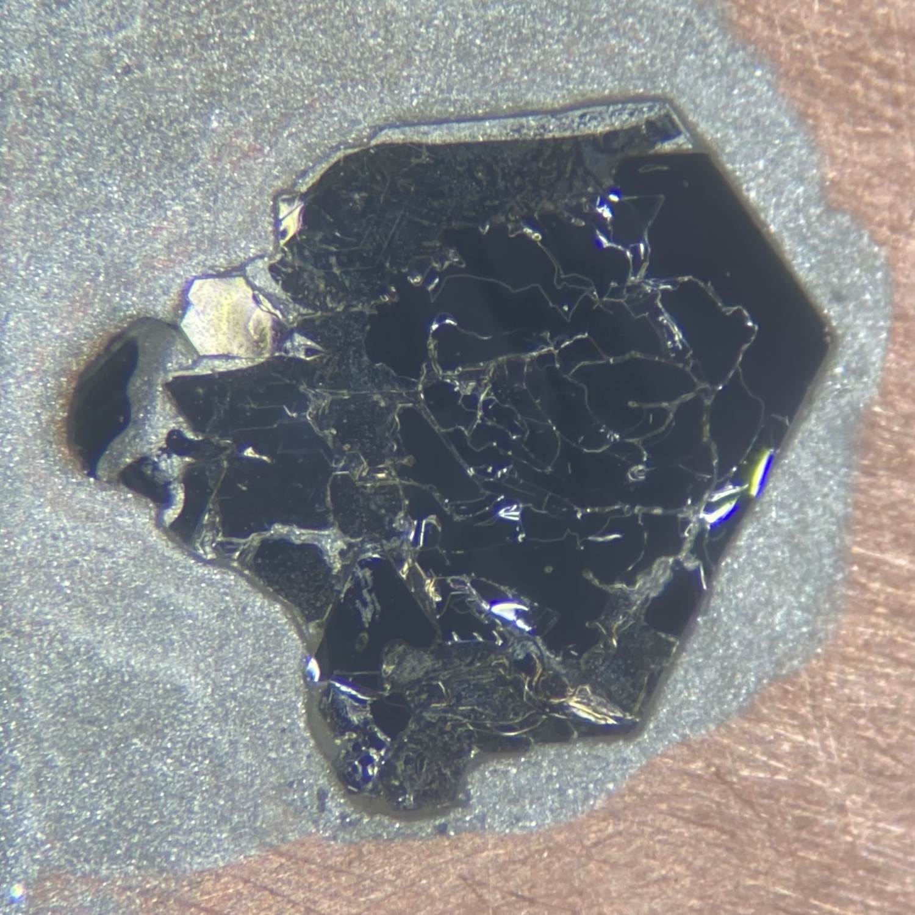
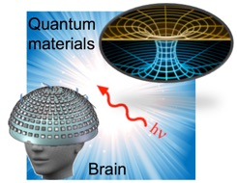
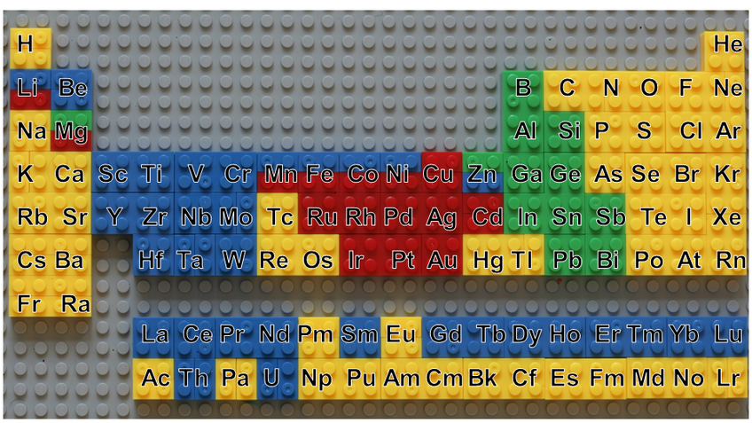

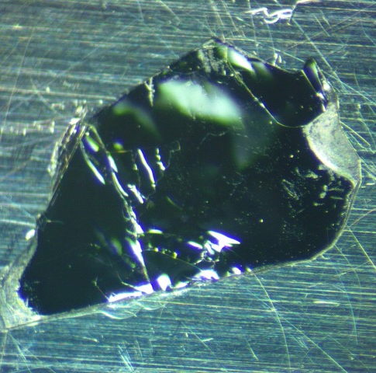
Collaboration
David Saykin
Erik Kountz
Aharon Kapitulnik
1 mm
Camron Farhang
Jing Xia
Dong Chen
Chandra Shenkar
Claudia Felser
Brenden Ortiz
Stephen Wilson
Ronny Thomale
1 mm

Slide 3
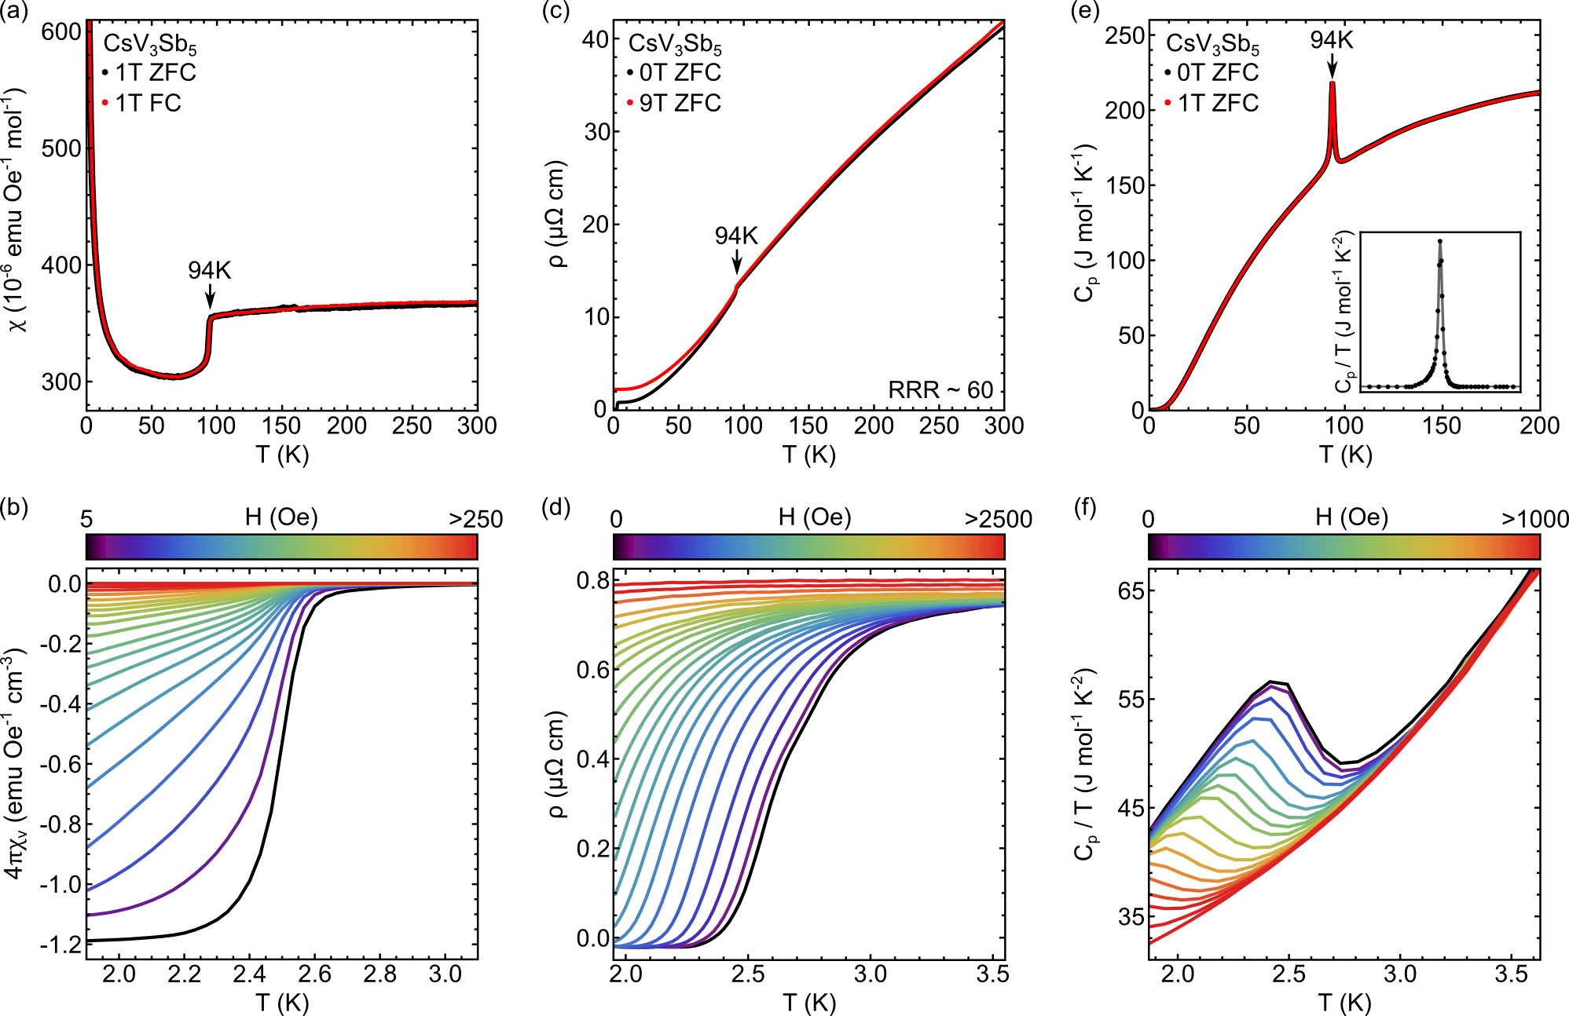
Properties of CsV₃Sb₅
Ortiz et al., PRL 125, 247002 (2020)
Layered Kagome metal
Superconducts below T_{c} = 2.5 K
Charge-density wave at T_{cdw} = 94 K
Cs
Sb
V

Slide 4
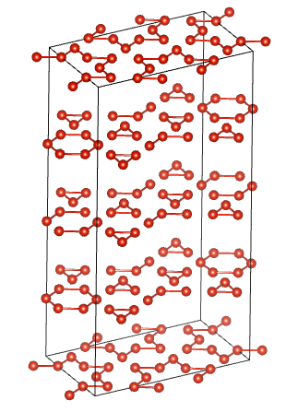

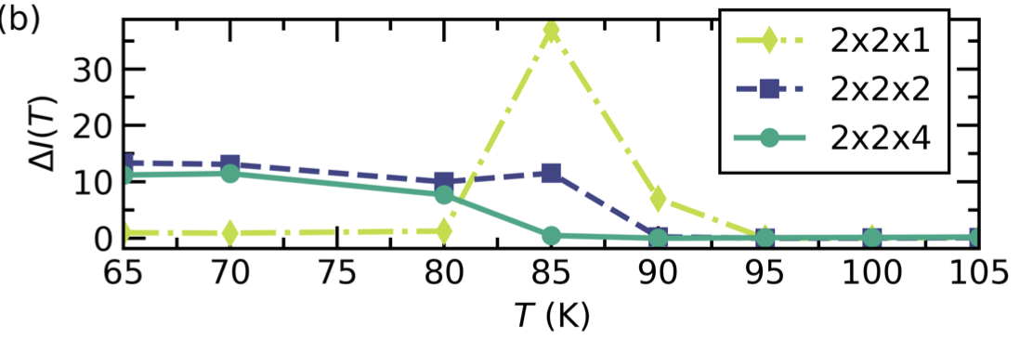
CDW structure in CsV₃Sb₅
Ortiz et al., PRX 11, 041030 (2021)
SoD
TrH
TrH
F27.8 Mallayya et al,
arXiv: 2211.16602
TrH
SoD

Slide 5
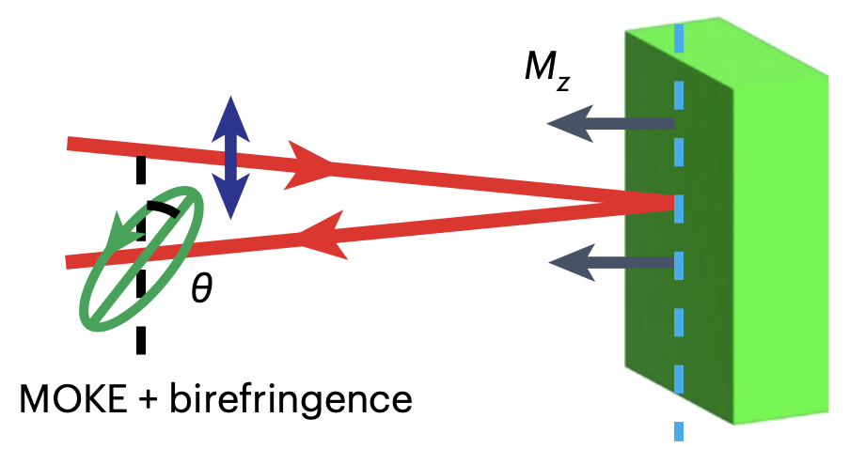
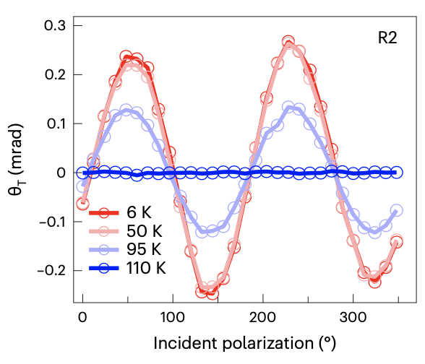
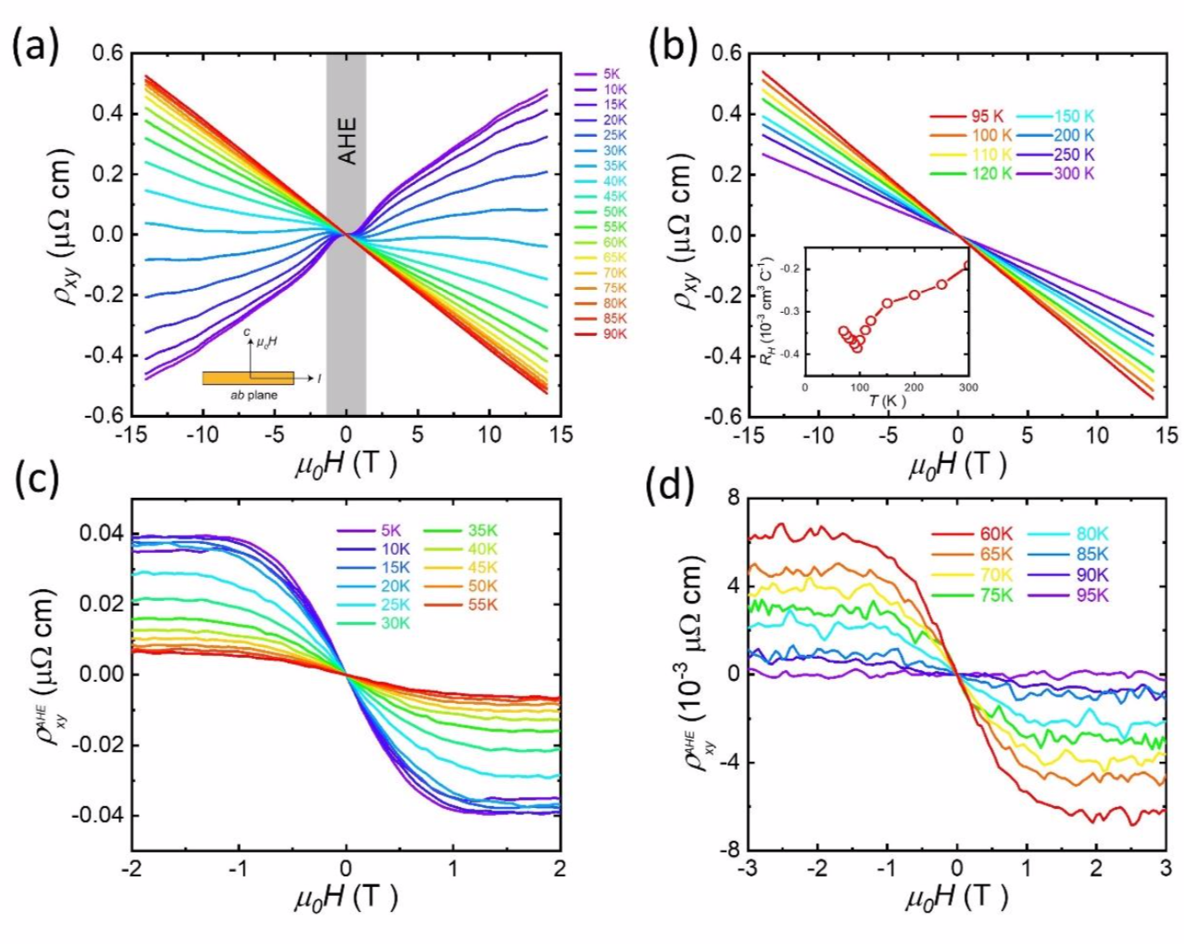
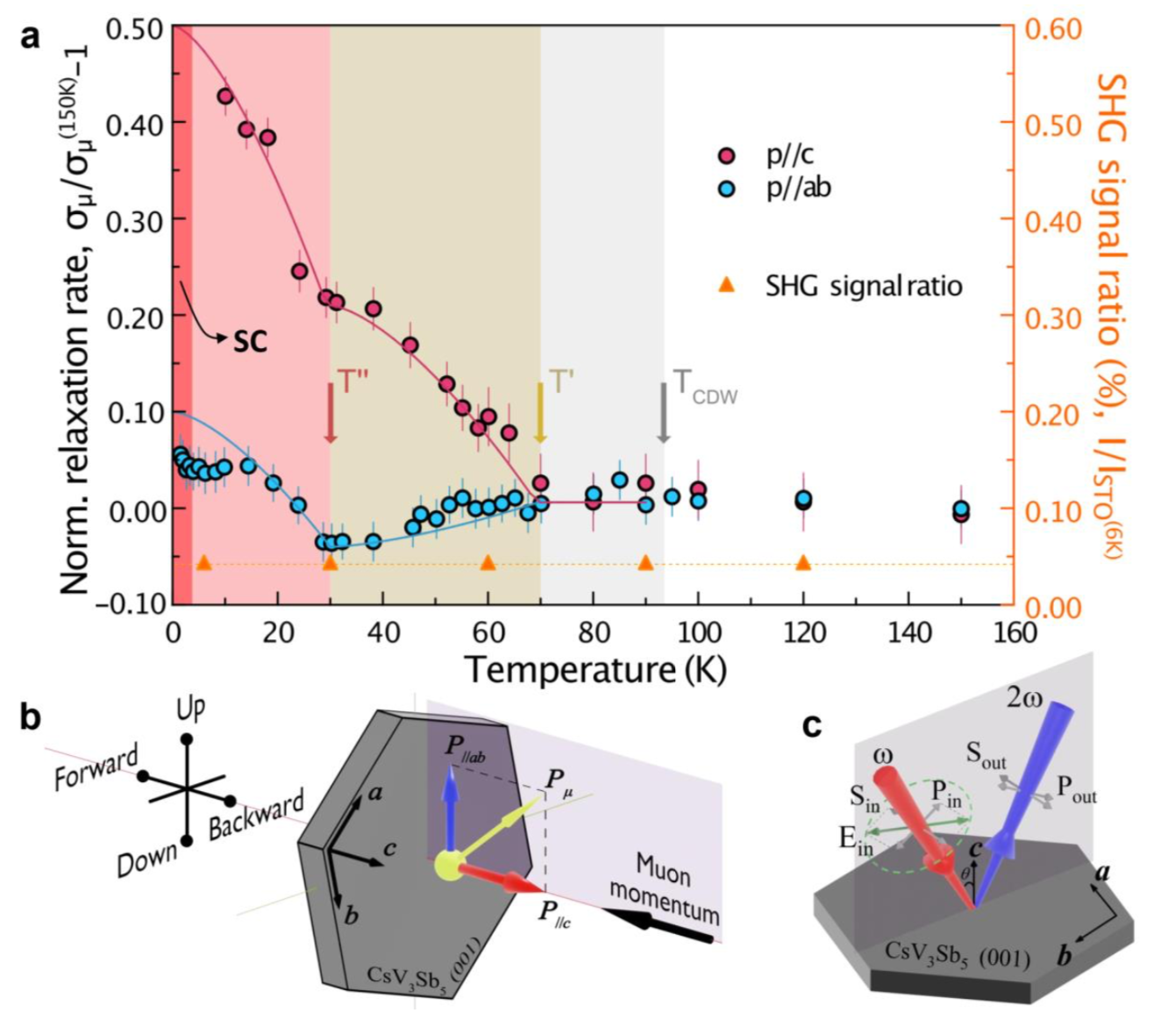
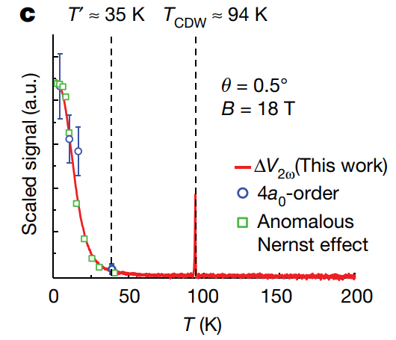
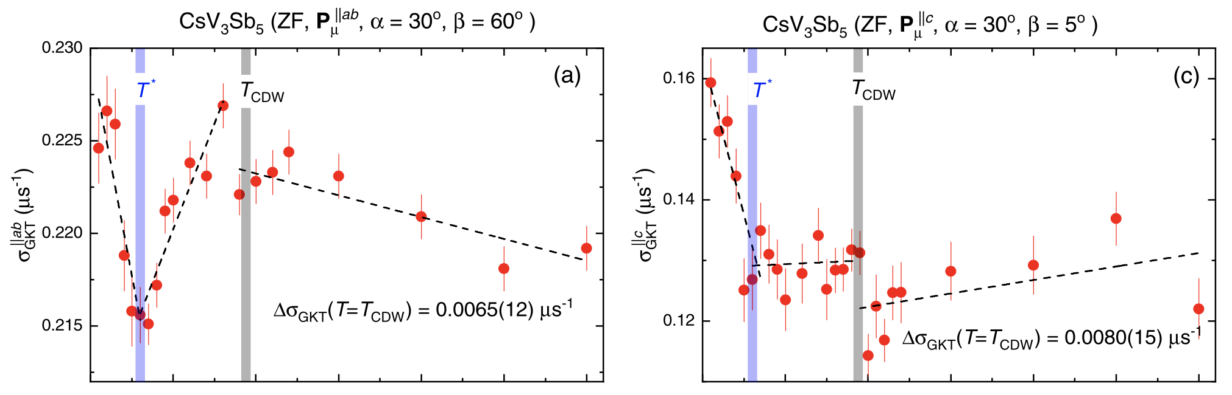
Hints of TRSB in CsV₃Sb₅
Rotation of polarization at finite incidence angle
  Wu et al., Phys. Rev. B 106, 205109
  Xu et al., nphys 18,1470 (2022)
Anomalous Hall Effect
  Yu et al., PRB 104, L041103 (2021)
Magnetochiral transport at T* = 35 K
  C. Guo et al., Nature 611, 461 (2022)
uSR rate change at T* = 30 K and T_{CDW} = 94 K
  L. Yu et al., arXiv: 2107.10714
  Khasanov et al., PRR 4, 023244
Q: Is there a time-reversal symmetry breaking?
A: Let’s test it with Polar Kerr Effect

Slide 6
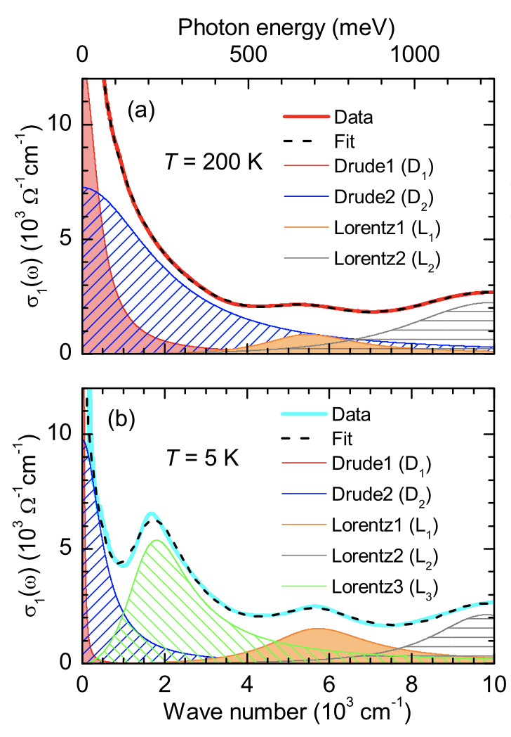
Optical properties of CsV₃Sb₅
Zhou et al. PRB 104, L041101 (2021)
Saykin et al., arXiv: 2209.10570
Reflectivity and Linear Birefringence

Slide 7
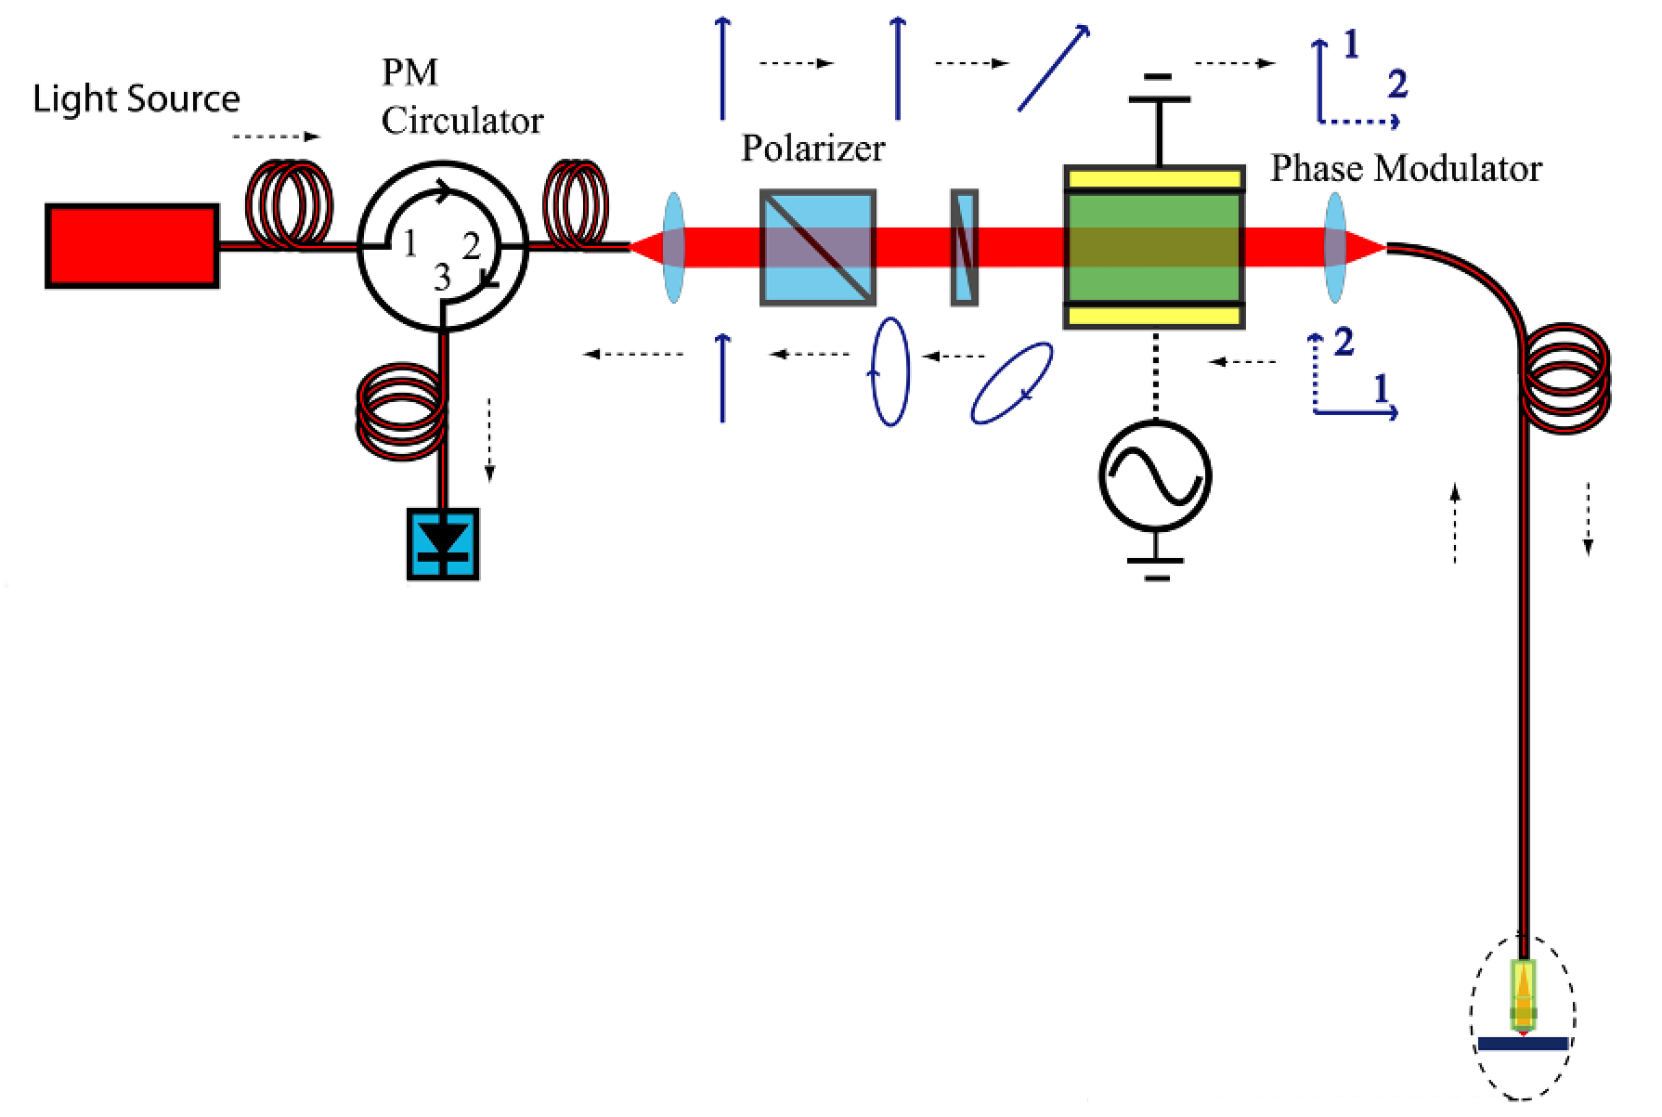
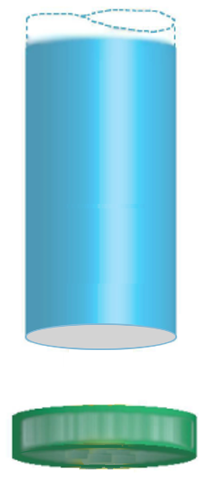
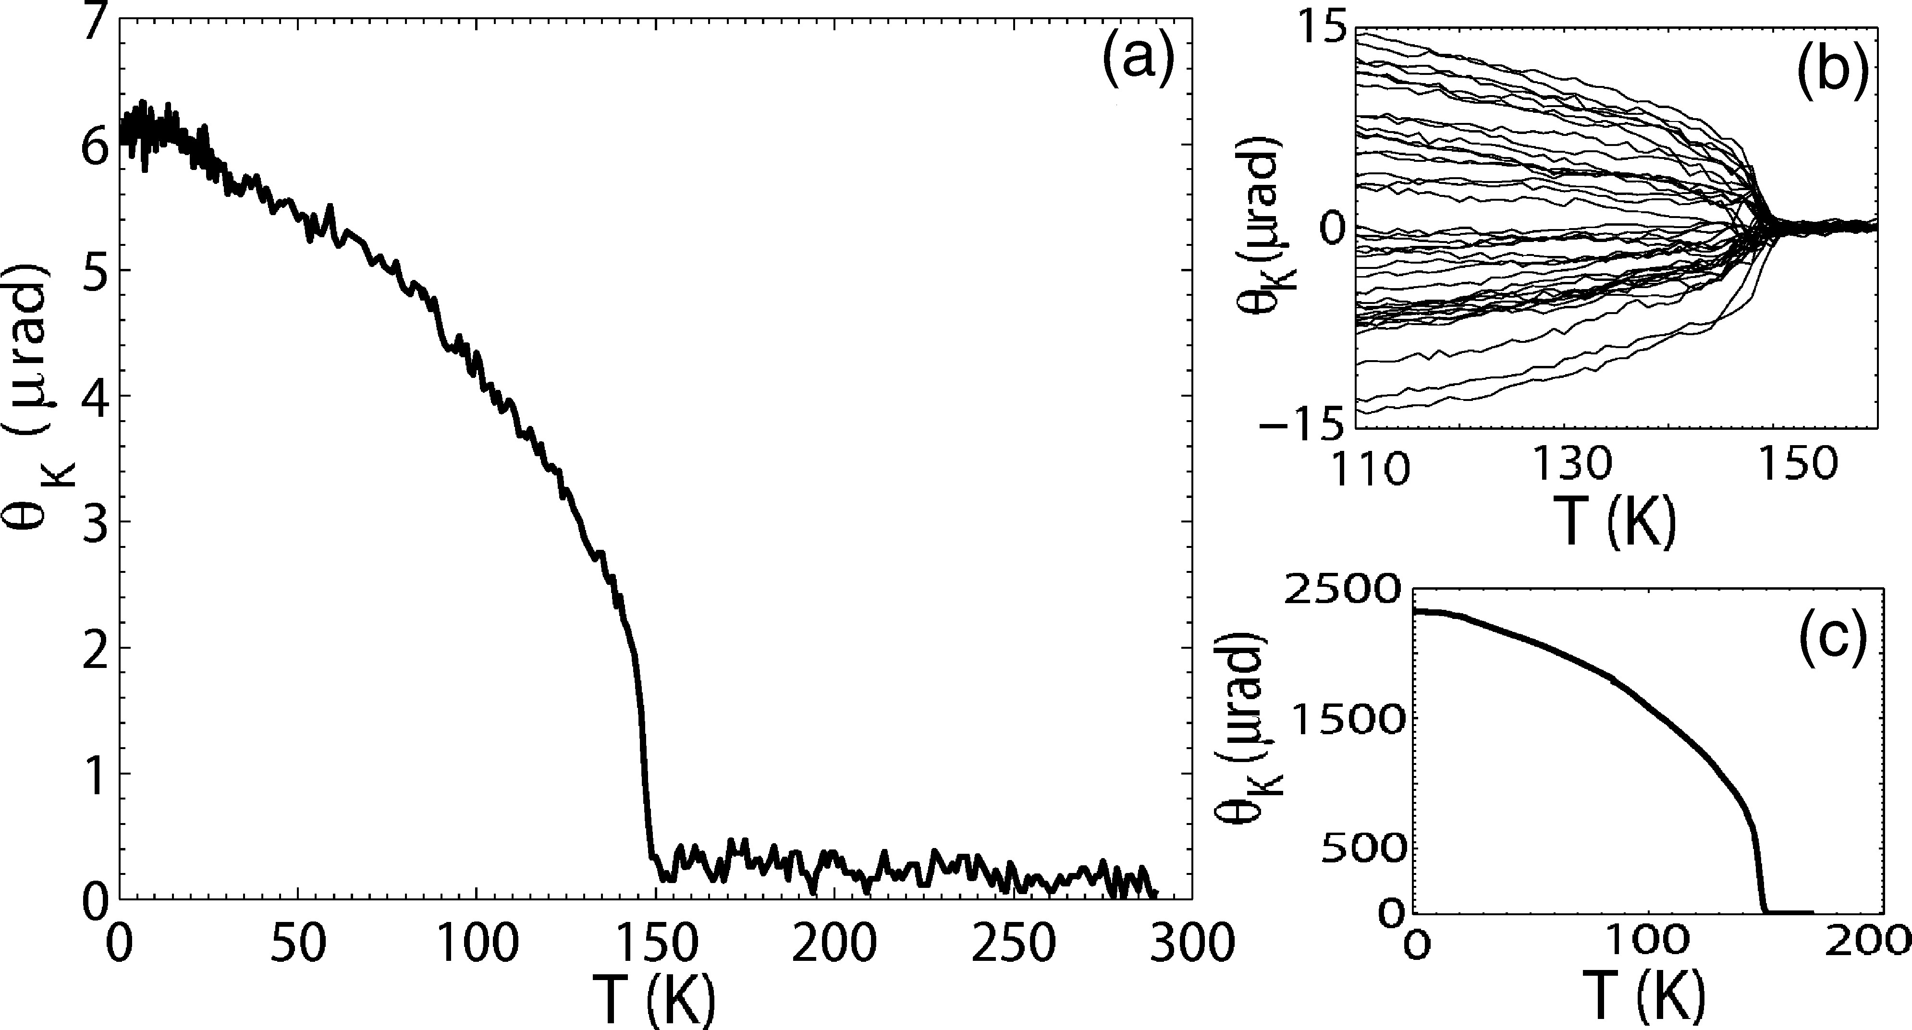
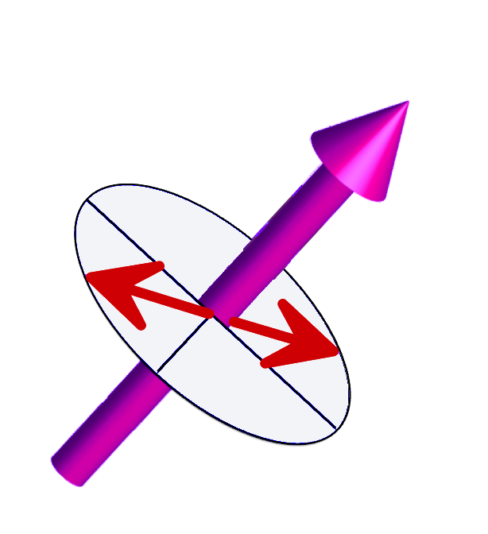
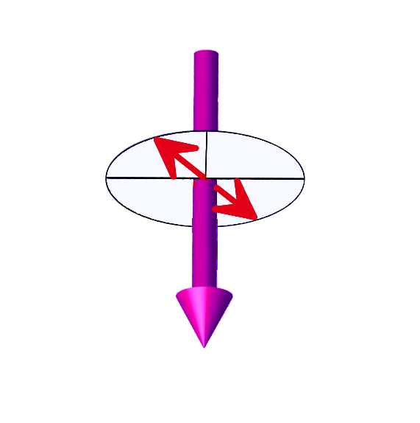




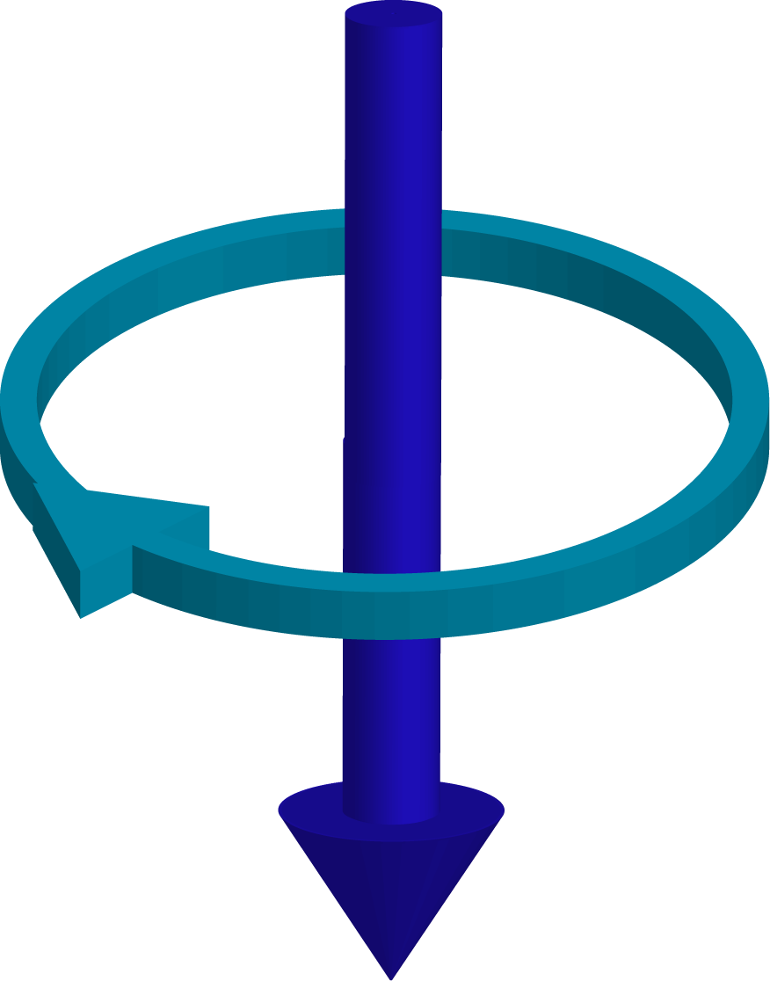
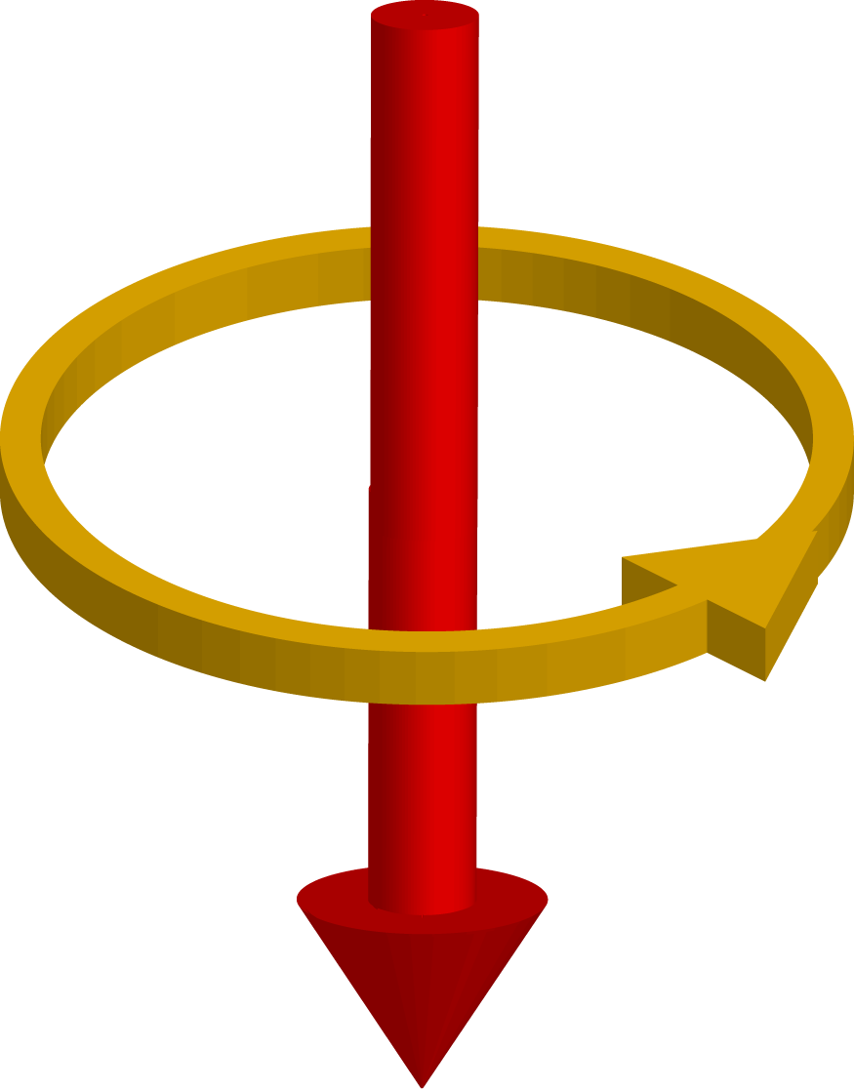
Zero-Area Sagnac Interferometer
Xia et al., APL 89, 062508 (2006)
Fiber
SrRuO₃
1
2
1550 nm
1
2
1
2
Properties:
Reciprocity
Robust against:
  Linear birefringence
  Optical activity
D = 27 um
P = 100 uW
1
2
Sample

Slide 8
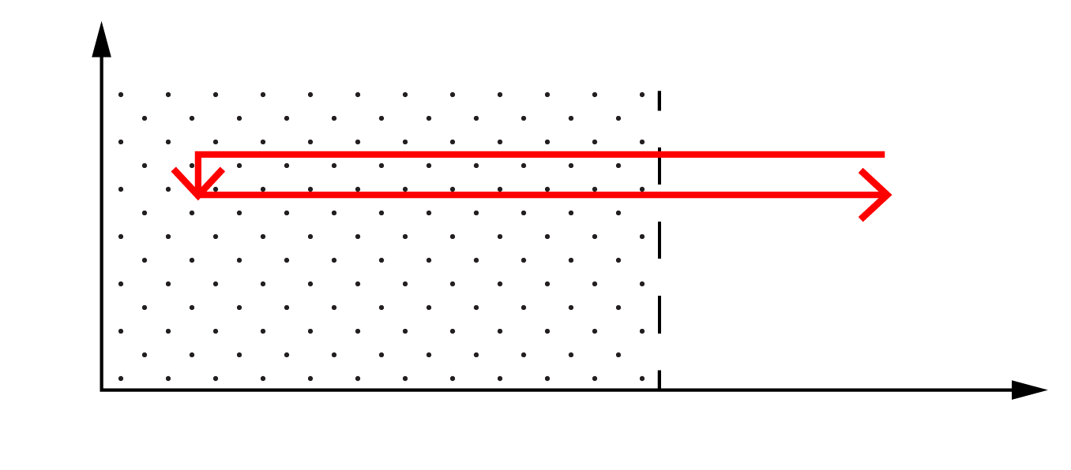
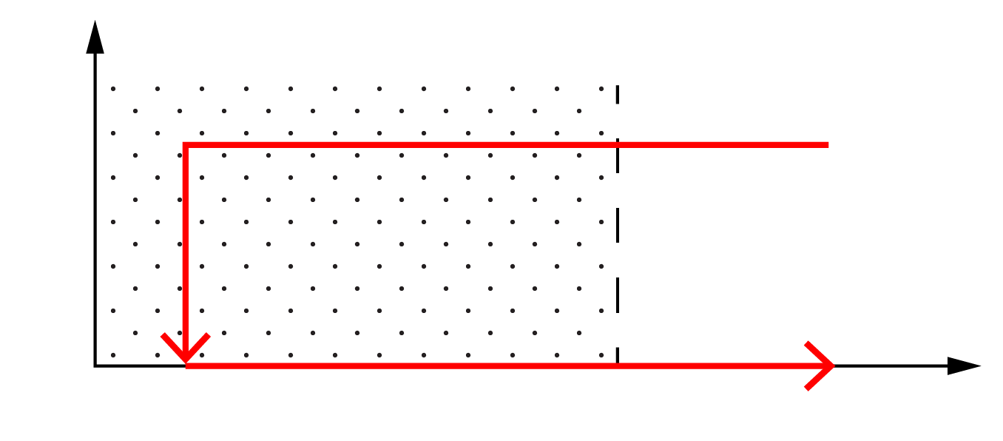
Diamagnetic Kerr response.
NO TRSB
Saykin et al., arXiv: 2209.10570
Sample 1 (Stanford, Dresden)
Sample 2 (Irvine, UCSB)
B
Data acquisition
T
T_{base} = 4.2 K
T_{CDW} = 93.5 K
B
H_{train}
T
Data acquisition
In-field Kerr signal demonstrates diamagnetic-like response onsetting at T_{cdw}
Zero-field Kerr signal shows no TRSB (within resolution ~30 nrad)

Slide 9
Summary
Saykin et al., arXiv: 2209.10570
Studied two independently grown CsV₃Sb₅ samples in two different laboratories in temperature range 4.2 K < T < 300 K
We detect CDW via birefringence
We observe diamagnetic shift in Kerr signal at T_{CDW} (in field)
We detect no spontaneous, uniform Time-Reversal Symmery Breaking within the resolution of our apparatus ~30 nanorad
    Finite-q TRSB is a possibility, but AFM order would not show diamagnetism

Slide 10
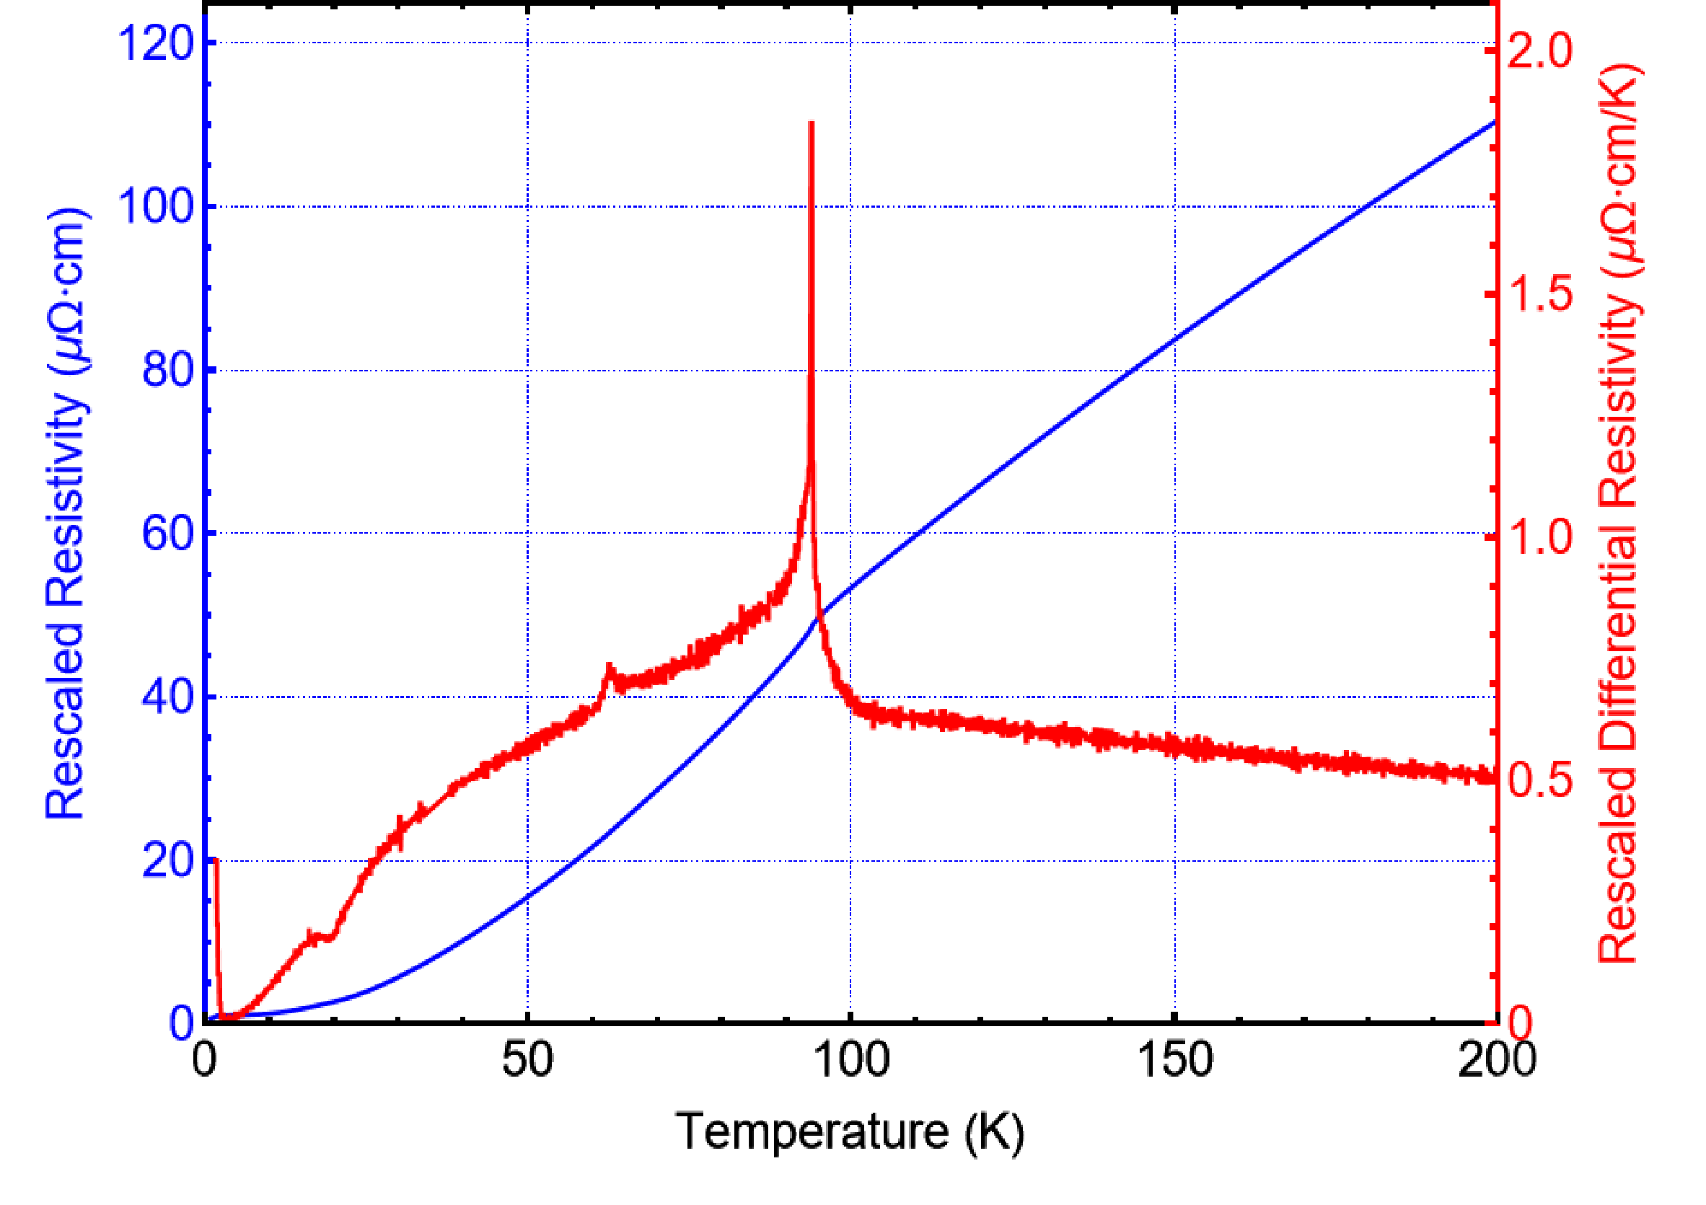
Resistance data
Saykin et al., arXiv: 2209.10570
Sample 1

Slide 11
Kerr microscopy (Sample 2)
Saykin et al., arXiv: 2209.10570
Finite-q TRSB (antiferromagnetic order) would not be detected by Sagnac interferometer due to finitebeam spot size ~20 um.
We see no spatial dependence of Kerr signal in 2D scan performed with 20 um resolution

Slide 12
Superconductivity in CsV₃Sb₅
Ortiz et al., PRL 125, 247002 (2020)

Slide 13
Anomalous Hall Effect
Yu et al., PRB 104, L041103 (2021)

Slide 14
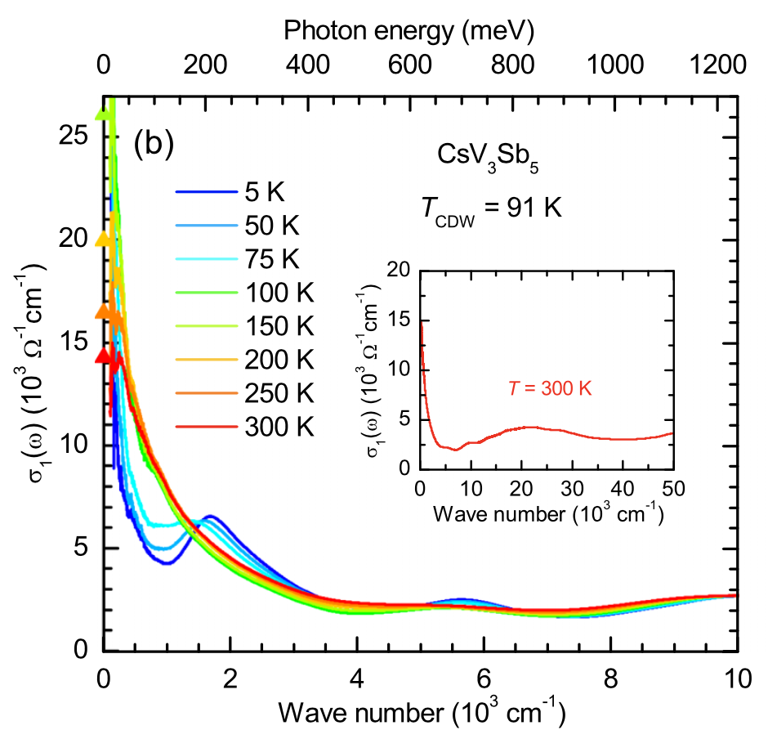
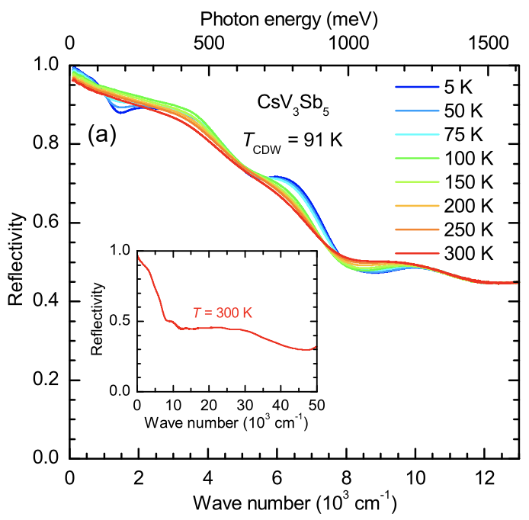
Optical properties of CsV₃Sb₅

Slide 15
Reflectivity and linear birefringence
Saykin et al., arXiv: 2209.10570
We are able to detect onset of linear birefringence simultaneously with Kerr effect measurements

Slide 16
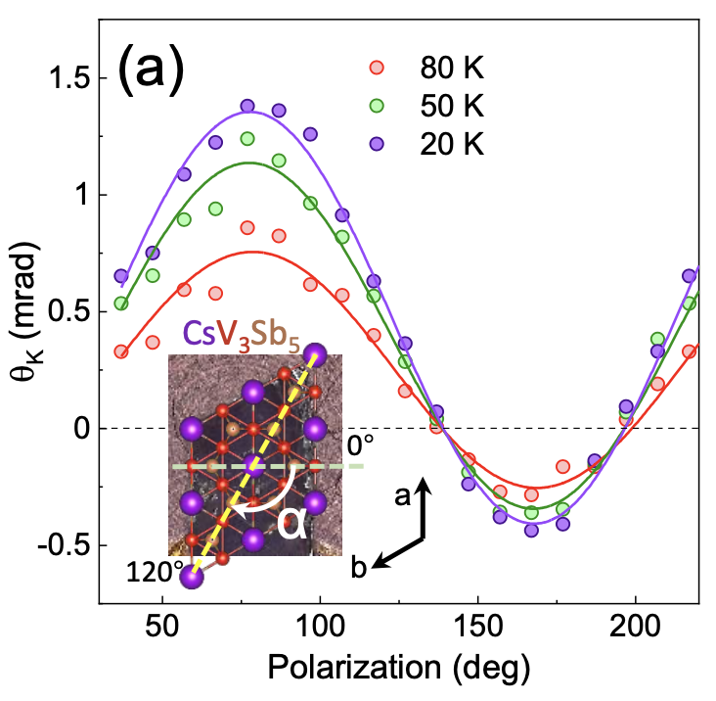
Linear Kerr effect measurements
Wu et al., Phys. Rev. B 106, 205109
Xu et al., nphys 18, pages 1470–1475 (2022)

Slide 17
Acknowledgements
Work at Stanford University was supported by the U.S. Department of Energy,
Office of Science, Basic Energy Sciences, Division of Materials Sciences and Engineering,
under Contract DE-AC02-76SF00515.
Work at UC Irvine was supported by the Gordon and Betty Moore Foundation through Grant GBMF10276.
S.D.W. and B.R.O. acknowledge support via the UC Santa Barbara NSF Quantum Foundry funded via the Q-AMASE-i pro- gram under award DMR-1906325.
R.T. acknowledges support from the Deutsche Forschungsgemeinschaft (DFG, German Research Foundation) through QUAST FOR 5249-449872909 (Project P3), through Project-ID 258499086-SFB 1170, and from the Würzburg-Dresden Cluster of Excellence on Complexity and Topology in Quantum Matter –
ct.qmat Project-ID 390858490-EXC 2147.

