Slide 1



Polar Kerr Effect Studies of Kagome Metals CsV₃Sb₅ and ScV₆Sn₆
David Saykin
March 7, 2024
APS March Meeting 2024
W16: Competing Orders in the Kagome Lattice Superconductors
Saykin et al., PRL 131, 016901 (2023)
Notes:
Samples came from MPI Dresden,
Work was funded by DOE, Office of Science, Basic Energy Sciences, Division of Materials Sciences and Engineering, under Contract DE-AC02-76SF00515.
This presentation is continuation of results published in PRL and concentrates on new results.

Slide 2
Part 1. Introduction
Part 2. Kerr effect measurements
W16: D. Saykin

Slide 3
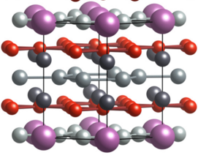
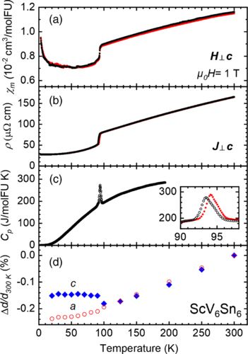
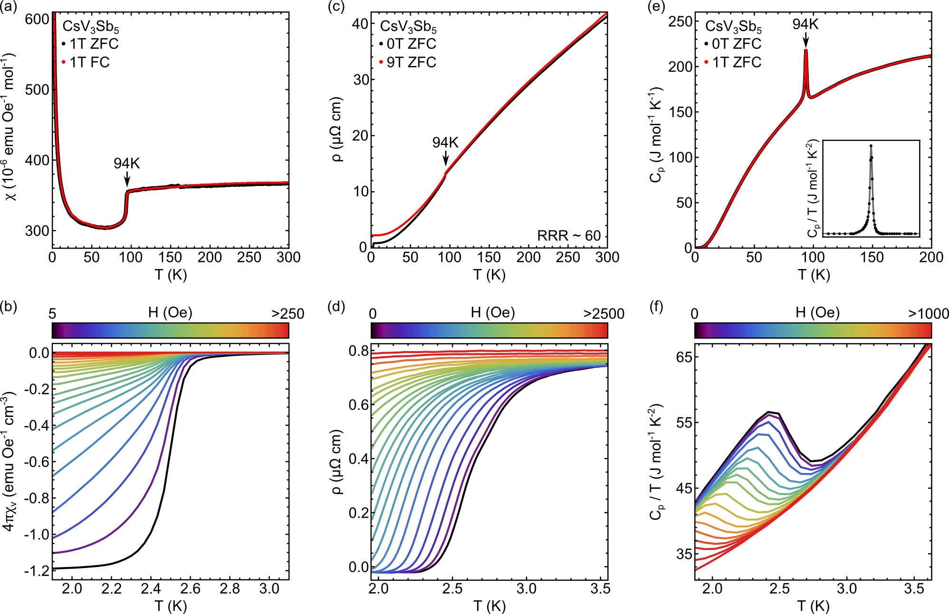
CsV₃Sb₅ and ScV₆Sn₆
Ortiz et al., PRL 125, 247002 (2020)
Arachchige et al., PRL 129, 216402 (2022)
Layered Kagome metals with Charge-density wave at T_{cdw} ~ 94 K
Cs
Sn₃
V
Sb
Sn₁
Sn₂
V
Sc
92 K
92 K
Notes:
d-electrons of vanadium contribute to bands near fermi-energy

Slide 4
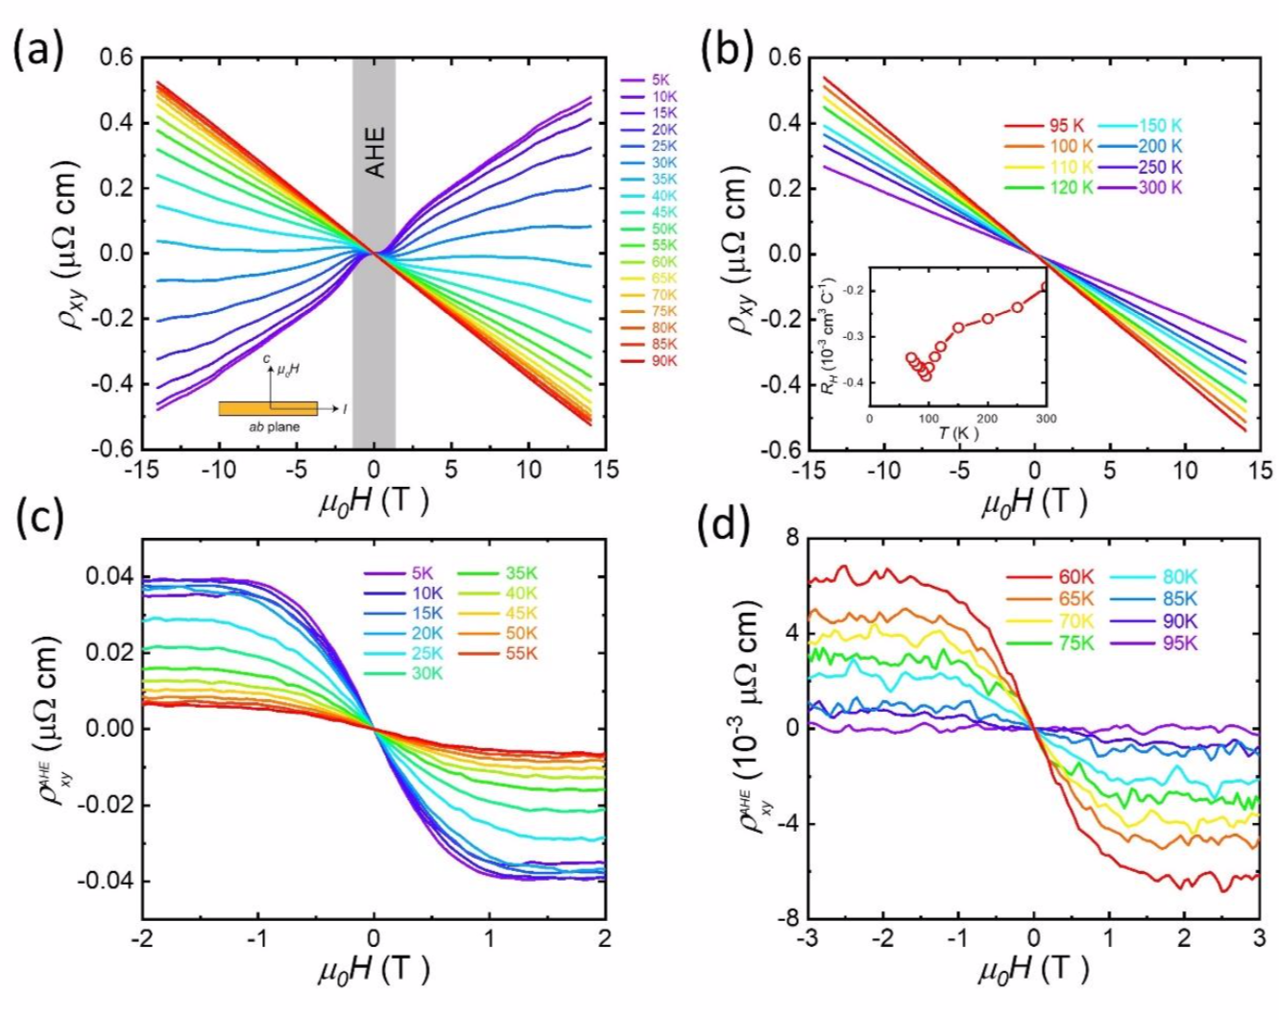
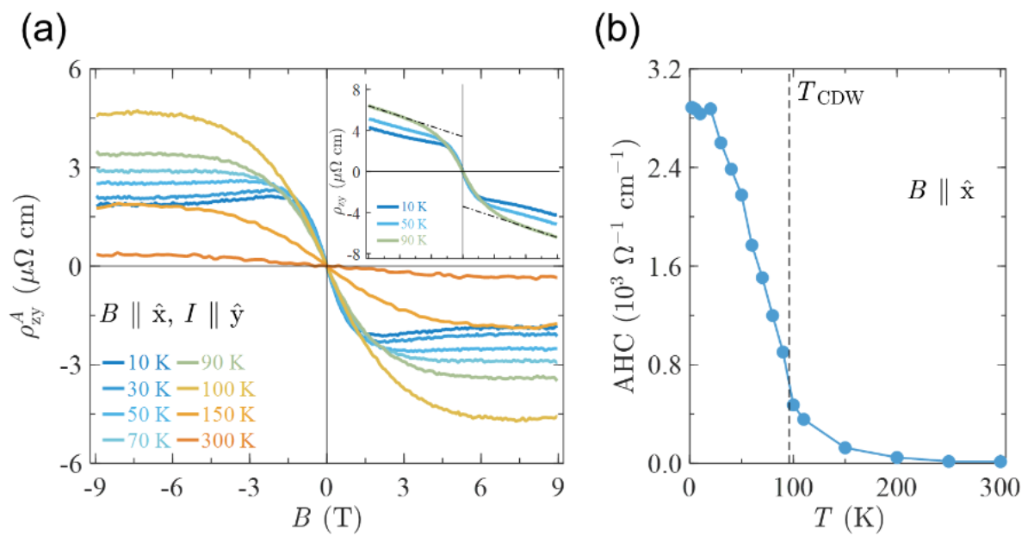
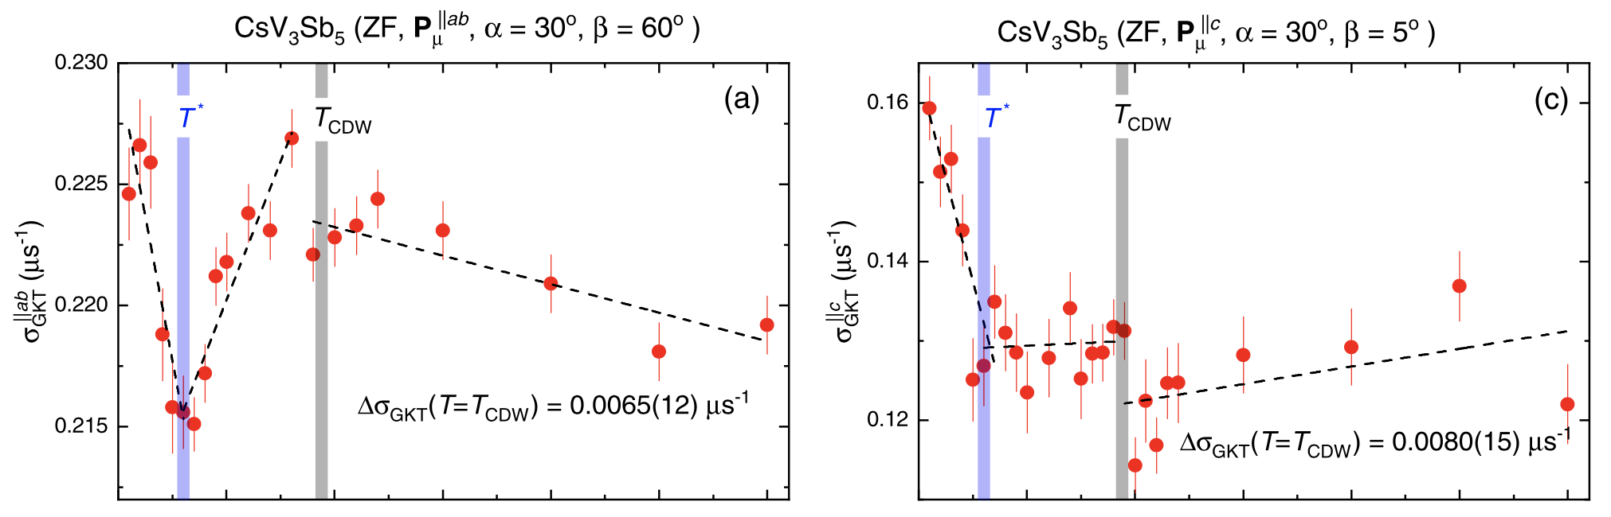
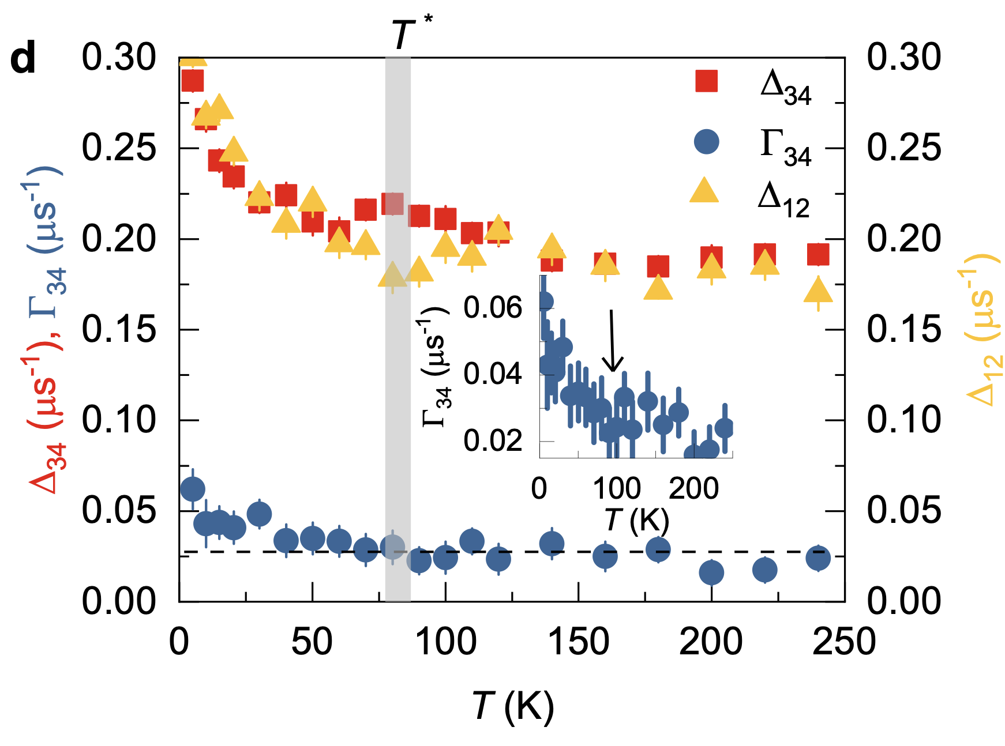
TRSB at CDW?
Yu et al., PRB 104, L041103 (2021)
Yi, PRB 109, 035124 (2024)
Khasanov et al., PRR 4, 023244 (2022)
Guguchia et al., arXiv:2304.06436
“Anomalous” Hall Effect
ScV₆Sn₆
CsV₃Sb₅
uSR rate change at T_{CDW}
Notes:
Add optical measurement here. Liang Wu.
Say “TRSB associated with CDW”

Slide 5
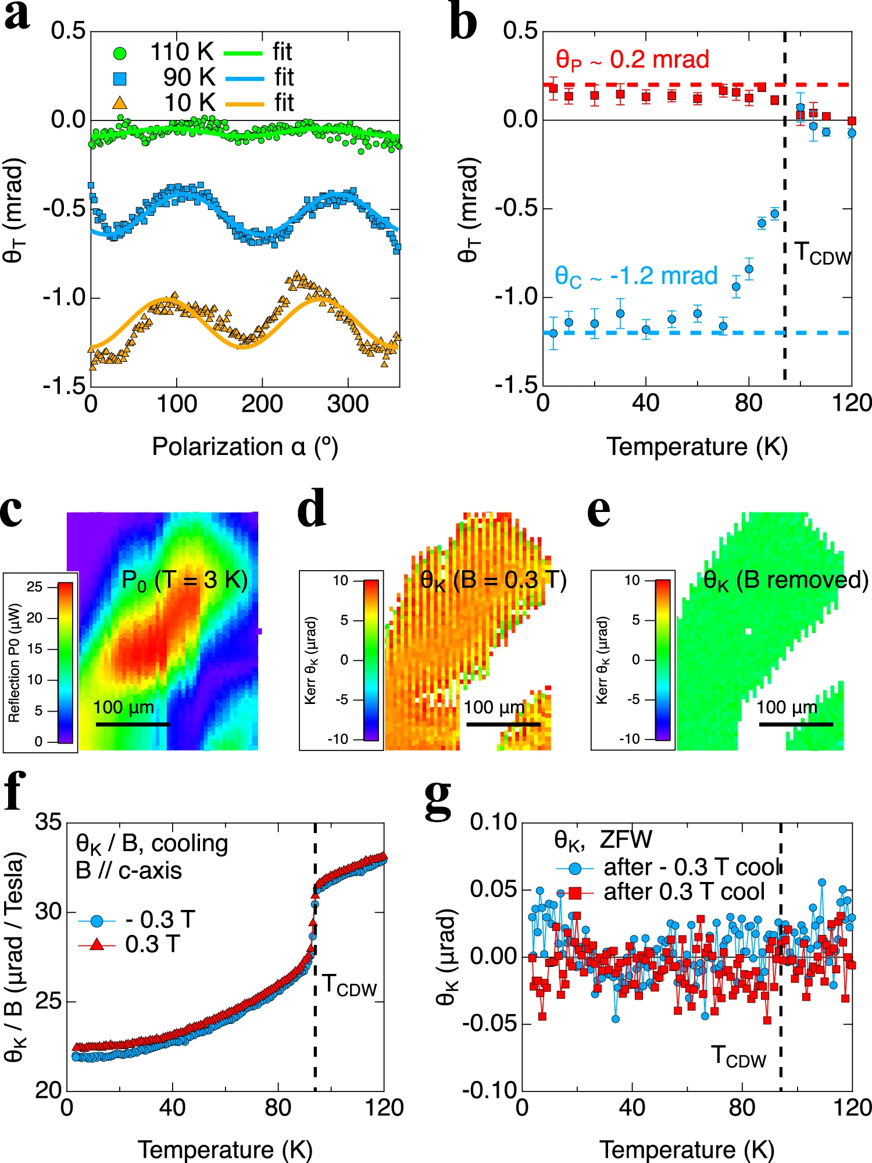
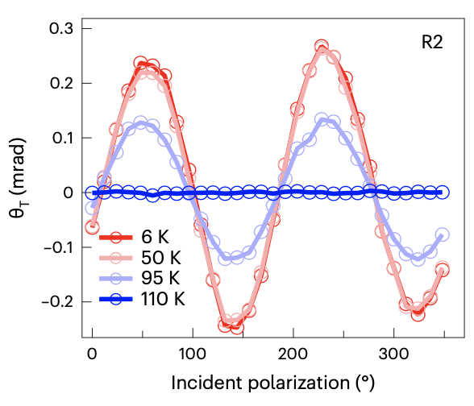
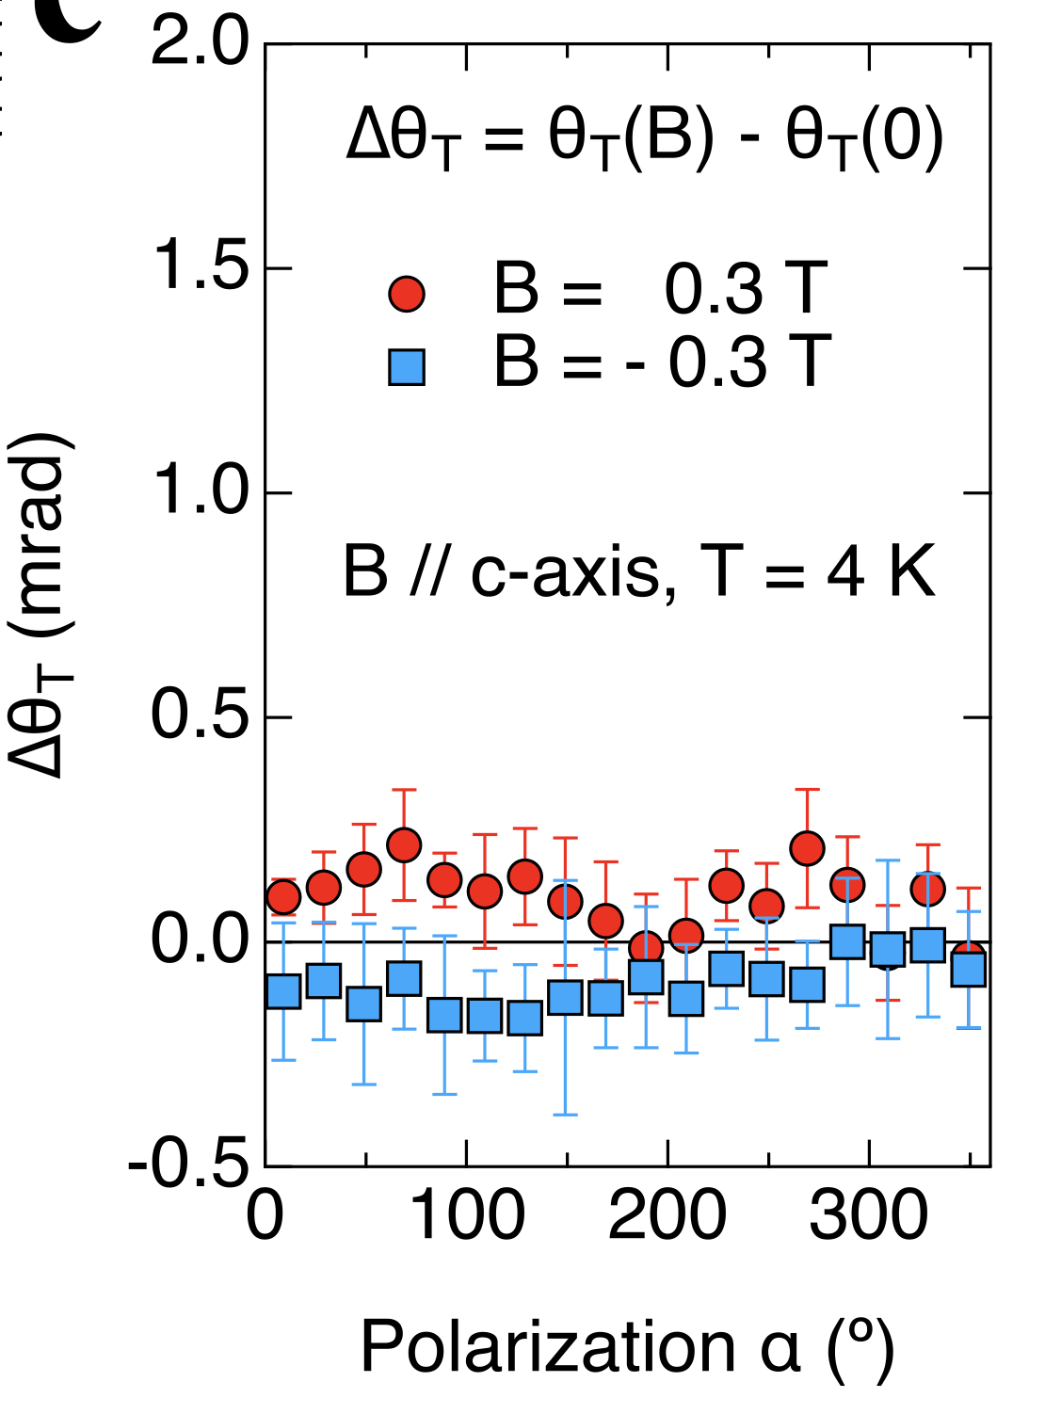
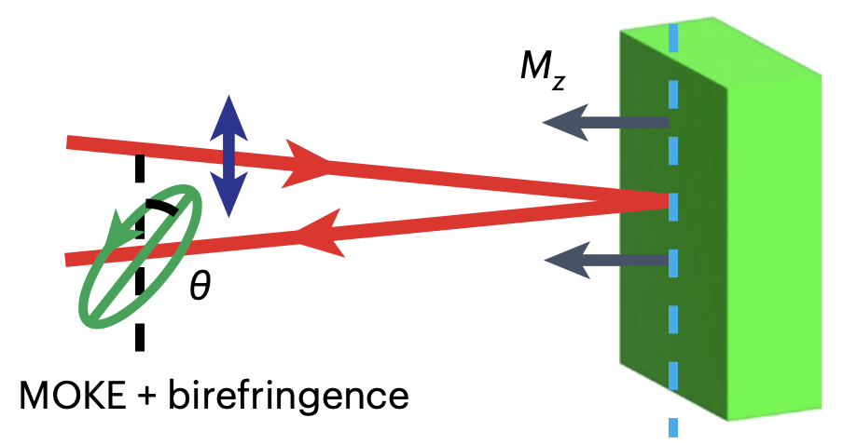

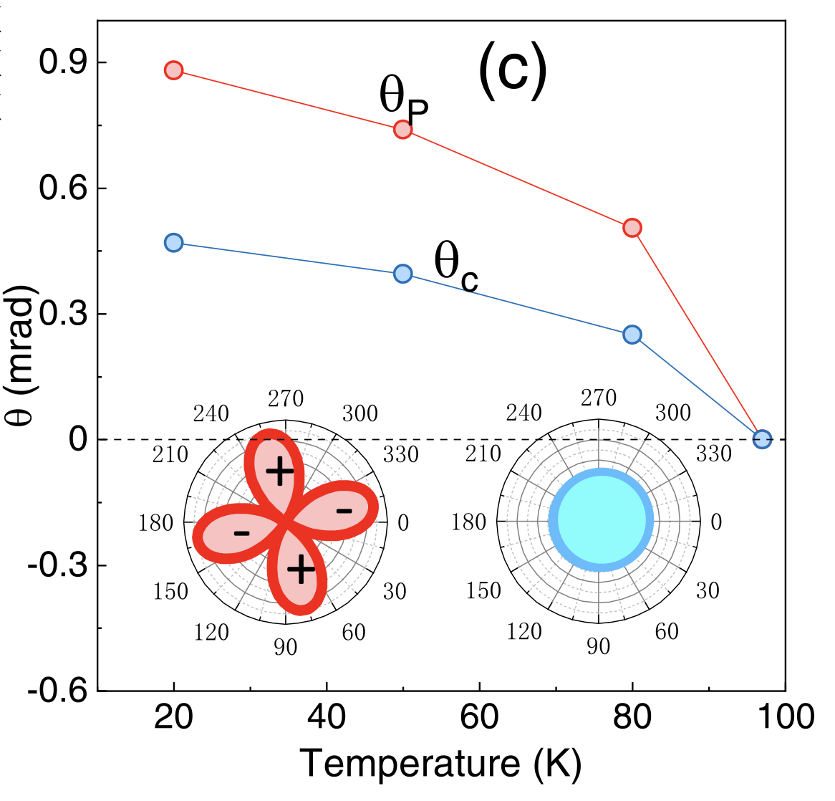
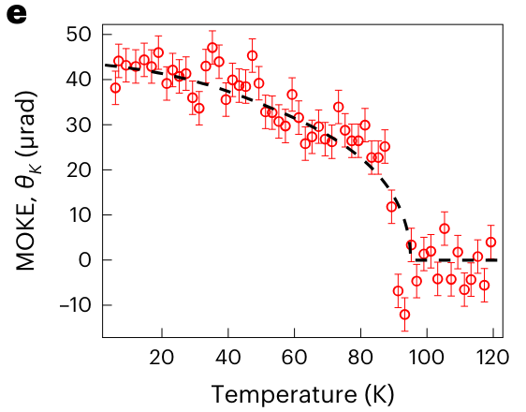
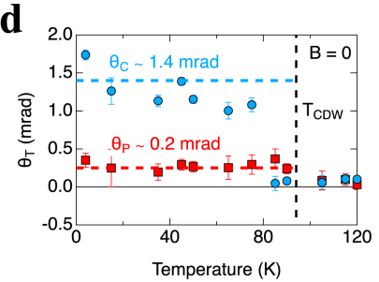
TRSB at CDW?
Xu et al., nphys 18, 1470–1475 (2022)
Farhang et al., ncomms 14, 5326 (2023)
Wu et al., PRB 106, 205109
1550 nm vs 800 nm
CsV₃Sb₅
Notes:
Add optical measurement here. Liang Wu.
TRSB associated with CDW

Slide 6
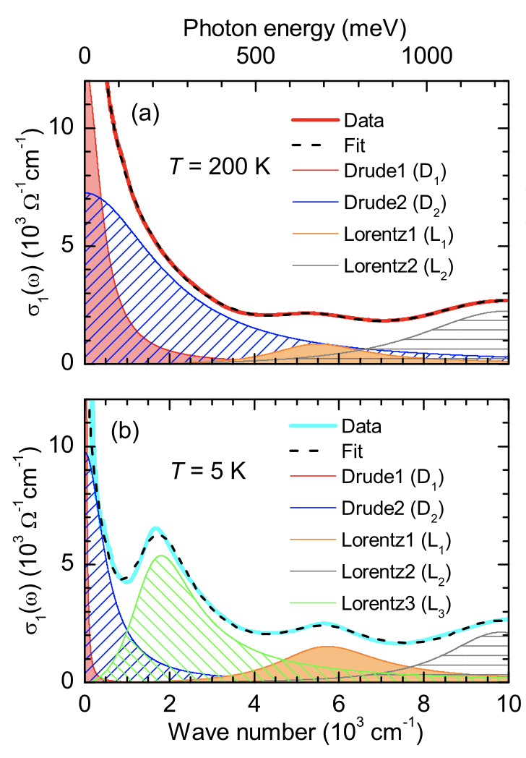
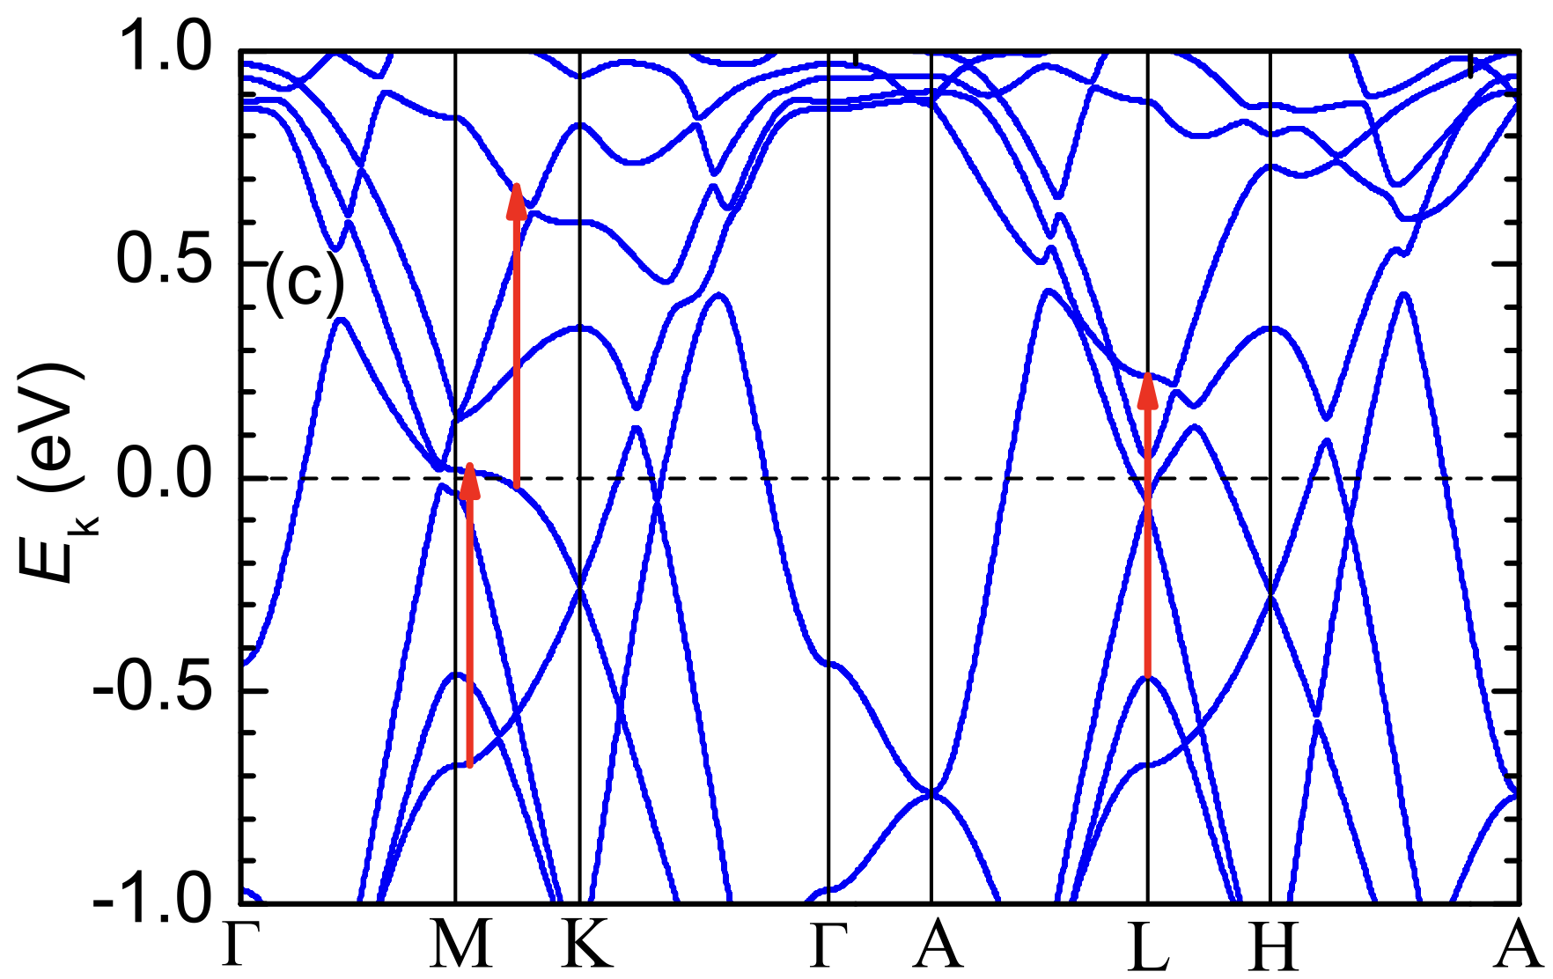
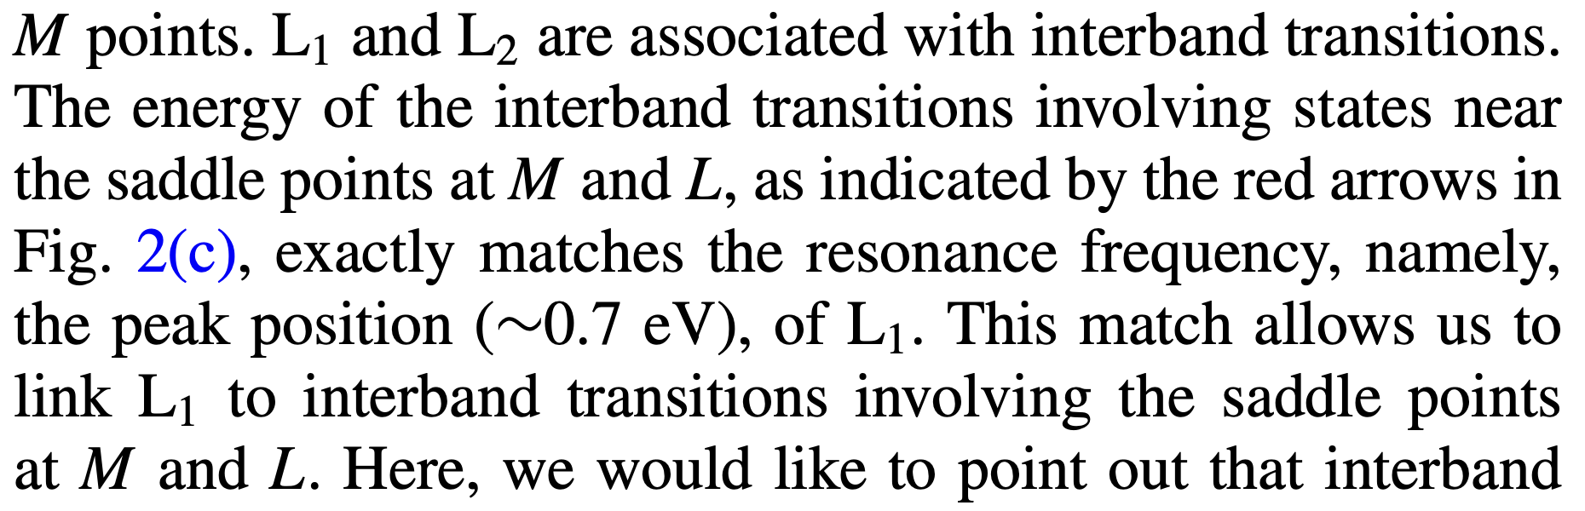
Optical properties of CsV₃Sb₅
Zhou et al. PRB 104, L041101 (2021)
1550 nm vs 800 nm
800 nm
5000
1550
1000
800
Wavelength (nm)
Notes:
Add optical measurement here. Liang Wu.
TRSB associated with CDW

Slide 7
Part 1. Introduction
Part 2. Kerr effect measurements
W16: D. Saykin

Slide 8
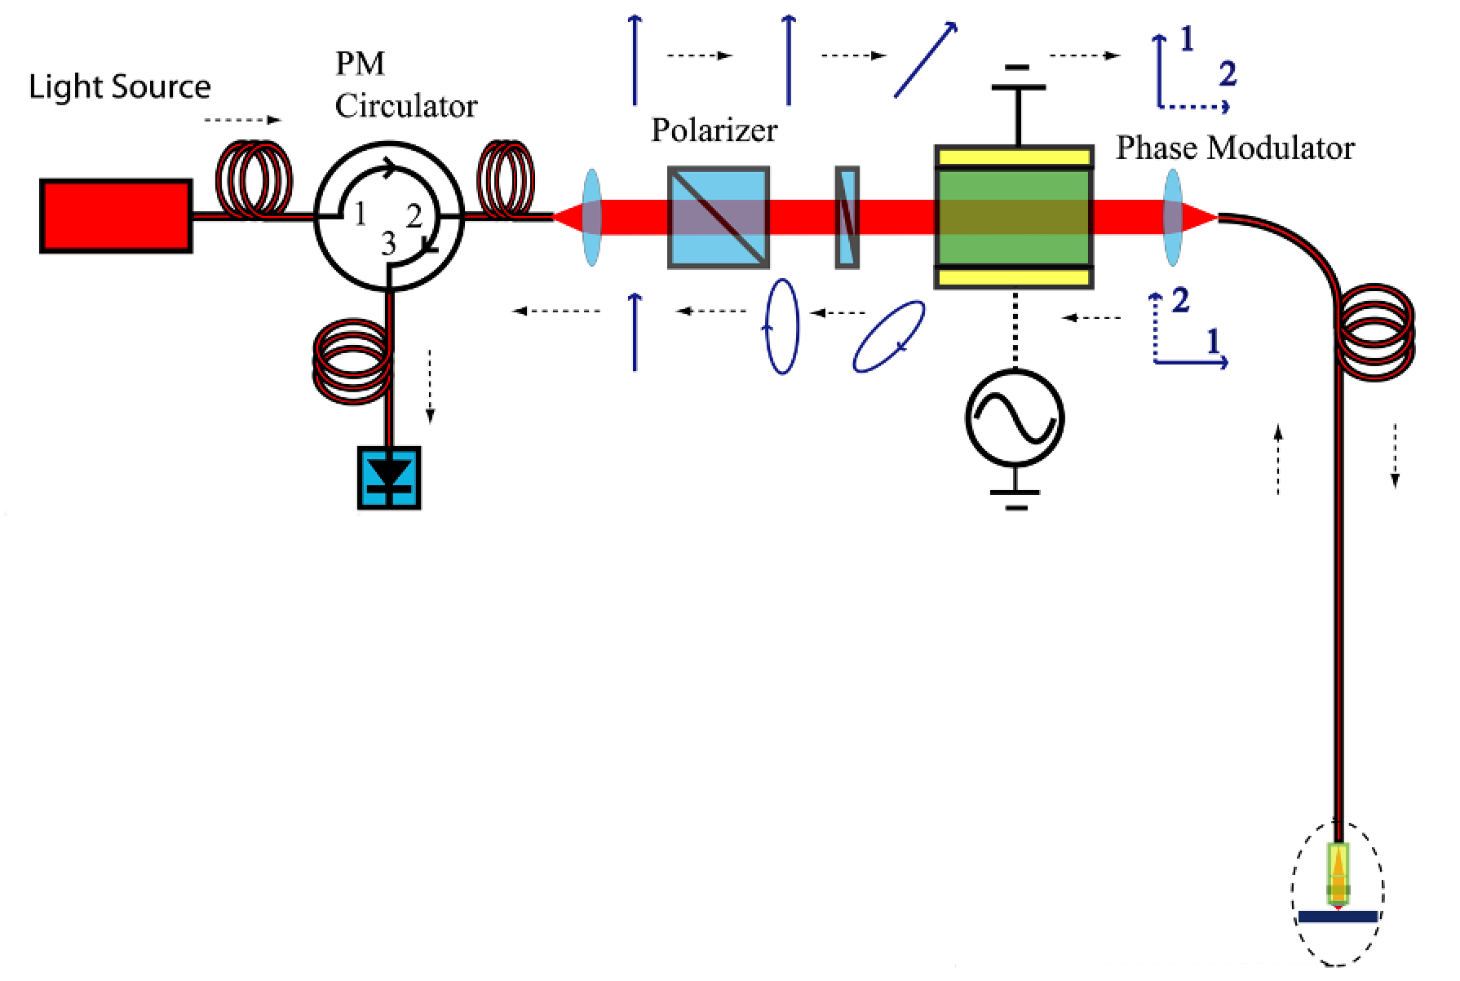
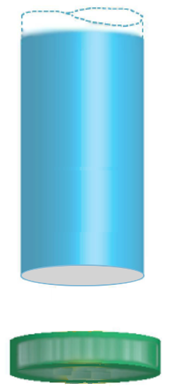
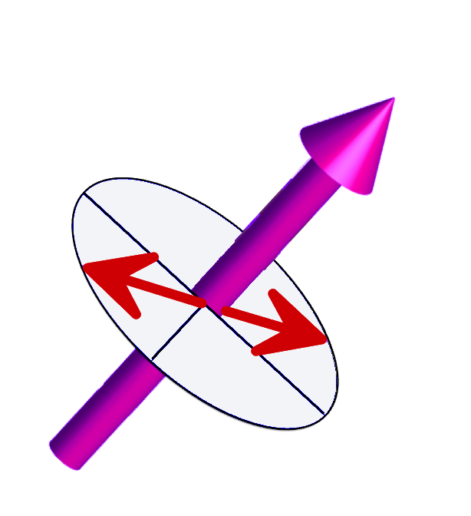
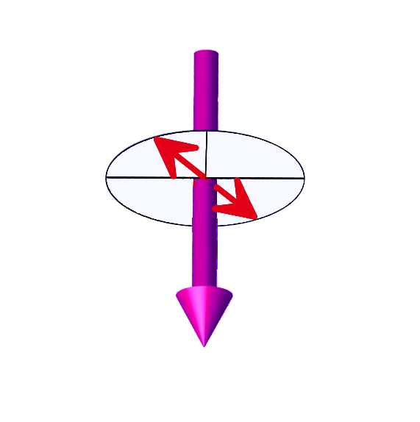




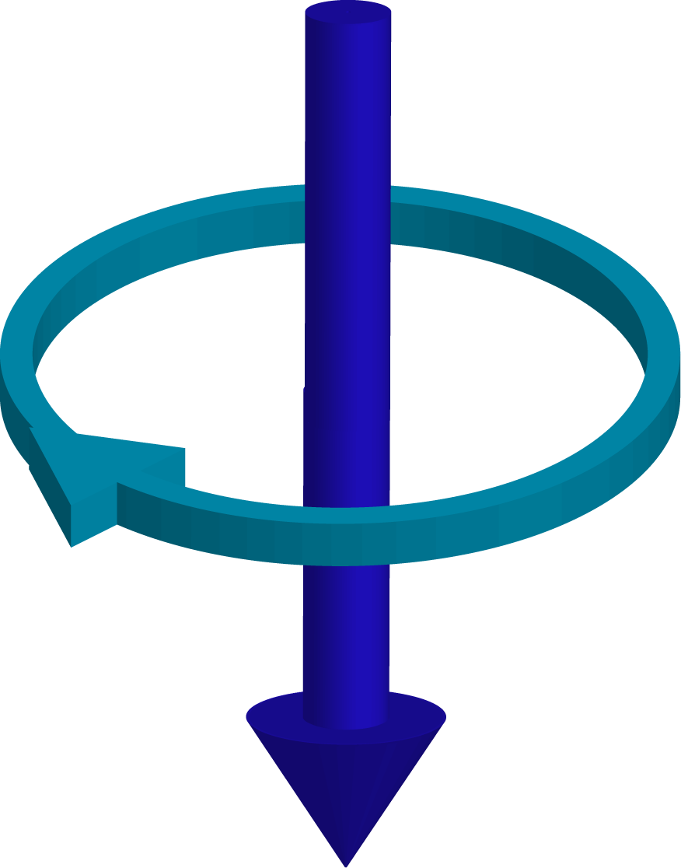
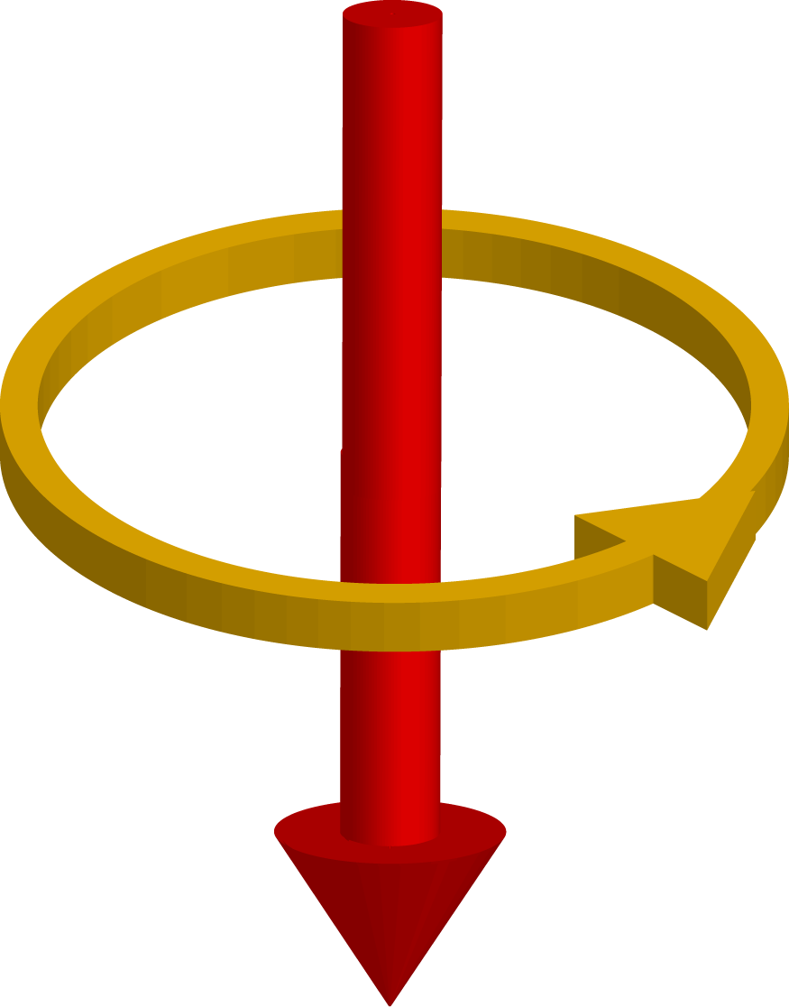

Zero-Area Sagnac Interferometer
Xia et al., APL 89, 062508 (2006)
Fiber
1
2
$$λ$$
Reciprocal by design
Robust against optical activity:
  Linear birefringence
  Circular dichroism
  Chiral crystal stacking
  …
D = 25 um
P = 100 uW
Sample
Notes:
Remove “1” and “2”.
Talk about SRO faster.
Add labels "(b) no field", "(c) field train"

Slide 9
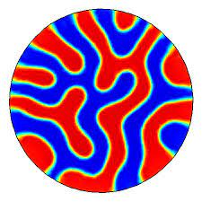
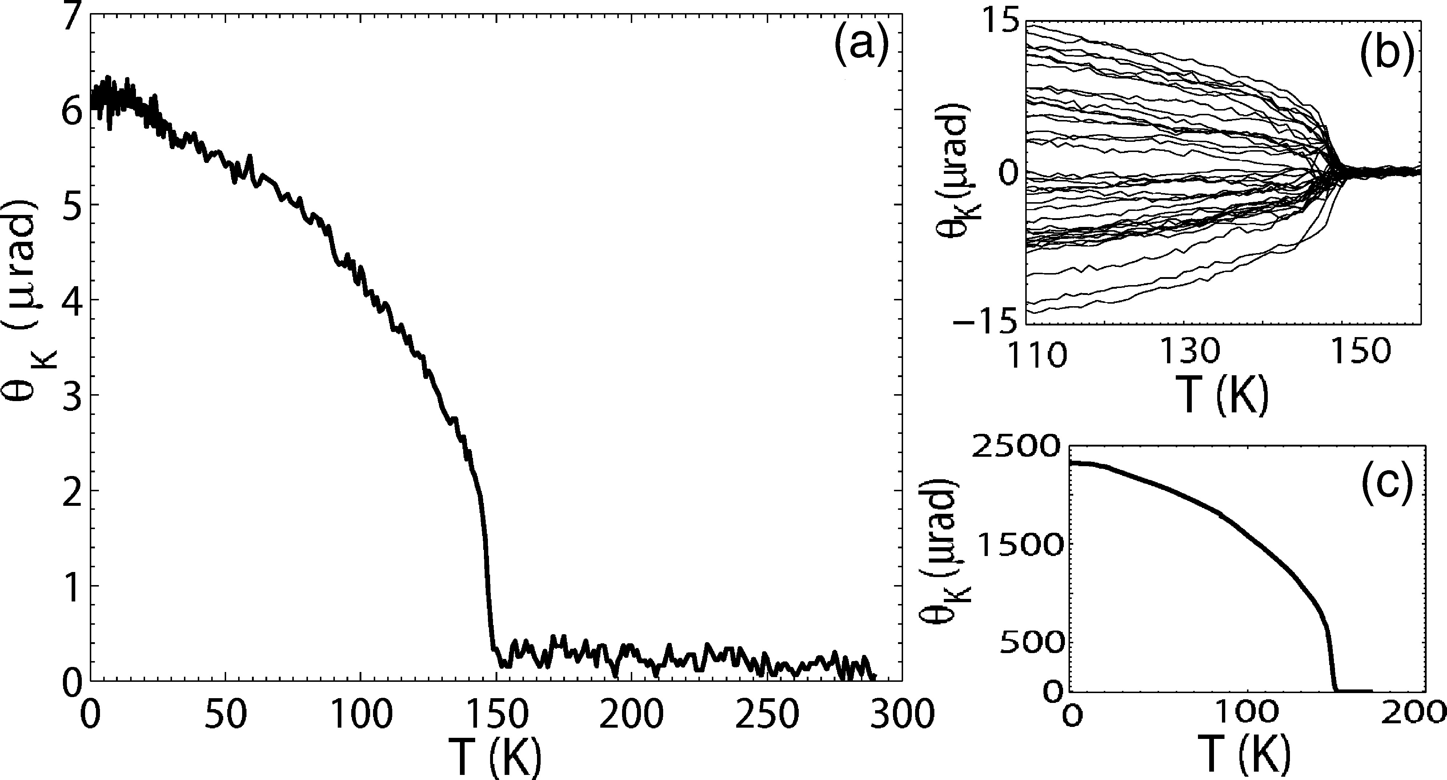
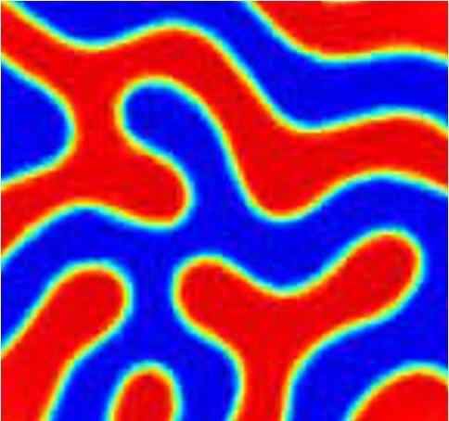


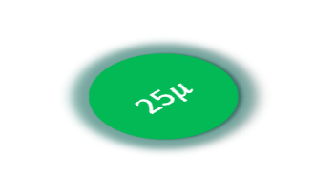
MOKE in SrRuO₃
Xia et al., APL 89, 062508 (2006)
SrRuO₃
25$μ$
No field
training
Field
trained
Notes:
Say that sign of MOKE changes with the sign of the training field.

Slide 10
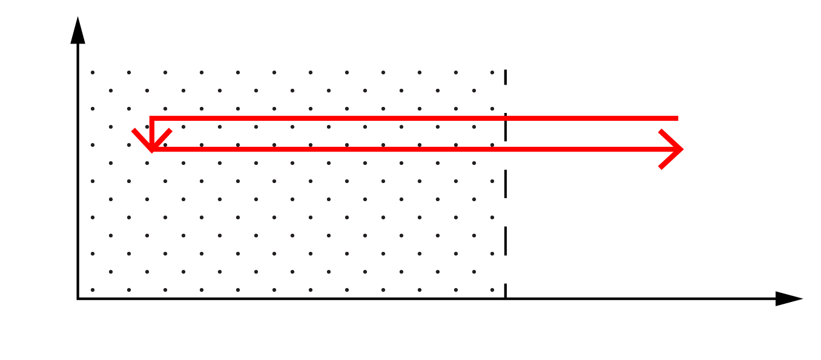
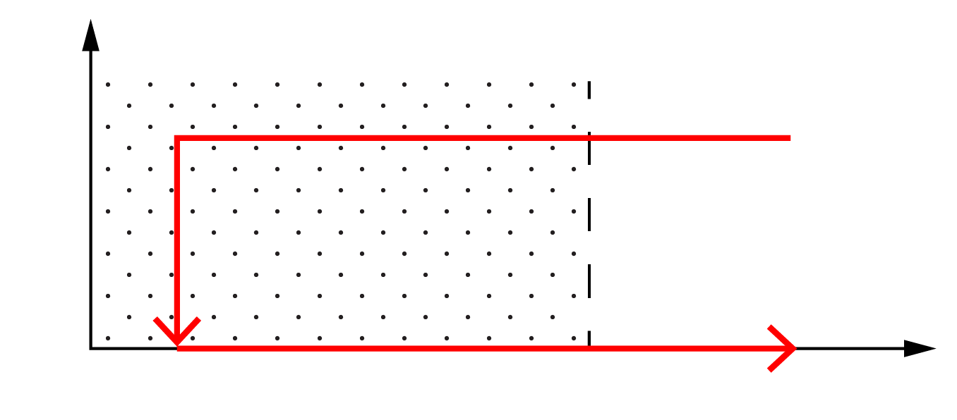
CsV₃Sb₅ @
1550 nm
Saykin et al., PRL 131, 016901 (2023)
Sample 1 (Stanford, Dresden)
Sample 2 (Irvine, UCSB)
B
Data acquisition
T
T_{base} = 4.2 K
T_{CDW} = 93.5 K
B
H_{train}
T
Data acquisition
In-field Kerr signal demonstrates diamagnetic-like response onsetting at T_{cdw}
Zero-field Kerr signal shows no TRSB (within resolution ~30 nrad)
Notes:
Remove Camron's data. Just add text to mention.

Slide 11
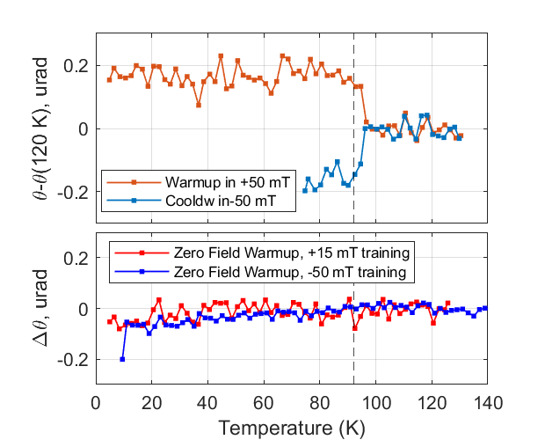
ScV₆Sn₆ @
CsV₃Sb₅ @
1550 nm
1550 nm
In-field Kerr signal demonstrates diamagnetic-like response onsetting at T_{cdw}
Zero-field Kerr signal shows no TRSB (within resolution ~50 nrad)
Notes:
Remove Camron's data. Just add text to mention.

Slide 12
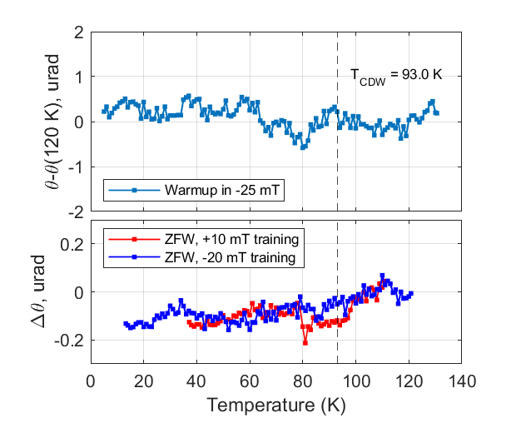
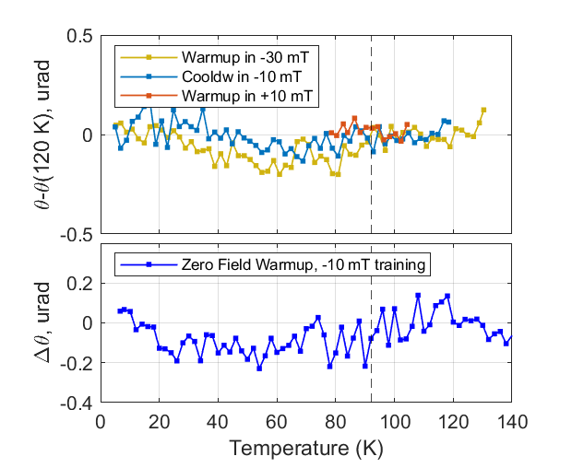
ScV₆Sn₆ @
CsV₃Sb₅ @
830 nm
830 nm

Slide 13
Summary
Saykin et al., PRL 131, 016901 (2023)
Studied CsV₃Sb₅ and ScV₆Sn₆ at 1550 and 830 nm
We observe shift in Kerr signal at T_{CDW} in finite magnetic field at 1550 nm, but not at 830 nm
We detect no spontaneous (uniform) Time-Reversal Symmetry Breaking
ScV₆Sn₆ @
1550 nm
CsV₃Sb₅ @
1550 nm
Notes:
Label plot "CVS @ 1550"
Less text

Slide 14
Part 1. Introduction
Part 2. Kerr effect measurements
Appendix
W16: D. Saykin

Slide 15
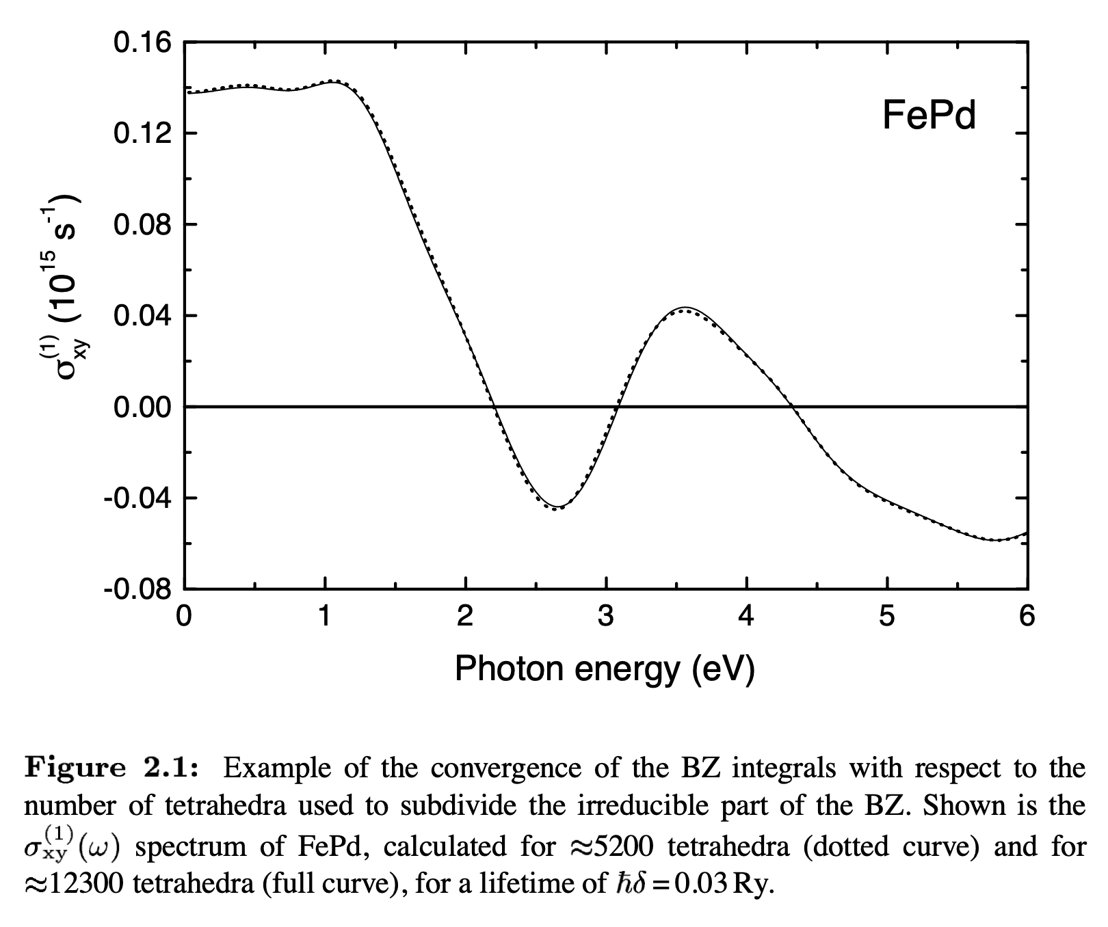
Oppeneer, Theory of the Magneto-Optical Kerr Effect in Ferromagnetic Compounds

Slide 16
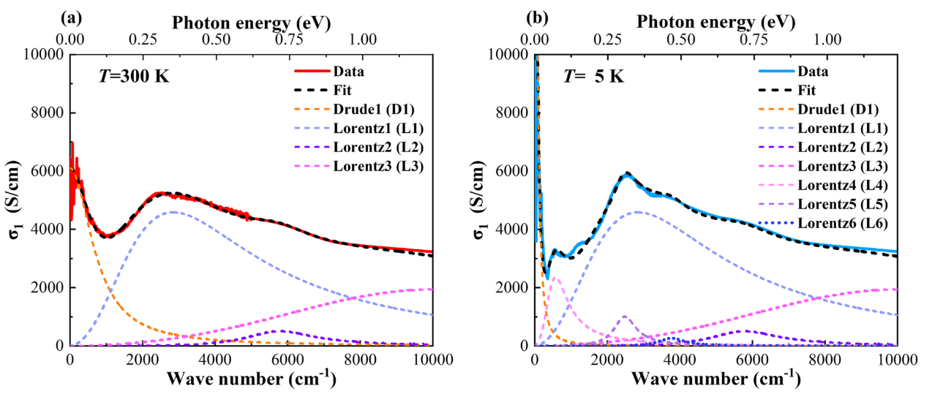
Optical properties of CsV₃Sb₅
Zhou et al. PRB 104, L041101 (2021)
Hu et al., PRB 107, 165119 (2023)
CsV₃Sb₅
ScV₆Sn₆
830 nm
5000
1550
1000
830
Wavelength (nm)
Notes:
Lorenz transition in the regime of our probing laser was shown to be associated with CDW.
Label vertical lines (instead of photon energy)

Slide 17
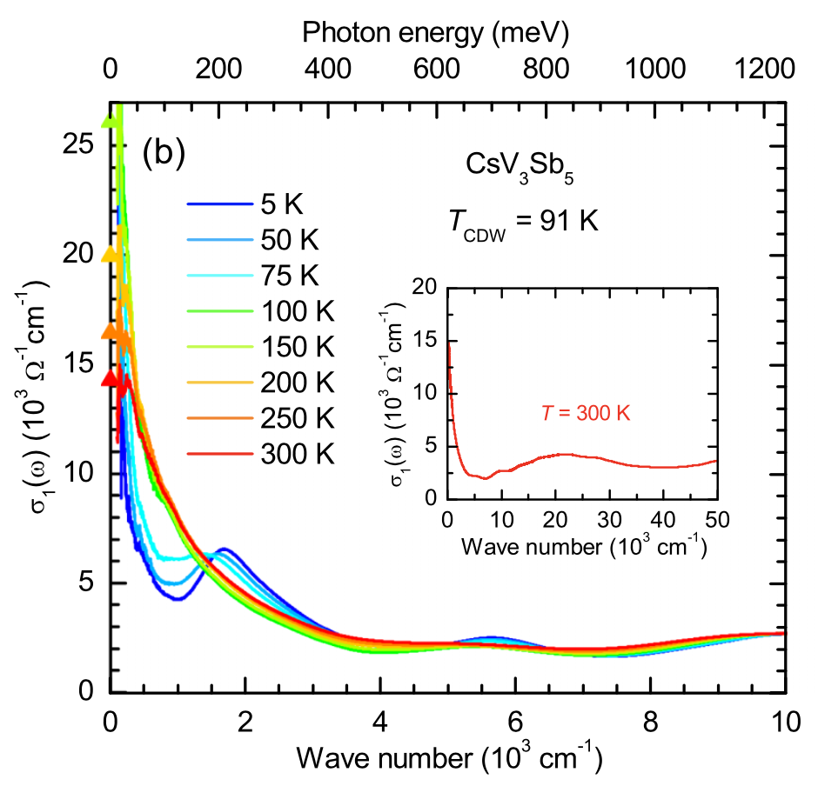
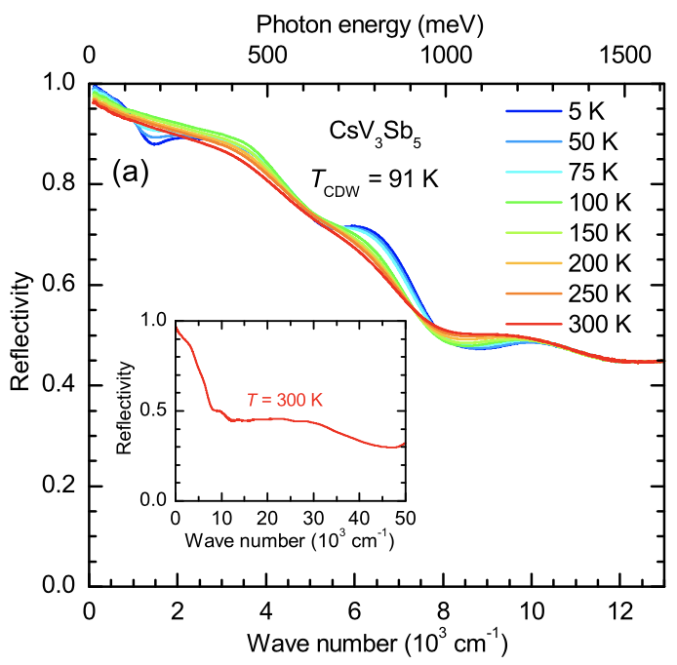
Optical properties of CsV₃Sb₅

Slide 18
Reflectivity and linear birefringence
Saykin et al., arXiv: 2209.10570
We are able to detect onset of linear birefringence simultaneously with Kerr effect measurements

Slide 19
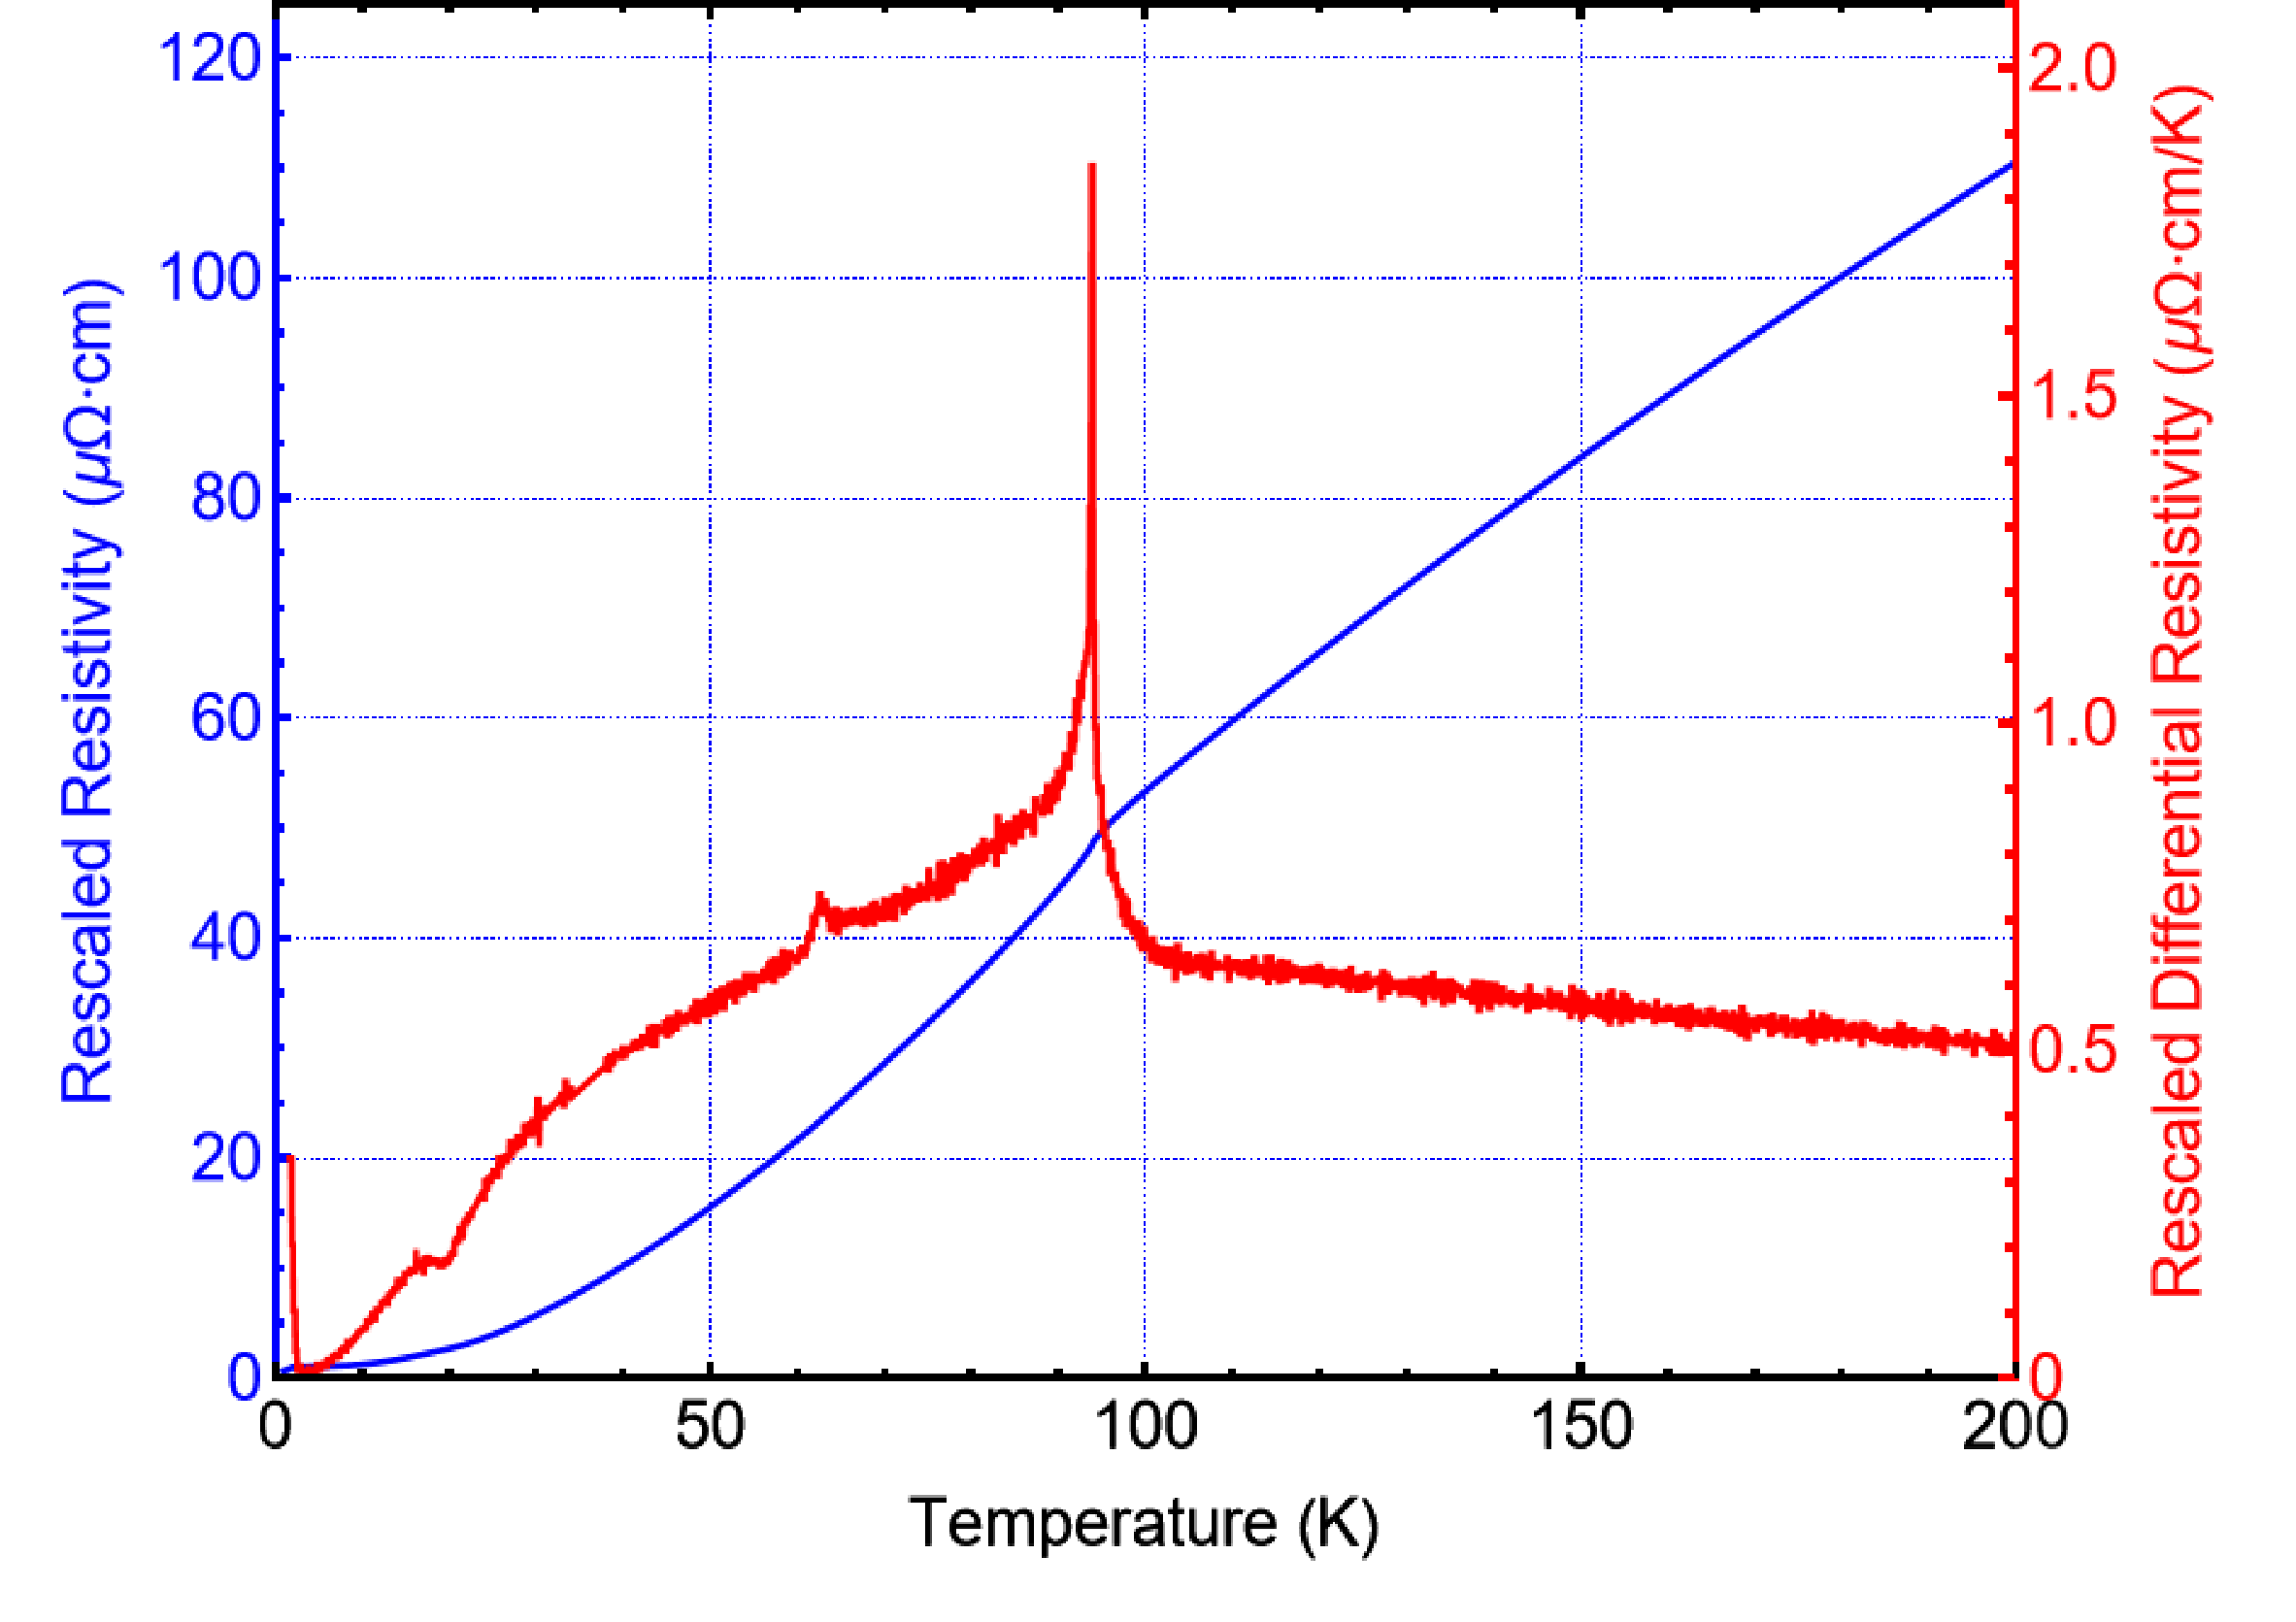
Resistance data
Saykin et al., arXiv: 2209.10570
Sample 1

Slide 20
Anomalous Hall Effect
Yu et al., PRB 104, L041103 (2021)

Slide 21
Superconductivity in CsV₃Sb₅
Ortiz et al., PRL 125, 247002 (2020)

Slide 22
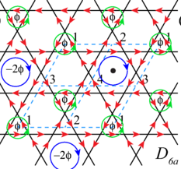
Chiral Flux phase
Theoretical predictions of Chiral flux state:
  Feng et al. PRB 104, 165136 (2021)
  Lin et al. PRB 104, 045122 (2021)
  Park et al. PRB 104, 035142 (2021)

Slide 23
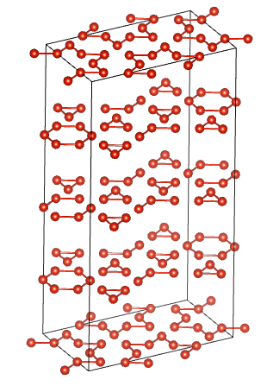
CDW structure in CsV₃Sb₅
Ortiz et al., PRX 11, 041030 (2021)
SoD
TrH
TrH
TrH
SoD

Slide 24
Kerr microscopy (Sample 2)
Saykin et al., arXiv: 2209.10570
Finite-q TRSB (antiferromagnetic order) would not be detected by Sagnac interferometer due to finite beam spot size ~20 um.
We see no spatial dependence of Kerr signal in 2D scan performed with 20 um resolution

Slide 25
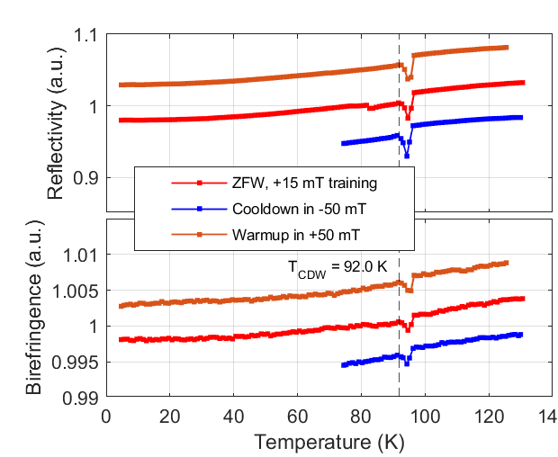
ScV₆Sn₆ @
1550 nm
Reflectivity and Birefringence
(each line is shifted)
Kerr effect

Slide 26
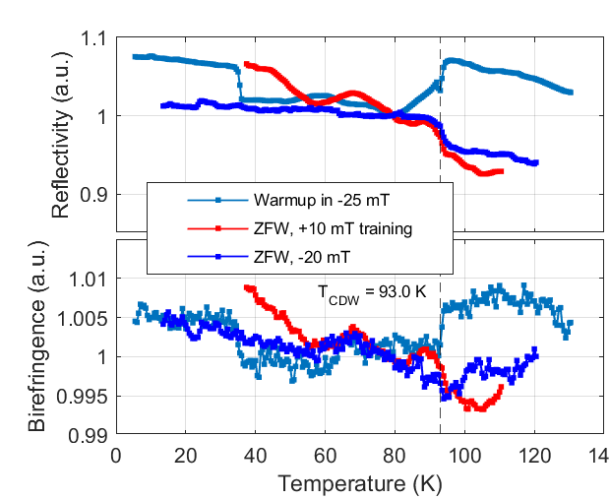
CsV₃Sb₅ @
830 nm
Kerr effect
Reflectivity and Birefringence

Slide 27
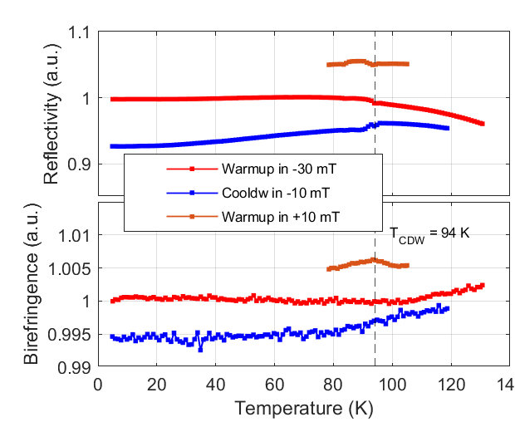
ScV₆Sn₆ @
830 nm
Reflectivity and Birefringence
(each line is shifted)
Kerr effect
Notes:
Make pictures for 1550 and 830 to make it easy to see which length is discussed

Slide 28







Acknowledgements
Work at Stanford University was supported by the U.S. Department of Energy,
Office of Science, Basic Energy Sciences, Division of Materials Sciences and Engineering,
under Contract DE-AC02-76SF00515.
Work at UC Irvine was supported by the Gordon and Betty Moore Foundation through Grant GBMF10276.
S.D.W. and B.R.O. acknowledge support via the UC Santa Barbara NSF Quantum Foundry funded via the Q-AMASE-i pro- gram under award DMR-1906325.
R.T. acknowledges support from the Deutsche Forschungsgemeinschaft (DFG, German Research Foundation) through QUAST FOR 5249-449872909 (Project P3), through Project-ID 258499086-SFB 1170, and from the Würzburg-Dresden Cluster of Excellence on Complexity and Topology in Quantum Matter –
ct.qmat Project-ID 390858490-EXC 2147.

Slide 29
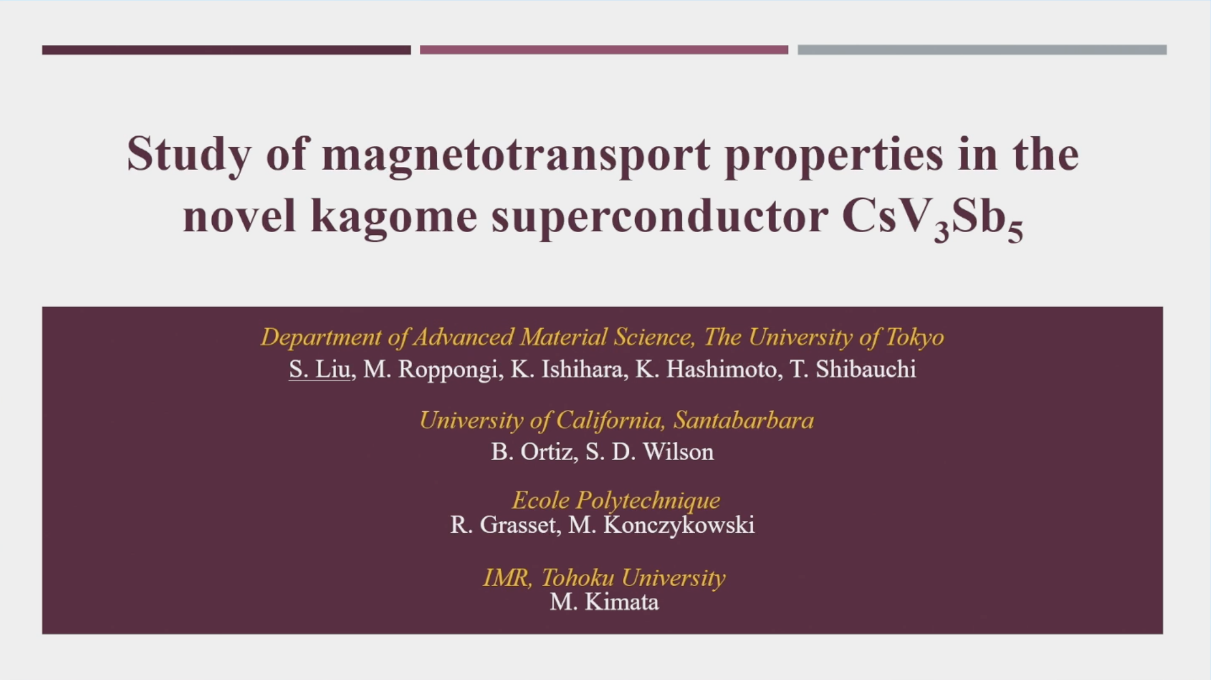

Slide 30
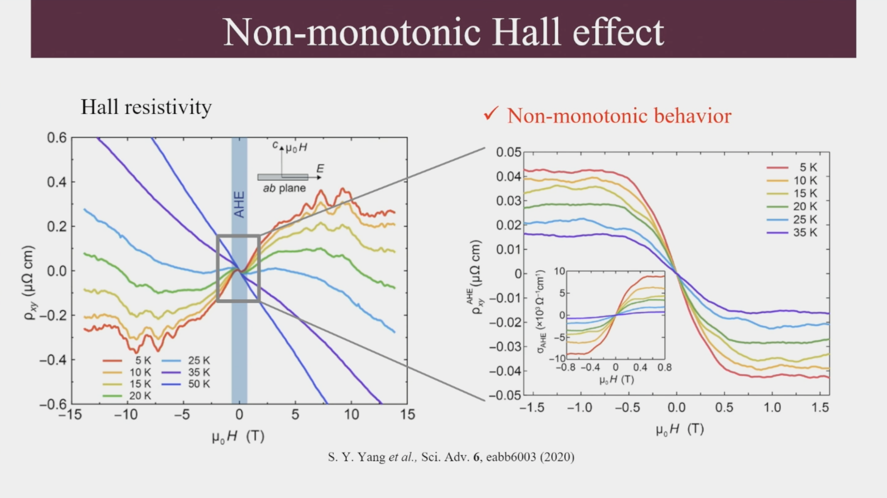

Slide 31
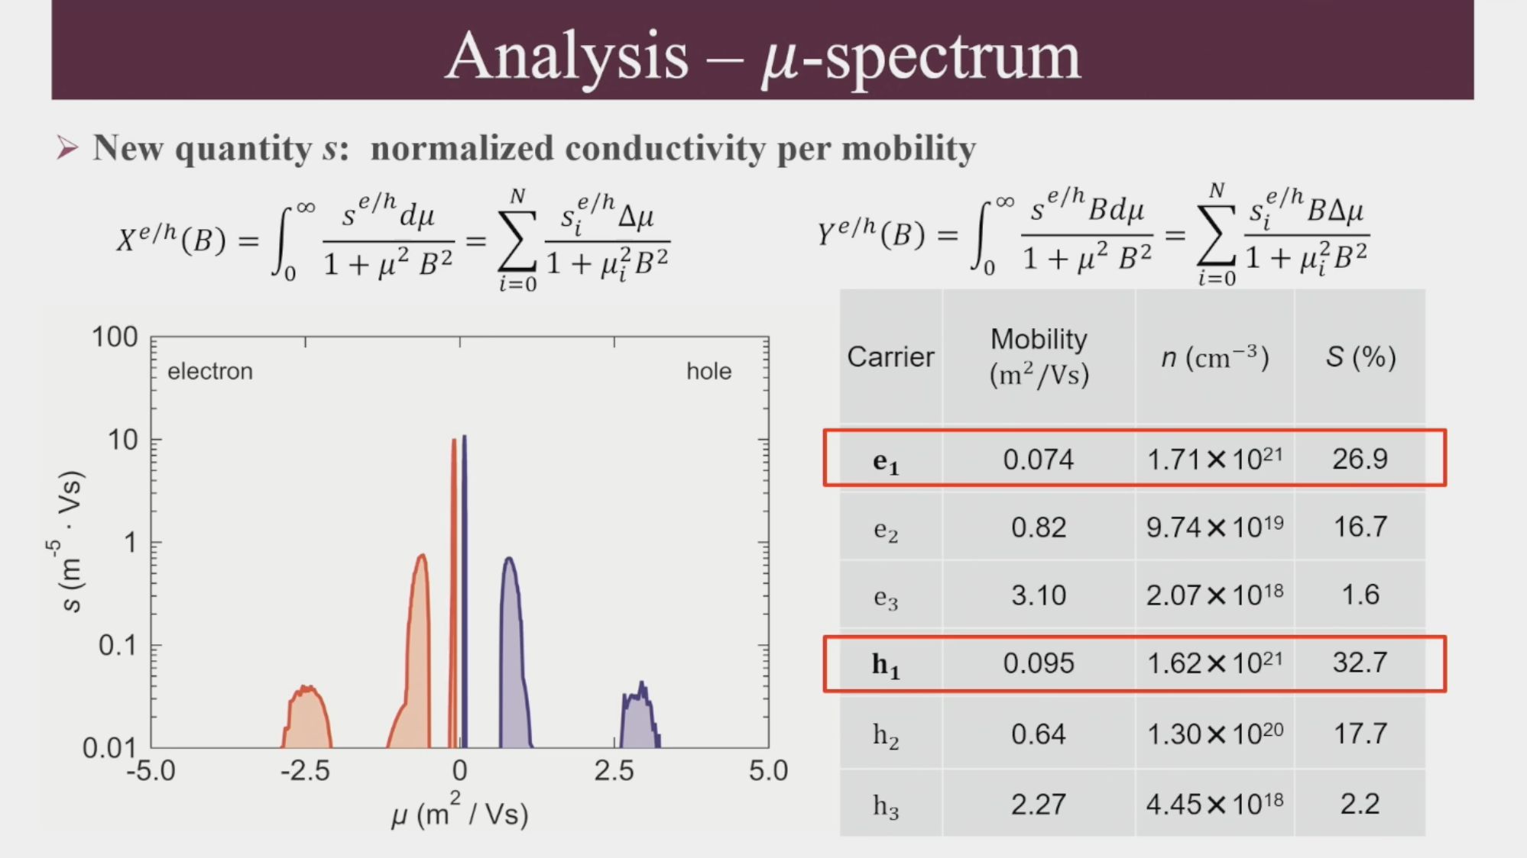

Slide 32
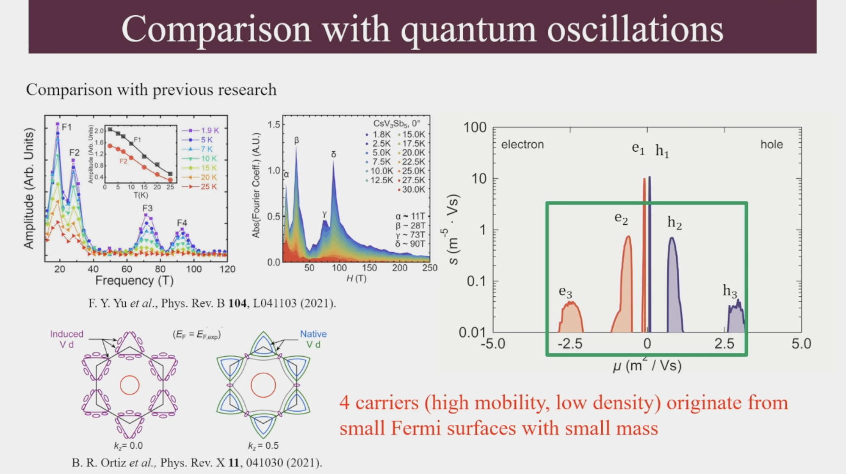

Slide 33
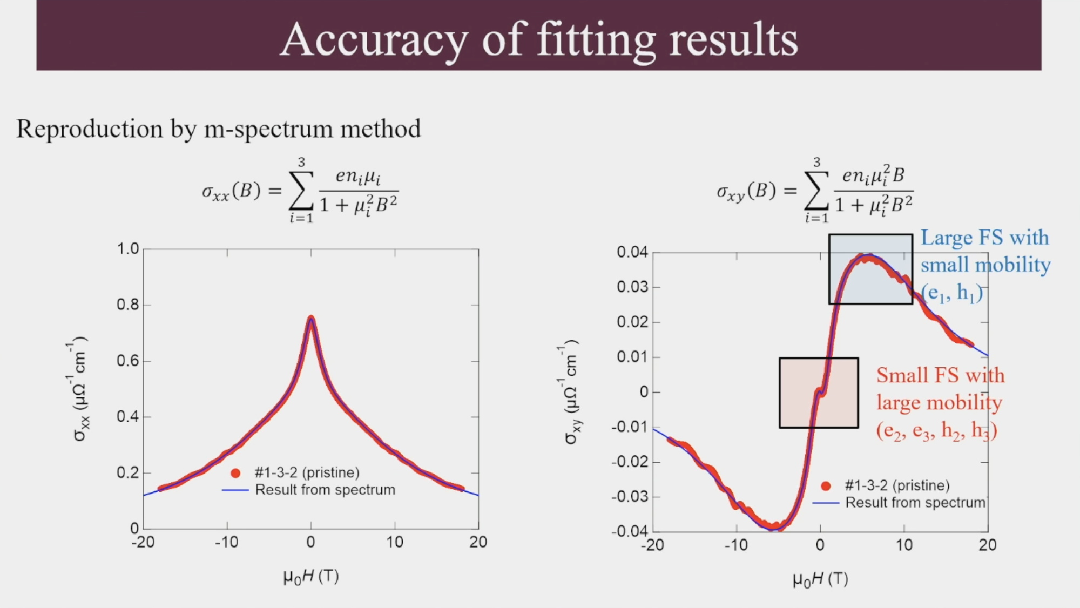

Slide 34
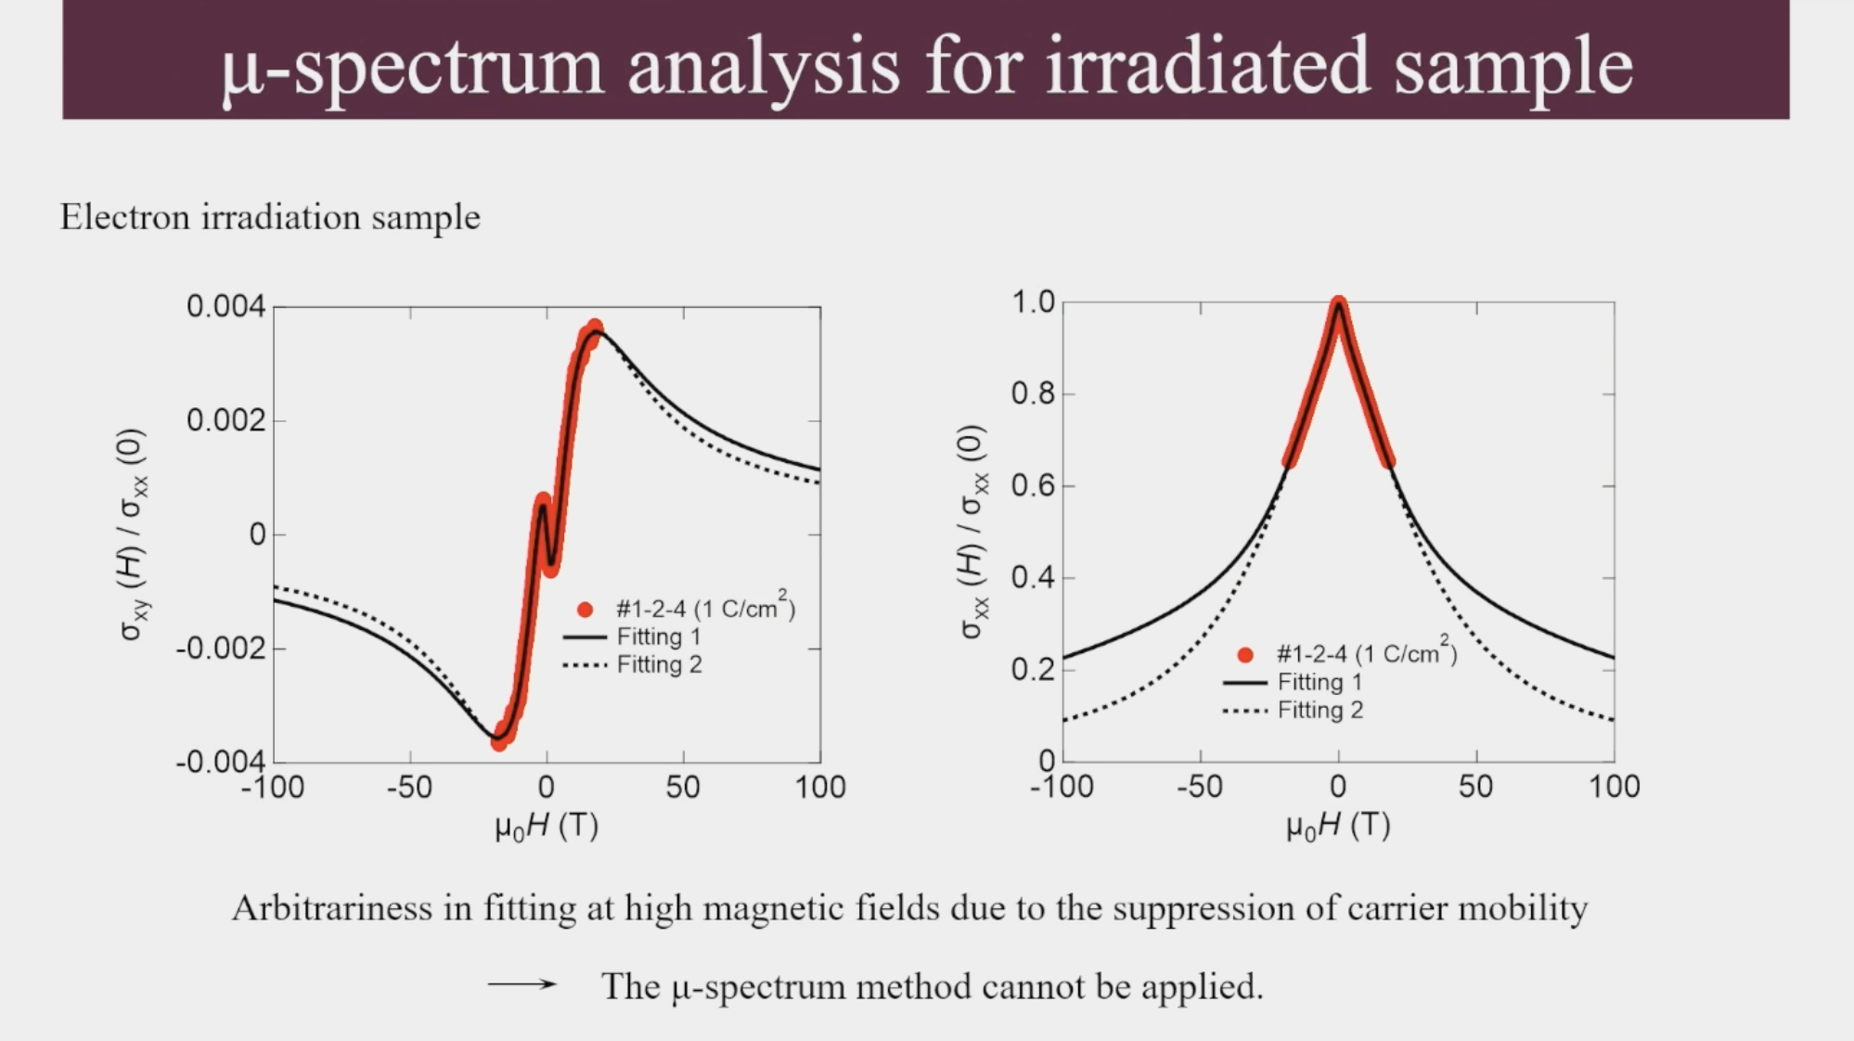

Slide 35
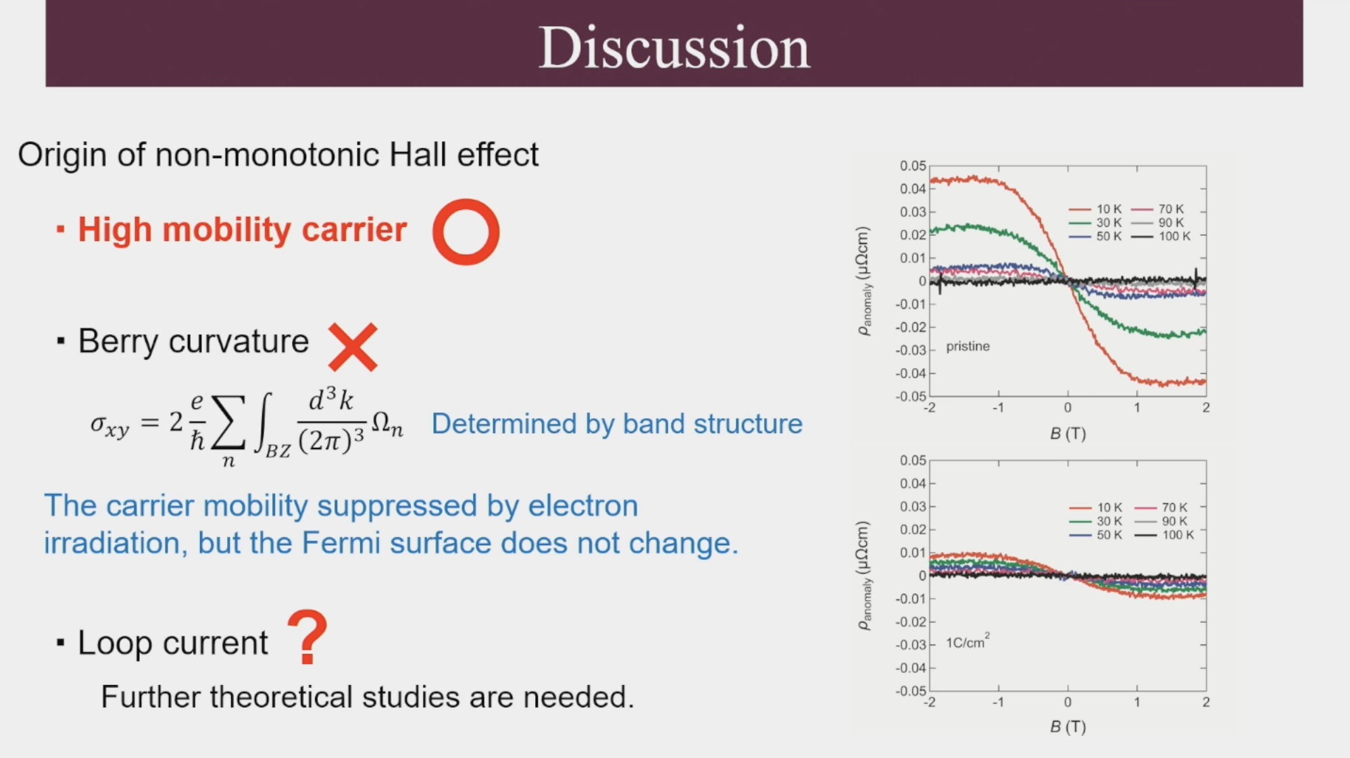

Slide 36
